Slide 1
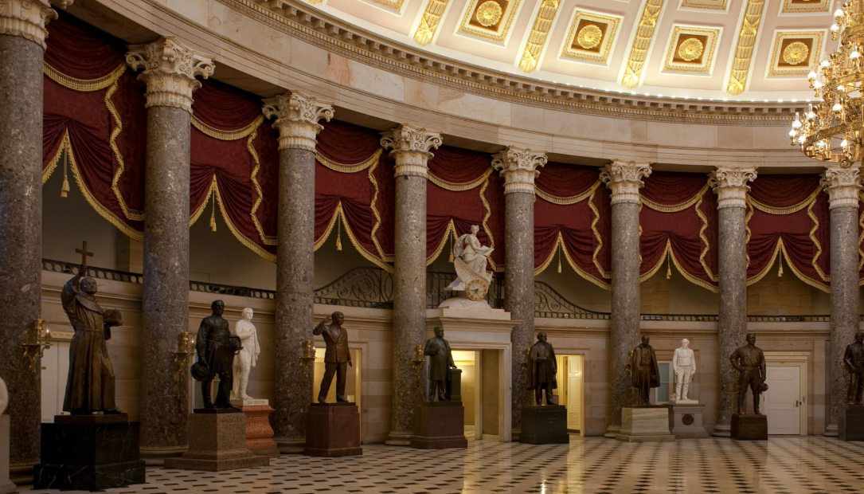

MEETING of the COMMISSION for HISTORICAL STATUES in the UNITED STATES CAPITOL
9:30 a.m. July 24, 2020
(this meeting will take place online)
Thank you for joining us, the meeting of the Commission will begin momentarily
We are concerned about your health, and we are committed to do all we can to reduce the risk and spread of novel coronavirus. Governor Ralph Northam declared a state of emergency in Virginia on Thursday, March 12 in response to COVID-19. In light of this action, the meeting of the Commission is being conducted using electronic communications in accord with Item 4-0.01.g. of Chapter 1283 (2020 Acts of Assembly), as the COVID-19 emergency makes it impracticable or unsafe to assemble
in a single location.
The purpose of the meeting is to discuss or transact the business statutorily required or necessary to continue operation of the Commission and the discharge of its lawful purposes, duties,
and responsibilities.
All Commission members and staff will be participating remotely.
In the event there is a disruption in the broadcast of the meeting,
please call (804) 482-6446.
Commission for Historical Statues
in the United States Capitol

Slide 2
MEETING of the COMMISSION for HISTORICAL STATUES in the UNITED STATES CAPITOL
9:30 a.m. July 24, 2020
(this meeting will take place online)
AGENDA
Call to Order by Julie Langan, Ex-Officio Member
Roll Call of Attendees
Approval of Meeting Agenda
Approval of July 1, 2020 Meeting Minutes
Election of Chair & Vice Chair
Overview of Commission Responsibilities
Overview of Statuary Hall and Robert E. Lee Statue
Remarks from Governor Ralph S. Northam
Overview of Statue Removal Process
Public Comment (90 minutes)
Overview of Written Public Comments
Board Discussion Regarding Removal of Robert E. Lee Statue
Next Steps
Adjourn
Commission for Historical Statues
in the United States Capitol

Slide 3
MEETING of the COMMISSION for HISTORICAL STATUES in the UNITED STATES CAPITOL
9:30 a.m. July 24, 2020
(this meeting will take place online)
AGENDA
Call to Order by Julie Langan, Ex-Officio Member
Roll Call of Attendees
Approval of Meeting Agenda
Approval of July 1, 2020 Meeting Minutes
Election of Chair & Vice Chair
Overview of Commission Responsibilities
Overview of Statuary Hall and Robert E. Lee Statue
Remarks from Governor Ralph S. Northam
Overview of Statue Removal Process
Public Comment (90 minutes)
Overview of Written Public Comments
Board Discussion Regarding Removal of Robert E. Lee Statue
Next Steps
Adjourn
Commission for Historical Statues
in the United States Capitol

Slide 4
MEETING of the COMMISSION for HISTORICAL STATUES in the UNITED STATES CAPITOL
9:30 a.m. July 24, 2020
(this meeting will take place online)
AGENDA
Call to Order by Julie Langan, Ex-Officio Member
Roll Call of Attendees
Approval of Meeting Agenda
Approval of July 1, 2020 Meeting Minutes
Election of Chair & Vice Chair
Overview of Commission Responsibilities
Overview of Statuary Hall and Robert E. Lee Statue
Remarks from Governor Ralph S. Northam
Overview of Statue Removal Process
Public Comment (90 minutes)
Overview of Written Public Comments
Board Discussion Regarding Removal of Robert E. Lee Statue
Next Steps
Adjourn
Commission for Historical Statues
in the United States Capitol

Slide 5
MEETING of the COMMISSION for HISTORICAL STATUES in the UNITED STATES CAPITOL
9:30 a.m. July 24, 2020
(this meeting will take place online)
AGENDA
Call to Order by Julie Langan, Ex-Officio Member
Roll Call of Attendees
Approval of Meeting Agenda
Approval of July 1, 2020 Meeting Minutes
Election of Chair & Vice Chair
Overview of Commission Responsibilities
Overview of Statuary Hall and Robert E. Lee Statue
Remarks from Governor Ralph S. Northam
Overview of Statue Removal Process
Public Comment (90 minutes)
Overview of Written Public Comments
Board Discussion Regarding Removal of Robert E. Lee Statue
Next Steps
Adjourn
Commission for Historical Statues
in the United States Capitol

Slide 6
MEETING of the COMMISSION for HISTORICAL STATUES in the UNITED STATES CAPITOL
9:30 a.m. July 24, 2020
(this meeting will take place online)
AGENDA
Call to Order by Julie Langan, Ex-Officio Member
Roll Call of Attendees
Approval of Meeting Agenda
Approval of July 1, 2020 Meeting Minutes
Election of Chair & Vice Chair
Overview of Commission Responsibilities
Overview of Statuary Hall and Robert E. Lee Statue
Remarks from Governor Ralph S. Northam
Overview of Statue Removal Process
Public Comment (90 minutes)
Overview of Written Public Comments
Board Discussion Regarding Removal of Robert E. Lee Statue
Next Steps
Adjourn
Commission for Historical Statues
in the United States Capitol

Slide 7
MEETING of the COMMISSION for HISTORICAL STATUES in the UNITED STATES CAPITOL
9:30 a.m. July 24, 2020
(this meeting will take place online)
AGENDA
Call to Order by Julie Langan, Ex-Officio Member
Roll Call of Attendees
Approval of Meeting Agenda
Approval of July 1, 2020 Meeting Minutes
Election of Chair & Vice Chair
Overview of Commission Responsibilities
Overview of Statuary Hall and Robert E. Lee Statue
Remarks from Governor Ralph S. Northam
Overview of Statue Removal Process
Public Comment (90 minutes)
Overview of Written Public Comments
Board Discussion Regarding Removal of Robert E. Lee Statue
Next Steps
Adjourn
Commission for Historical Statues
in the United States Capitol

Slide 8
Overview of Commission Responsibilities
Julie Langan
Overview of Commission Responsibilities
Julie Langan
Unless otherwise noted, all images are public domain or courtesy of the Architect of the Capitol
Unless otherwise noted, all images are public domain or courtesy of the AOC
Commission for Historical Statues
in the United States Capitol
Commission for Historical Statues
in the United States Capitol

Slide 9
HB 1406 Historical Statues in the United States Capitol,
Commission for; removal of Robert E. Lee statue
Appoint 3 citizen members – completed July 1
Determine whether the Robert E. Lee statue in the National Statuary Hall Collection at the United States Capitol should be replaced
Hold at least one public hearing prior to making a recommendation to the
General Assembly regarding which Virginian of historic renown should replace the Lee statue
Select a sculptor for the new statue, with preference given to a sculptor from Virginia
Estimate the costs associated with the new statue, including costs related to construction and placement of the new statue, for the removal and transfer of the Lee statue, and for any unveiling ceremony of the new statue
Recommend to the General Assembly a suitable state, local, or private nonprofit history museum in the Commonwealth for placement of the Lee statue.
Commission for Historical Statues
in the United States Capitol

Slide 10
MEETING of the COMMISSION for HISTORICAL STATUES in the UNITED STATES CAPITOL
9:30 a.m. July 24, 2020
(this meeting will take place online)
AGENDA
Call to Order by Julie Langan, Ex-Officio Member
Roll Call of Attendees
Approval of Meeting Agenda
Approval of July 1, 2020 Meeting Minutes
Election of Chair & Vice Chair
Overview of Commission Responsibilities
Overview of Statuary Hall and Robert E. Lee Statue
Remarks from Governor Ralph S. Northam
Overview of Statue Removal Process
Public Comment (90 minutes)
Overview of Written Public Comments
Board Discussion Regarding Removal of Robert E. Lee Statue
Next Steps
Adjourn
Commission for Historical Statues
in the United States Capitol

Slide 11
National Statuary Hall and the
Robert E. Lee Statue
Jim Hare, DHR
Commission for Historical Statues
in the United States Capitol
Commission for Historical Statues
in the United States Capitol

Slide 12
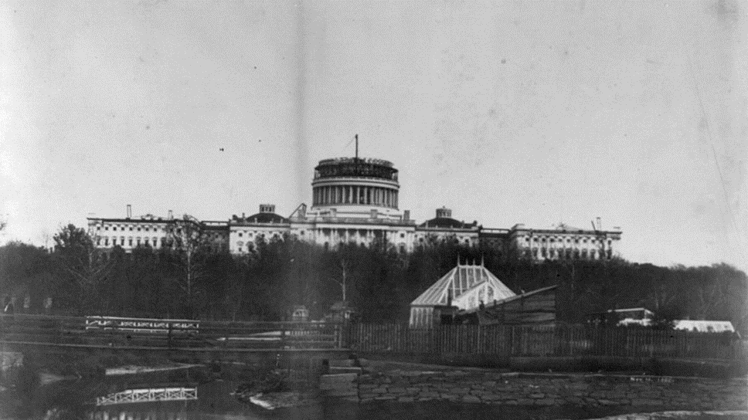
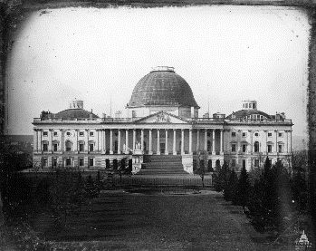
The U.S. Capitol prior to the extension c. 1850 (right), and
during construction of the new Senate and House wings, and the cast iron Dome c. 1860
Commission for Historical Statues
in the United States Capitol

Slide 13
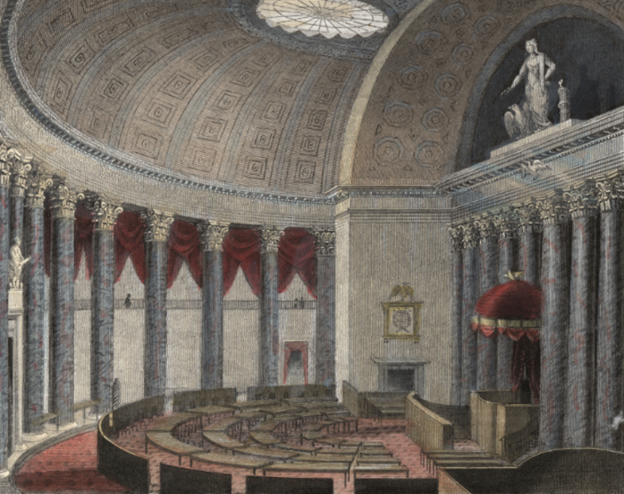
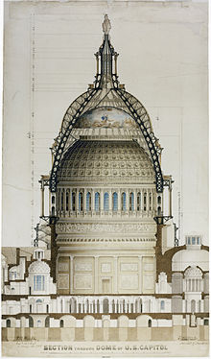
Old House of Representatives Chamber
New Capitol Rotunda

Slide 14
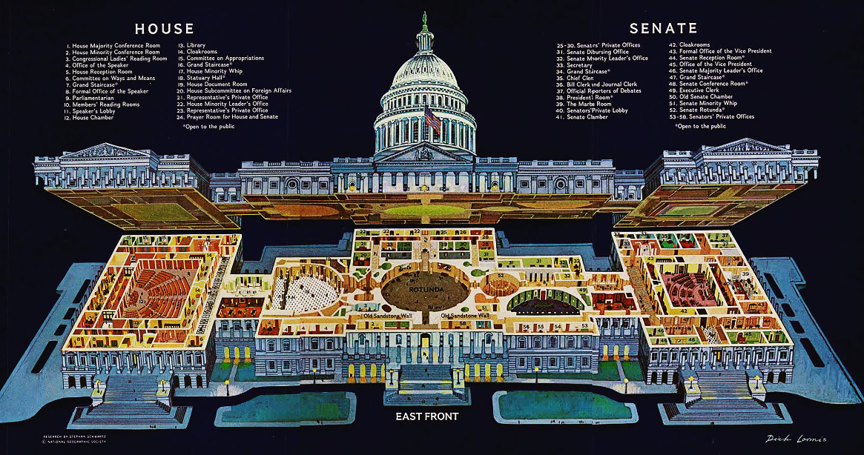
ROTUNDA and CRYPT
Commission for Historical Statues
in the United States Capitol

Slide 15
HALL OF COLUMNS
Commission for Historical Statues
in the United States Capitol

Slide 16
NATIONAL STATUARY HALL
Commission for Historical Statues
in the United States Capitol

Slide 17
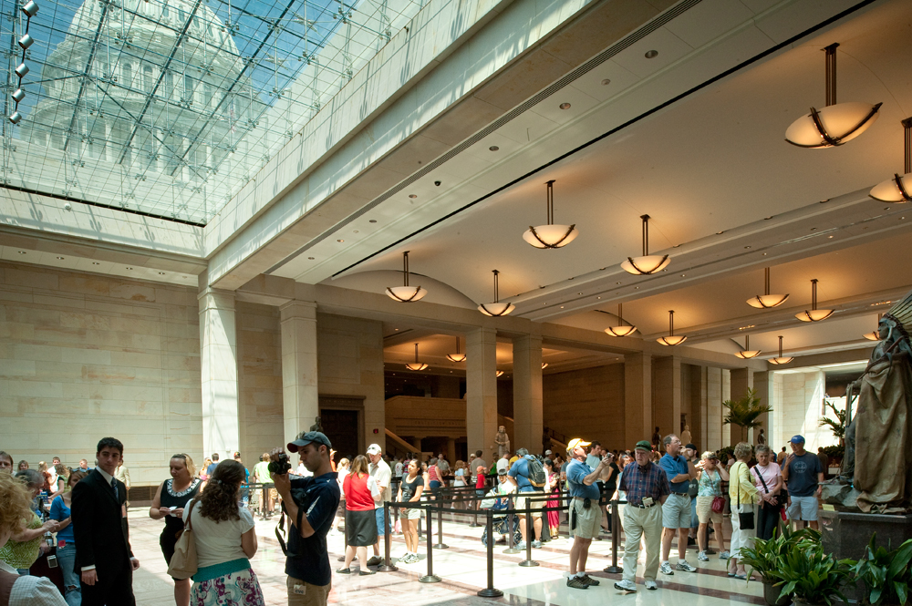
CAPITOL VISITORS CENTER (Emancipation Hall)
Commission for Historical Statues
in the United States Capitol

Slide 18
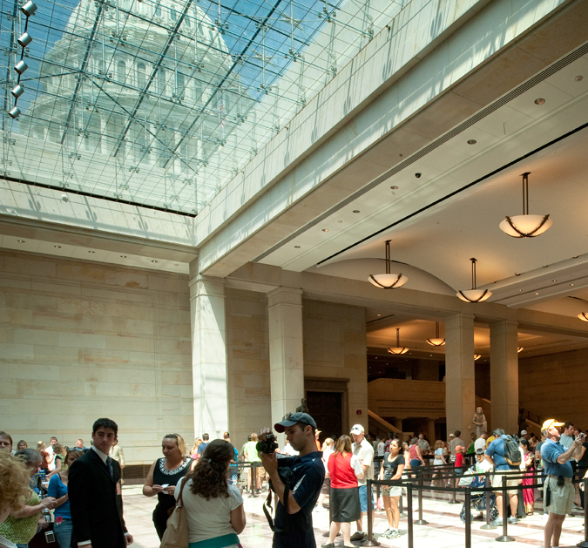
CAPITOL VISITORS CENTER
24 Statues
24 States
AK, Ernest Gruenigh
AL, Helen Keller
AR, James Paul Clarke
AZ, Eusebio Kino
CO, John L. Swigert
DE, John Middleton Clayton
FL, Edmund Kirby Smith
HI, Kamehameha I
ID, William Edgar Borah
KY, Ephraim McDowell
LA, Edward D. White
MN. Maria L. Sanford
MS, James Z. George
MT, Jeannette Rankin
ND, Sakakawea
NE, Julius Sterling Morgan
NM, Po-pay
NV, Sarah Winnemucca
OR, John McLoughlin
SC, Wade Hampton
SD, Joseph Ward
UT, Philo T. Farnsworth
WA, Mother Joseph
WY, Chief Washakie
Commission for Historical Statues
in the United States Capitol

Slide 19
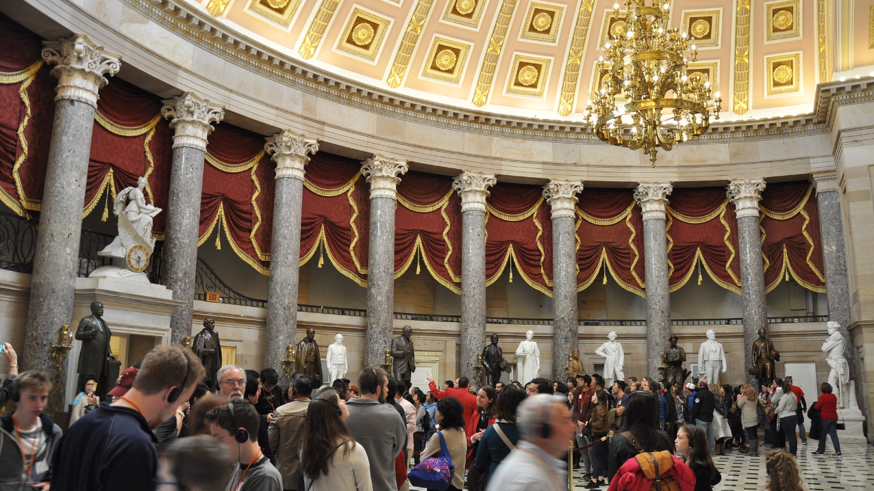
NATIONAL STATUARY HALL
Commission for Historical Statues
in the United States Capitol

Slide 20
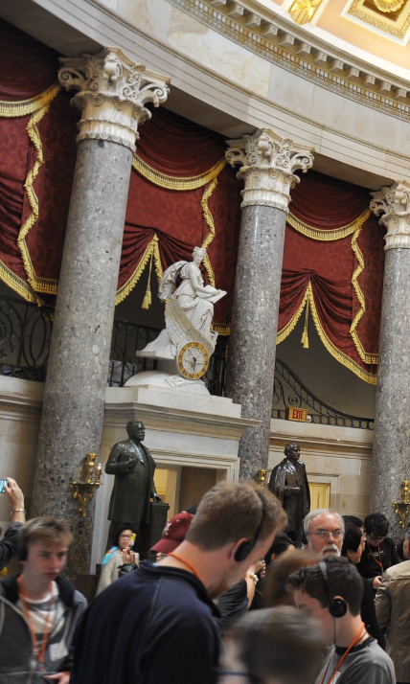
NATIONAL STATUARY HALL
35 Statues
34 States
AL, Joseph Wheeler
AR, Uriah Milton Rose
AZ, Barry Goldwater
CA, F. Junipero Serra
FL, John Gorrie
GA, Alexander Stephens
IA, Dr. Norman Borlaug
ID, George Laird Shoup
IL, Frances E. Willard
IN, Lewis Wallace
KS, John James Ingalls
KY, Henry Clay
LA, Huey Long
ME, Hannibal Hamlin
MI, Lewis Cass
MN, Henry M. Rice
MO, Thomas Hart Benton
MO, Charles Russell
MS, Jefferson Davis
NC, Zebulon Vance
ND, John Burke
NE, Chief Standing Bear
NH, Daniel Webster
OH, Thomas Edison
OK, Sequoyah
OR, Jason Lee
PA, Robert Fulton
SD, William Beadle
TN, John Sevier
TX, Sam Houston
UT, Brigham Young
VT, Ethan Allen
WA, Marcus Whitman
WI, Robert La Follette
WV, Francis H. Pierpont
Commission for Historical Statues
in the United States Capitol

Slide 21
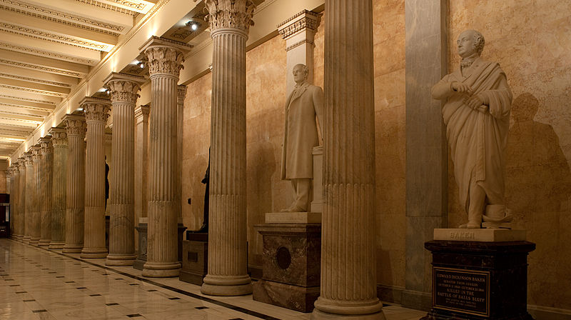
HALL OF COLUMNS
Commission for Historical Statues
in the United States Capitol

Slide 22
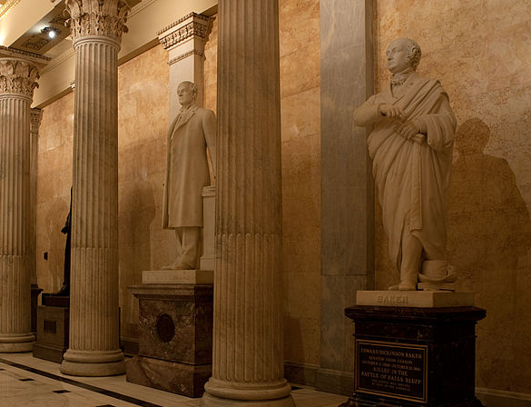
HALL OF COLUMNS
15 Statues
15 States
CO, Florence Sabin
HI, Fr. Damien
IA, Samuel Kirkwood
IL, James Shields
IN, Oliver H. P. Morton
MA, John Winthrop
MD, John Hanson
MO, Francis Blair
NJ, Philip Kearny
NV, Patrick A. McCarran
RI, Roger Williams
TX, Stephen Austin
VT, Jacob Collamer
WV, John E. Kenna
WY, Esther H. Morris
Commission for Historical Statues
in the United States Capitol

Slide 23
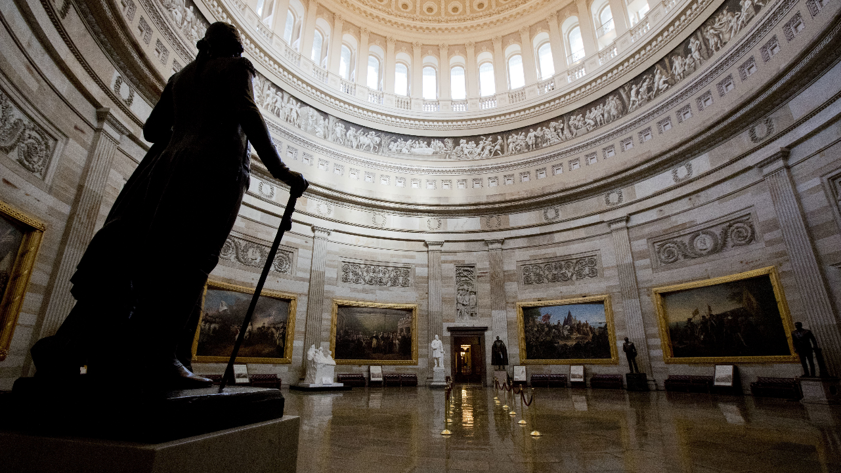
ROTUNDA
Image WJCT Media
Commission for Historical Statues
in the United States Capitol

Slide 24
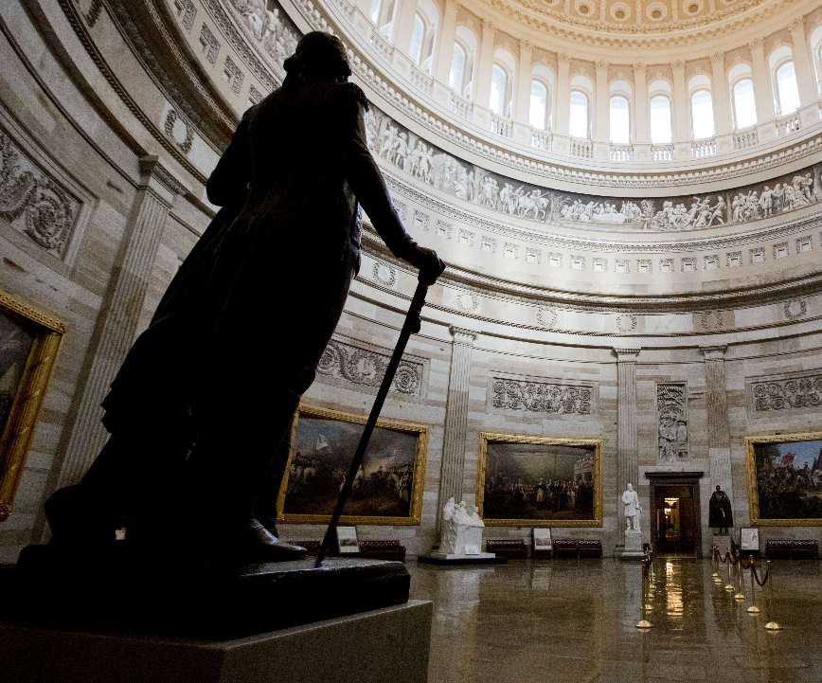
ROTUNDA
6 Statues
6 States
CA, Ronald Reagan
KS, Dwight D. Eisenhower
MI, Gerald Ford
OH, James A. Garfield
TN, Andrew Jackson
VA, George Washington
Image by Matt H. Wade
Commission for Historical Statues
in the United States Capitol

Slide 25
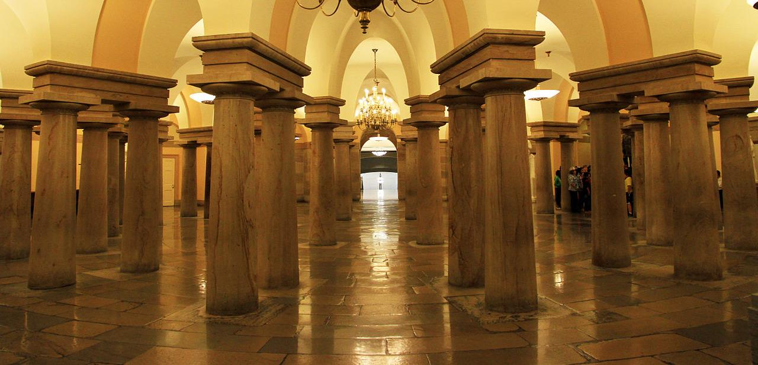
CRYPT
Commission for Historical Statues
in the United States Capitol

Slide 26
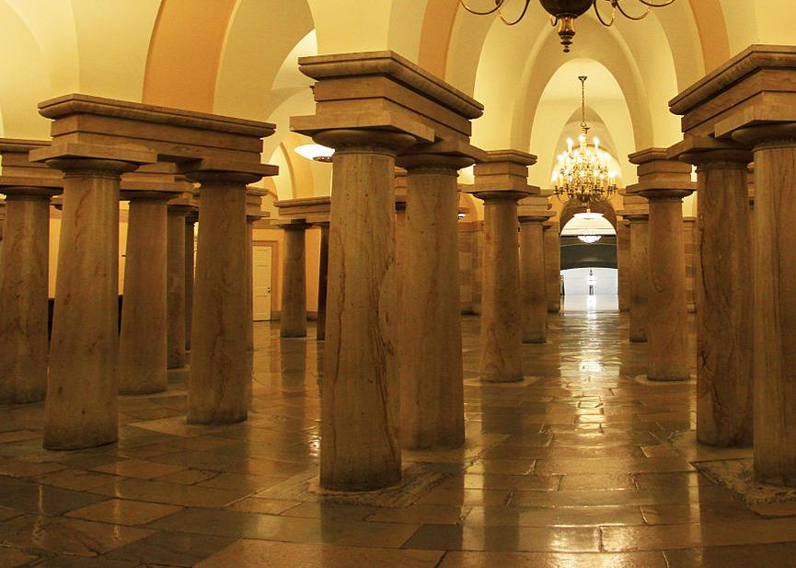
CRYPT
13 Statues
13 Statues
CT, Roger Sherman
DE, Caesar Rodney
GA, Crawford W. Long
MA, Samuel Adams
MD, Charles Carroll
NC, Charles B. Aycock
NH, John Stark
NJ, Richard Stockton
NY, Robert R. Livingston
PA, John Peter Gabriel Muhlenberg
RI, Nathanael Greene
SC, John C. Calhoun
VA, Robert E. Lee
Commission for Historical Statues
in the United States Capitol

Slide 27
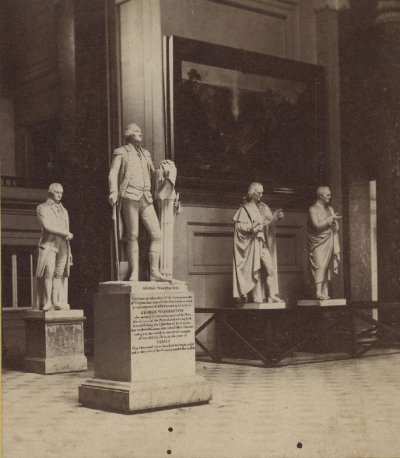

George Washington
Plaster copy after Houdon
Purchased by Congress and installed circa 1868 in National Statuary Hall
Commission for Historical Statues
in the United States Capitol

Slide 28
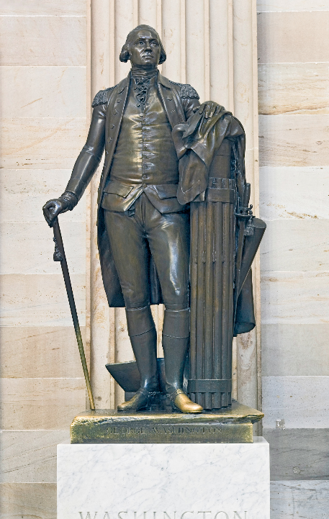
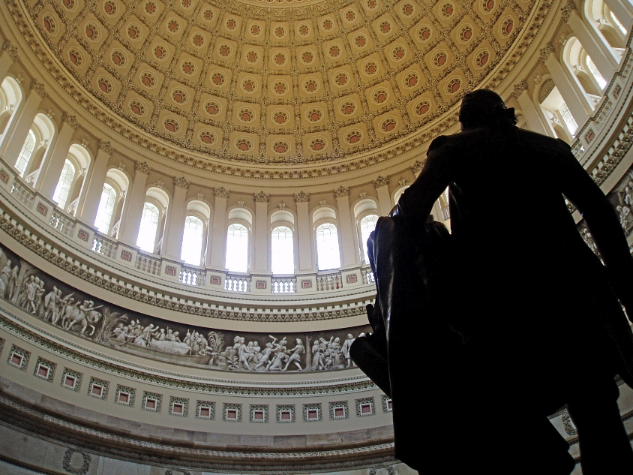
George Washington
Bronze copy after Houdon, completed by 1908. Commissioned by VA General Assembly. Cost, $7000.
Image above: Matt H. Wade
Commission for Historical Statues
in the United States Capitol

Slide 29
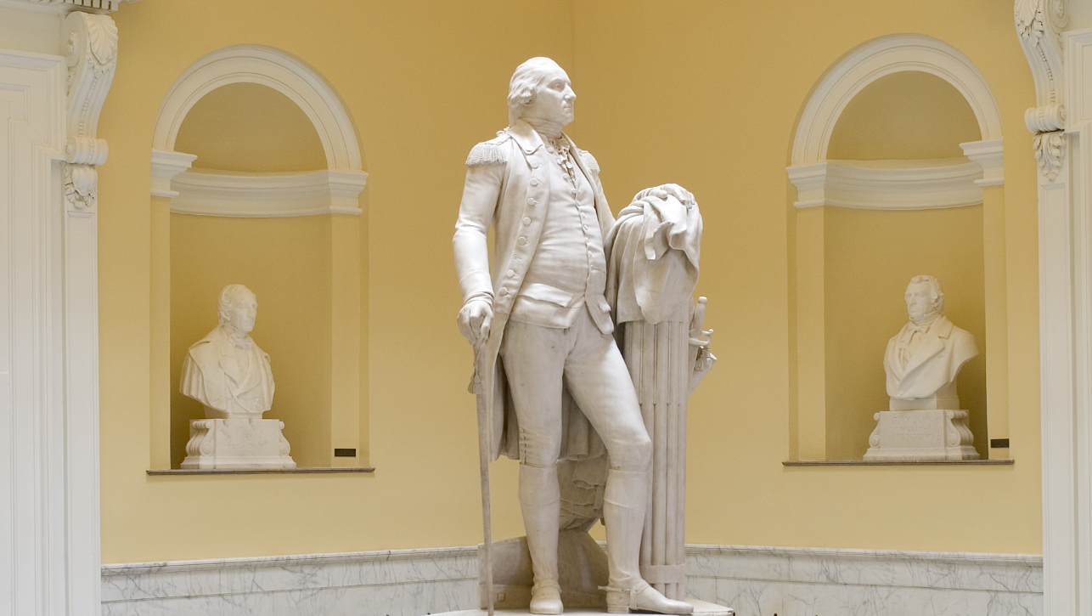
George Washington
Jean-Antoine Houdon
Virginia State Capitol
Commissioned by the Virginia General Assembly in 1784
Image VA General Assembly

Slide 30
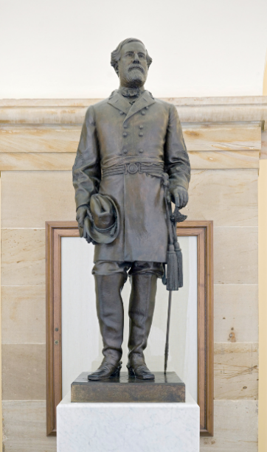
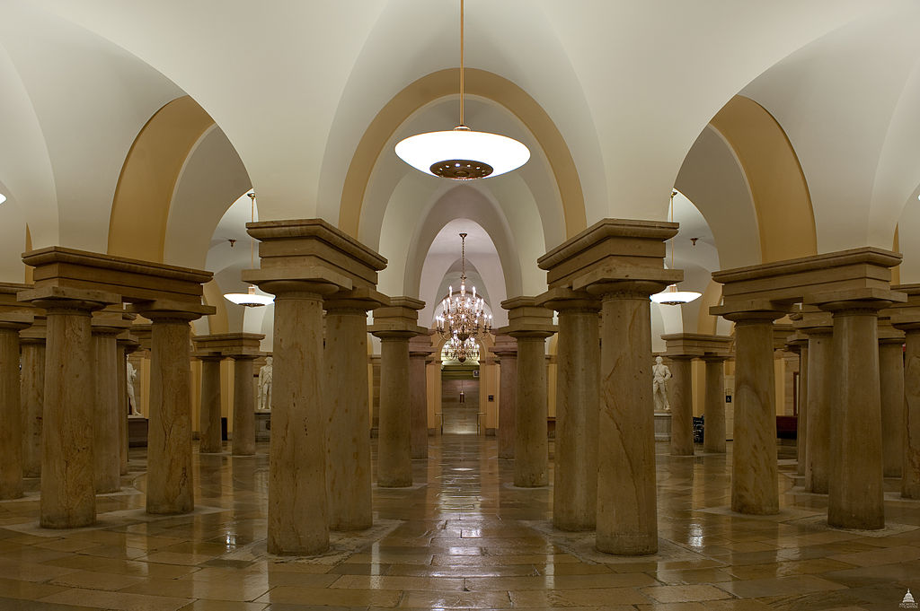
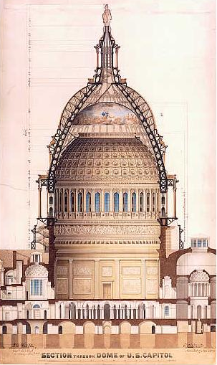
Robert E. Lee
Edward V. Valentine, 1908
Commissioned by the VA
General Assembly for $10,000.
Commission for Historical Statues
in the United States Capitol

Slide 31
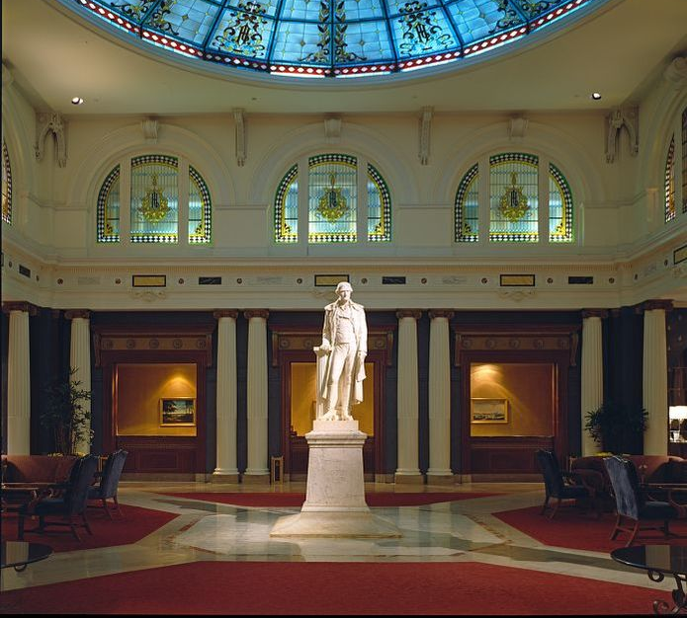
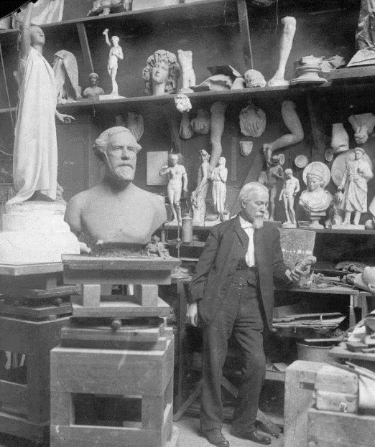
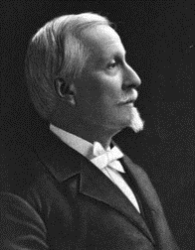
Edward V. Valentine
1838-1930
Photo above: Cook Collection, Valentine Richmond History Center
Commission for Historical Statues
in the United States Capitol

Slide 32
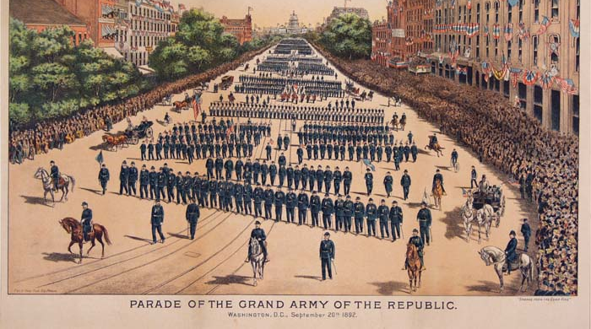
Image above: Library of Congress
Commission for Historical Statues
in the United States Capitol

Slide 33
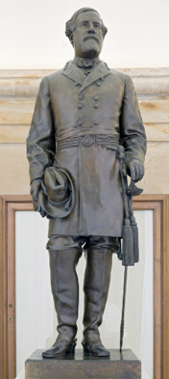
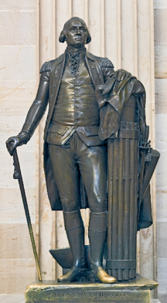
Commission for Historical Statues
in the United States Capitol

Slide 34
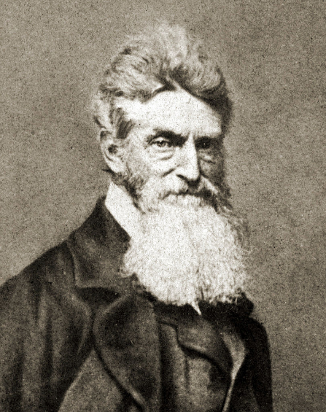
Commission for Historical Statues
in the United States Capitol

Slide 35
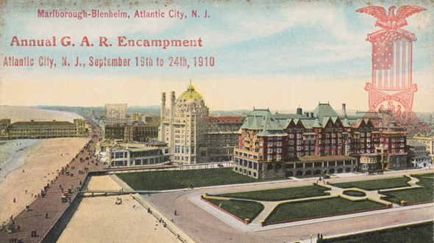
Commission for Historical Statues
in the United States Capitol

Slide 36
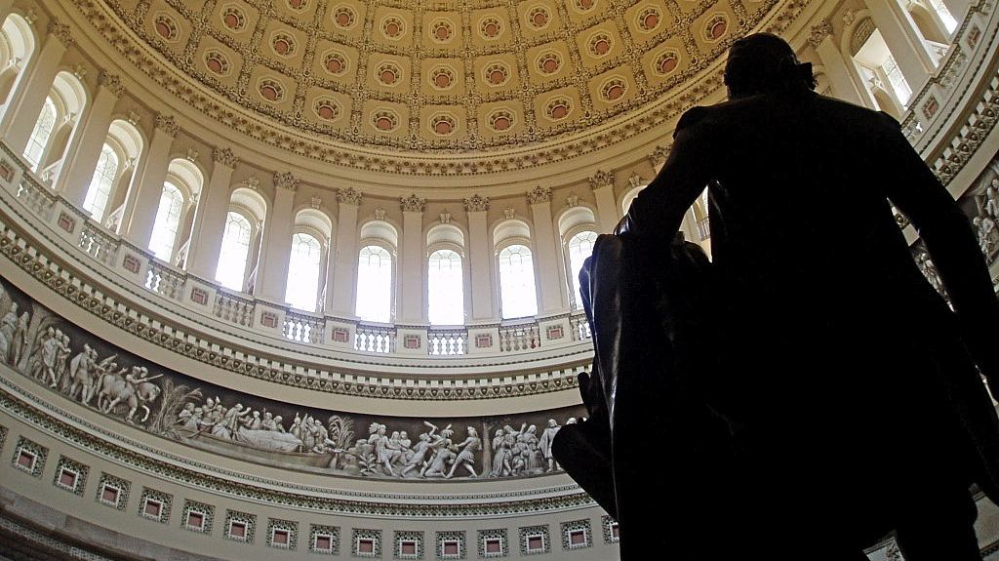
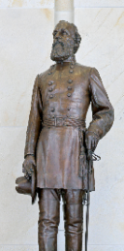
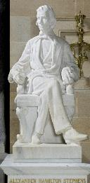
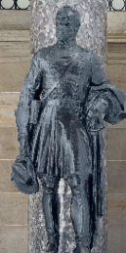
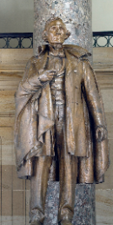
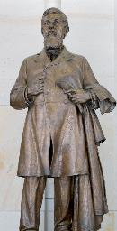
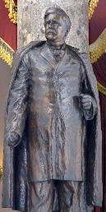
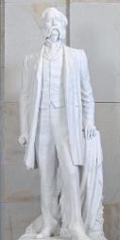
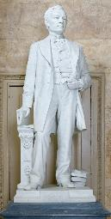
Confederates
Edmund K. Smith, FL
Alexander Stephens, GA
Joseph Wheeler, GA
Jefferson Davis, MS
James Z. George, MS
Zebulon Vance, NC
Wade Hampton, SC
Robert E. Lee, VA
John E. Kenna, WV
SMITH
STEPHENS
WHEELER
DAVIS
GEORGE
VANCE
HAMPTON
KENNA
Commission for Historical Statues
in the United States Capitol
Commission for Historical Statues
in the United States Capitol

Slide 37
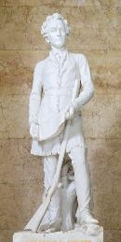
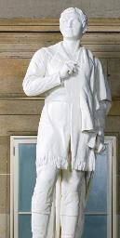
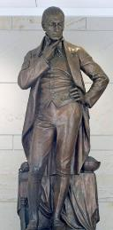
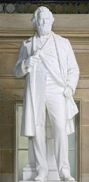
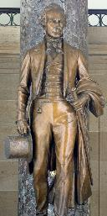
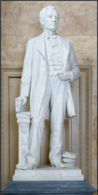
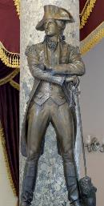
Native Virginians
Stephen Austin, TX
Sam Houston, TX
Ephraim McDowell, KY
Henry Clay, KY
John E. Kenna, WV
Francis Harrison Pierpont, WV
John Sevier, TN
Robert E. Lee, VA
George Washington, VA
AUSTIN
HOUSTON
MCDOWELL
PIERPONT
CLAY
KENNA
SEVIER
Commission for Historical Statues
in the United States Capitol
Commission for Historical Statues
in the United States Capitol

Slide 38
MEETING of the COMMISSION for HISTORICAL STATUES in the UNITED STATES CAPITOL
9:30 a.m. July 24, 2020
(this meeting will take place online)
AGENDA
Call to Order by Julie Langan, Ex-Officio Member
Roll Call of Attendees
Approval of Meeting Agenda
Approval of July 1, 2020 Meeting Minutes
Election of Chair & Vice Chair
Overview of Commission Responsibilities
Overview of Statuary Hall and Robert E. Lee Statue
Remarks from Governor Ralph S. Northam
Overview of Statue Removal Process
Public Comment (90 minutes)
Overview of Written Public Comments
Board Discussion Regarding Removal of Robert E. Lee Statue
Next Steps
Adjourn
Commission for Historical Statues
in the United States Capitol

Slide 39
MEETING of the COMMISSION for HISTORICAL STATUES in the UNITED STATES CAPITOL
9:30 a.m. July 24, 2020
(this meeting will take place online)
AGENDA
Call to Order by Julie Langan, Ex-Officio Member
Roll Call of Attendees
Approval of Meeting Agenda
Approval of July 1, 2020 Meeting Minutes
Election of Chair & Vice Chair
Overview of Commission Responsibilities
Overview of Statuary Hall and Robert E. Lee Statue
Remarks from Governor Ralph S. Northam
Overview of Statue Removal Process
Public Comment (90 minutes)
Overview of Written Public Comments
Board Discussion Regarding Removal of Robert E. Lee Statue
Next Steps
Adjourn
Commission for Historical Statues
in the United States Capitol

Slide 40
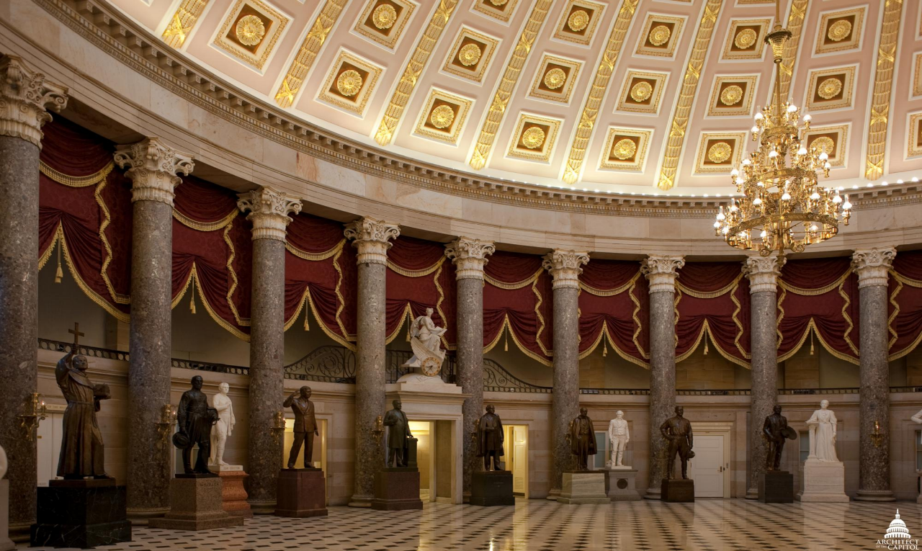
Overview of Statue Removal Process
Julie Langan
Commission for Historical Statues
in the United States Capitol

Slide 41
Procedure and Guidelines for Replacement of Statues
in the National Statuary Hall Collection
Overseen by the Architect of the U.S.
In accordance with legislation enacted in 2000, “Any State may request the Joint Committee on the Library of Congress to approve the replacement of a statue the State has provided for display in Statuary Hall” under two conditions:
(A) the request has been approved by a resolution adopted by the legislature of the State and the request has been approved by the Governor of the State, and
(B) the statue to be replaced has been displayed in the Capitol of the United States for at
least 10 years as of the time the request is made, except that the Joint Committee may waive this requirement for cause at the request of a State.
Commission for Historical Statues
in the United States Capitol

Slide 42
Steps in the Procedure for Replacement
      Responsibilities of the Commonwealth
      Commonwealth requests to replace statue
      Action by Joint Committee on the Library
      Agreement regarding replacement
      Approval of the Marquette
      Approval of full-size clay model & pedestal design
      Approval of completed statue, cast in bronze or carved in stone,
        and completed pedestal
      Ceremony & program
      Statue removal/installation and ownership
      Determination of permanent location
Commission for Historical Statues
in the United States Capitol

Slide 43
Guidelines for Replacement Statues Address
    Subject Matter
    Material - marble or bronze.
    Pedestal
    Inscriptions
    Size and Weight
    Patina and Coating
Commission for Historical Statues
in the United States Capitol

Slide 44
Possible Changes to Procedure and Guidelines
  HR 7273 passed the U.S. House of Representatives on Wednesday that would mandate the removal of “all statues of individuals who voluntarily served” the Confederacy
  The bill specifically identifies five statues for removal and tasks the Architect of the U.S. Capitol with identifying those that qualify for removal
  The bill appropriates funding for removal and storage
Commission for Historical Statues
in the United States Capitol

Slide 45
MEETING of the COMMISSION for HISTORICAL STATUES in the UNITED STATES CAPITOL
9:30 a.m. July 24, 2020
(this meeting will take place online)
AGENDA
Call to Order by Julie Langan, Ex-Officio Member
Roll Call of Attendees
Approval of Meeting Agenda
Approval of July 1, 2020 Meeting Minutes
Election of Chair & Vice Chair
Overview of Commission Responsibilities
Overview of Statuary Hall and Robert E. Lee Statue
Remarks from Governor Ralph S. Northam
Overview of Statue Removal Process
Public Comment (90 minutes)
Overview of Written Public Comments
Board Discussion Regarding Removal of Robert E. Lee Statue
Next Steps
Adjourn
Commission for Historical Statues
in the United States Capitol

Slide 46
Public Comment
Commission for Historical Statues
in the United States Capitol

Slide 47
MEETING of the COMMISSION for HISTORICAL STATUES in the UNITED STATES CAPITOL
9:30 a.m. July 24, 2020
(this meeting will take place online)
AGENDA
Call to Order by Julie Langan, Ex-Officio Member
Roll Call of Attendees
Approval of Meeting Agenda
Approval of July 1, 2020 Meeting Minutes
Election of Chair & Vice Chair
Overview of Commission Responsibilities
Overview of Statuary Hall and Robert E. Lee Statue
Remarks from Governor Ralph S. Northam
Overview of Statue Removal Process
Public Comment (90 minutes)
Overview of Written Public Comments
Board Discussion Regarding Removal of Robert E. Lee Statue
Next Steps
Adjourn
Commission for Historical Statues
in the United States Capitol

Slide 48
Overview of Written Public Comment
Julie Langan
Commission for Historical Statues
in the United States Capitol

Slide 49
Total of 48 written comments received via email
In favor of removal : 47
Opposed to removal : 1
Commission for Historical Statues
in the United States Capitol

Slide 50
In Favor of Removal – Common Themes
Numerous suggestions for other worthy Virginia subjects
There are more deserving Virginians to honor
Lee represented white supremacy, not Virginia heritage
Confederate subjects are inappropriate in public spaces
Lee does not represent the Virginia of today
It is past time for this statue to be removed
Lee himself did not want statues/monuments
How do we want to represent Virginia?
Lee committed treason against the US - Traitors should not be in places of reverence
Lee was on the wrong side of history
Lee represents racism
Commission for Historical Statues
in the United States Capitol

Slide 51
Opposed to Removal
“I am writing to you to object to the proposal to remove the Robert E. Lee statue
from the United States Capitol. I believe that Robert E. Lee is an appropriate
representative of Virginia. He was an outstanding man who served the country and Virginia.
He was and is well respected by citizens from all over the country, including contemporary
figures from the Northern states and Presidents Theodore Roosevelt and Dwight D. Eisenhower. When the Civil War ended, Lee urged his soldiers to go
home and be good citizens. He became president of Washington College and
made innovations that helped revive the college and lead it into modern times.
Robert E. Lee was a man of great moral and honorable character.
Please do not remove his statue from the Capitol. “
Sue Anne Boothe
Floyd
Commission for Historical Statues
in the United States Capitol

Slide 52
MEETING of the COMMISSION for HISTORICAL STATUES in the UNITED STATES CAPITOL
9:30 a.m. July 24, 2020
(this meeting will take place online)
AGENDA
Call to Order by Julie Langan, Ex-Officio Member
Roll Call of Attendees
Approval of Meeting Agenda
Approval of July 1, 2020 Meeting Minutes
Election of Chair & Vice Chair
Overview of Commission Responsibilities
Overview of Statuary Hall and Robert E. Lee Statue
Remarks from Governor Ralph S. Northam
Overview of Statue Removal Process
Public Comment (90 minutes)
Overview of Written Public Comments
Board Discussion Regarding Removal of Robert E. Lee Statue
Next Steps
Adjourn
Commission for Historical Statues
in the United States Capitol

Slide 53
Board Discussion Regarding Removal of the Robert E. Lee Statue
Commission for Historical Statues
in the United States Capitol

Slide 54
MEETING of the COMMISSION for HISTORICAL STATUES in the UNITED STATES CAPITOL
9:30 a.m. July 24, 2020
(this meeting will take place online)
AGENDA
Call to Order by Julie Langan, Ex-Officio Member
Roll Call of Attendees
Approval of Meeting Agenda
Approval of July 1, 2020 Meeting Minutes
Election of Chair & Vice Chair
Overview of Commission Responsibilities
Overview of Statuary Hall and Robert E. Lee Statue
Remarks from Governor Ralph S. Northam
Overview of Statue Removal Process
Public Comment (90 minutes)
Overview of Written Public Comments
Board Discussion Regarding Removal of Robert E. Lee Statue
Next Steps
Adjourn
Commission for Historical Statues
in the United States Capitol

Slide 55
Next Steps
    DHR staff to prepare interim report to General Assembly
    Commission to meet in August to consider:
      Interim report to the General Assembly
      Disposition of statue following its removal
Commission for Historical Statues
in the United States Capitol

Slide 56
MEETING of the COMMISSION for HISTORICAL STATUES in the UNITED STATES CAPITOL
9:30 a.m. July 24, 2020
(this meeting will take place online)
AGENDA
Call to Order by Julie Langan, Ex-Officio Member
Roll Call of Attendees
Approval of Meeting Agenda
Approval of July 1, 2020 Meeting Minutes
Election of Chair & Vice Chair
Overview of Commission Responsibilities
Overview of Statuary Hall and Robert E. Lee Statue
Remarks from Governor Ralph S. Northam
Overview of Statue Removal Process
Public Comment (90 minutes)
Overview of Written Public Comments
Board Discussion Regarding Removal of Robert E. Lee Statue
Next Steps
Adjourn
Commission for Historical Statues
in the United States Capitol

