Slide 1
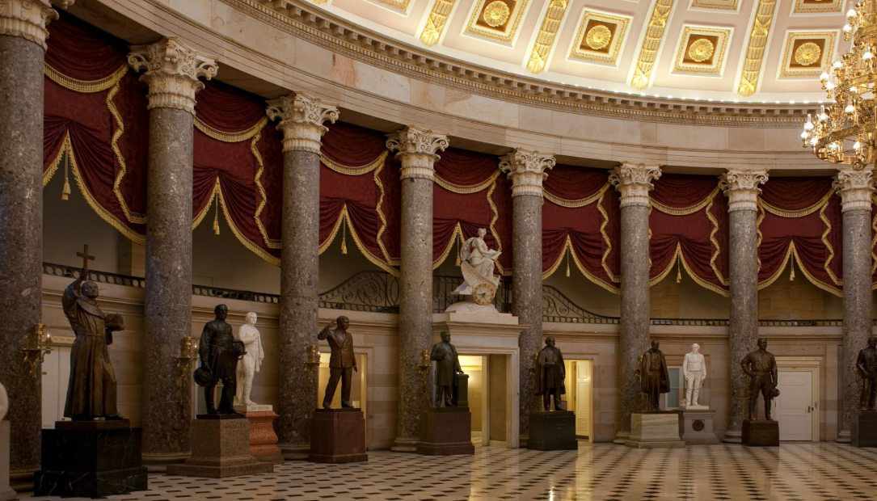

MEETING of the COMMISSION for HISTORICAL STATUES in the UNITED STATES CAPITOL
10:00 a.m. January 4, 2023
Thank you for joining us.
The meeting of the Commission will begin momentarily.
Commission members and staff will be participating in person. This meeting will be broadcast virtually
via Webex and will be recorded.
Registration to provide virtual public comment closed at
5 P.M. on JANUARY 3, 2023
In the event there is a disruption in the broadcast of the meeting,
please call (804) 482-6446.
Commission for Historical Statues
in the United States Capitol

Slide 2
MEETING of the COMMISSION for HISTORICAL STATUES in the UNITED STATES CAPITOL
10:00 a.m. January 4, 2023
Welcome
Commission for Historical Statues
in the United States Capitol

Slide 3
MEETING of the COMMISSION for HISTORICAL STATUES in the UNITED STATES CAPITOL
10:00 a.m. July 21, 2022
Agenda
Call to Order
Roll Call Attendance
Approval of Meeting Agenda
Approval of July 21, 2022 Meeting Minutes
Approval of Virtual Meeting Policy
Public Comment
Introduction of Selected Sculptor
Update/Next Steps
Work Session Between Sculptor, Commission and Johns Family
Adjourn
Commission for Historical Statues
in the United States Capitol

Slide 4
Virtual Meeting Policy
  During the 2022 Session of the General Assembly, HB 444 was passed that authorizes certain public bodies to hold all virtual meetings in certain circumstances.
  In order for the Commission to be able to hold an all virtual meeting under this new code section, 2.2-3708.3, the Board must pass a policy the proposed policy to do so.

Slide 5
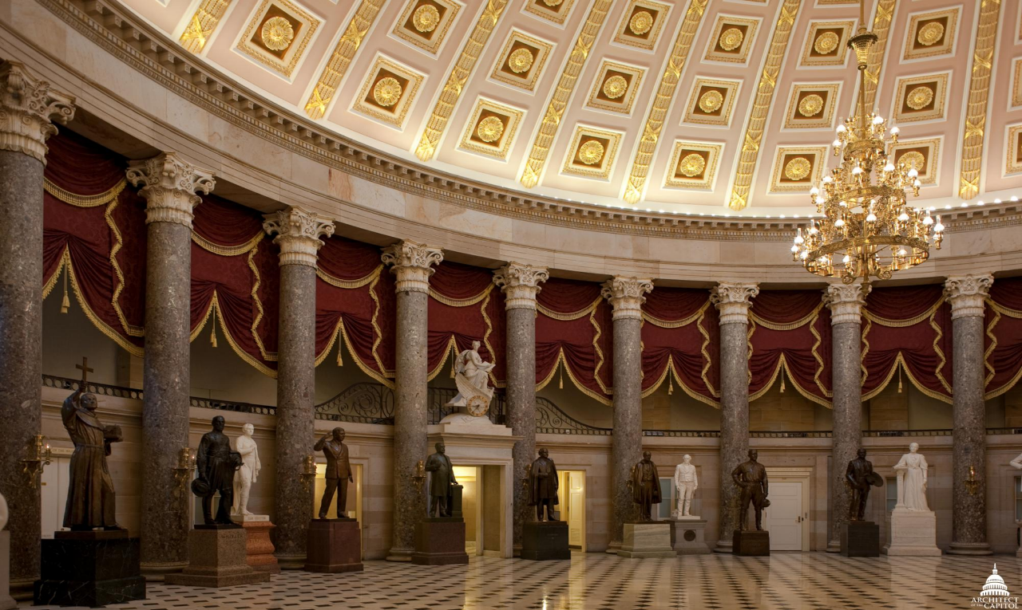
Public Comment – Summary of Written Comments
Virtual Comments
In Person Comments
Commission for Historical Statues
in the United States Capitol

Slide 6
Update
  Since the July 2022 meeting:
  Governor approved carry forward of appropriation
  DHR entered into contract with Steven Weitzman
  Langan consulted with Cameron Patterson re: historic photos of Moton
  Langan sent photos of maquette to OAC Curator for feedback
  Weitzman and Langan had call with Curator at the OAC
  Weitzman reduced size of lectern in response to Curator’s comments.

Slide 7
Next Steps
  Weitzman & Langan to meet with Curator of the OAC on January 10
  Finalize design concept
  Negotiate project cost & timeline w/ sculptor
  Continue to consult with Johns family members
  Approval Process:
    Commission to meet to approve maquette
    Submit photos of approved maquette to OAC for approval
    Commission to meet to approve full size model, pedestal and inscriptions
    Submit photos of approved model, pedestal & inscriptions to OAC for approval
    Submit photos of finished bronze statue to OAC for approval
  Transport and temporary installation
  Unveiling Program
  Installation in crypt

Slide 8
DISCUSSION OF DESIGN CONCEPT/ELEMENTS
Overall design concept & pose
Lectern style & type of seal
Expression
Attire
Books
Pedestal – inscriptions – future meeting
Commission for Historical Statues
in the United States Capitol

Slide 9
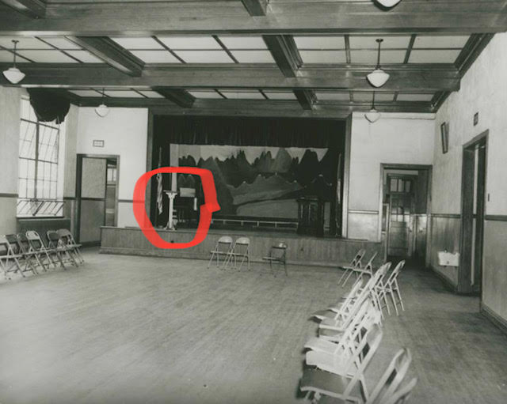
Lectern
Commission for Historical Statues
in the United States Capitol

Slide 10
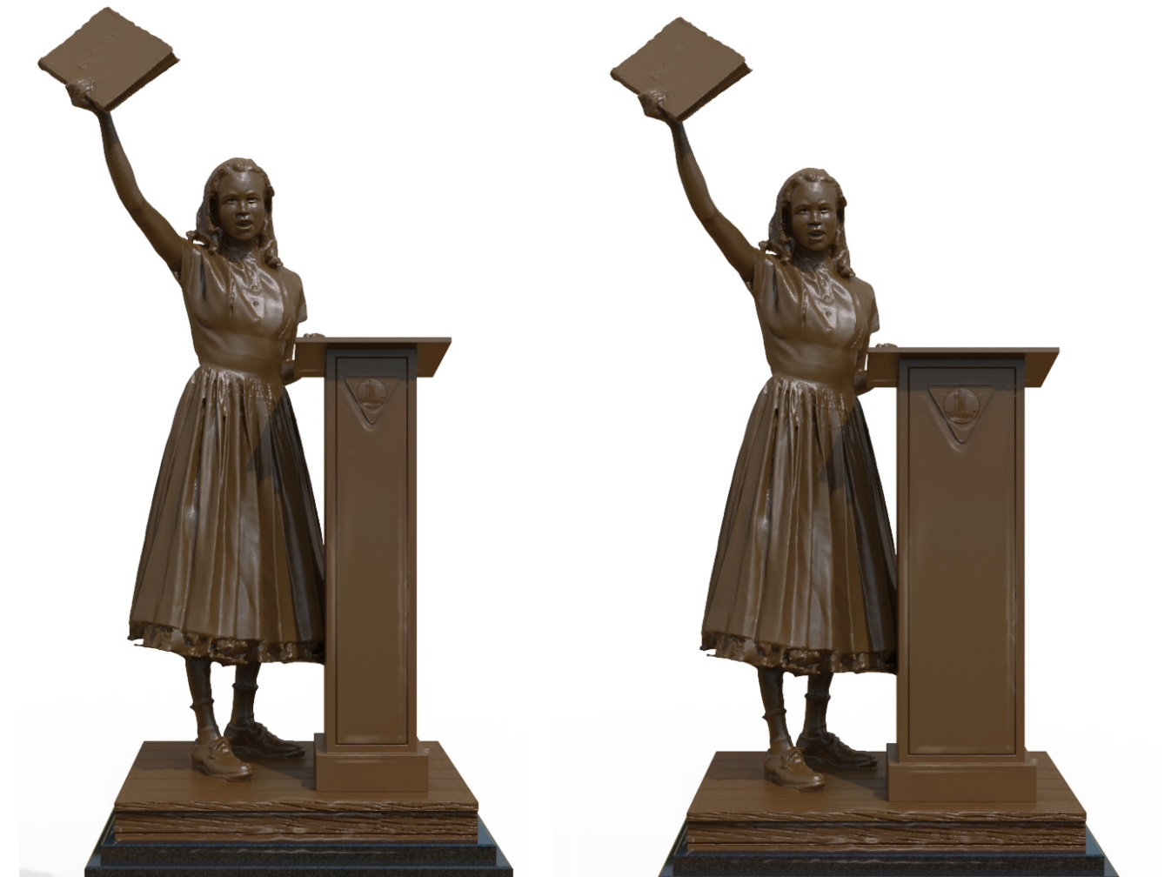
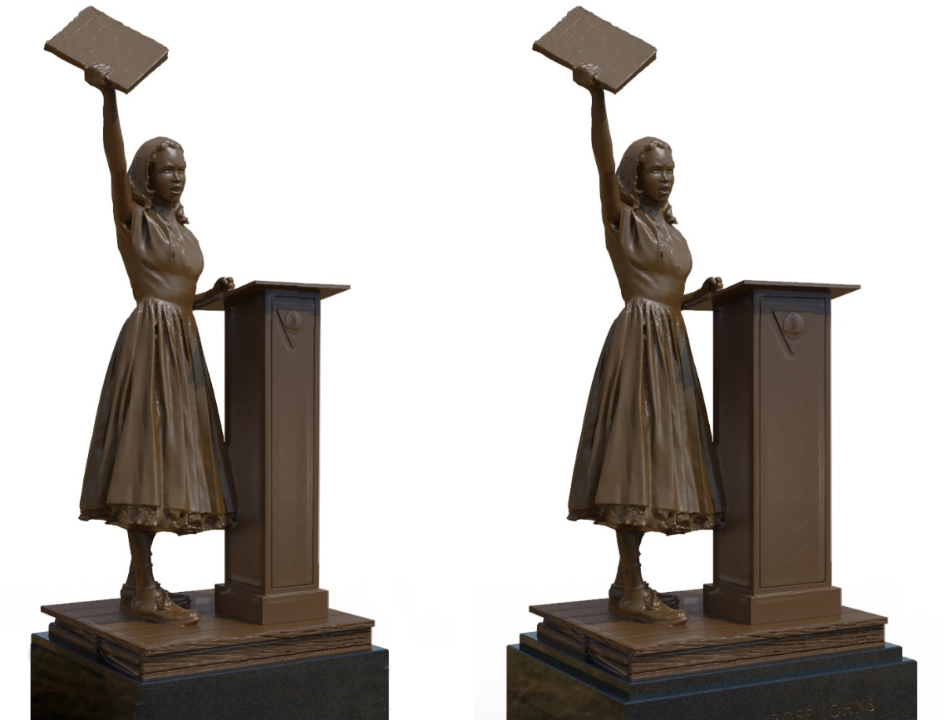

Slide 11
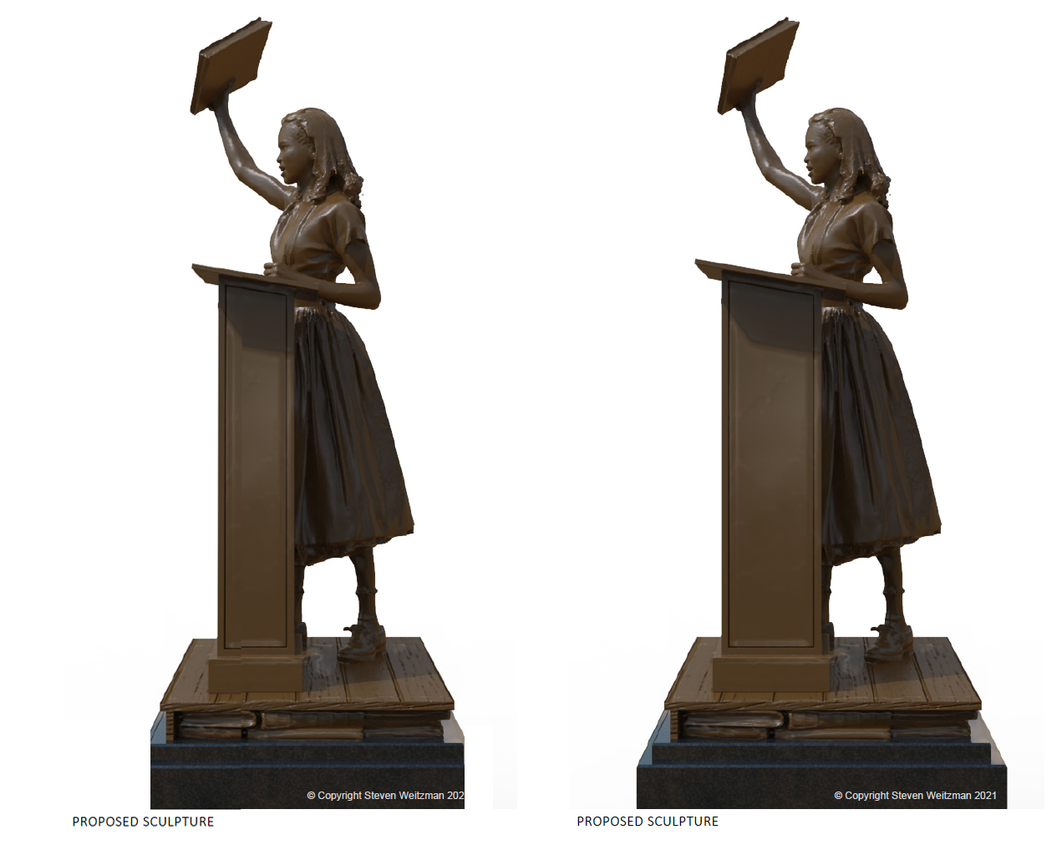
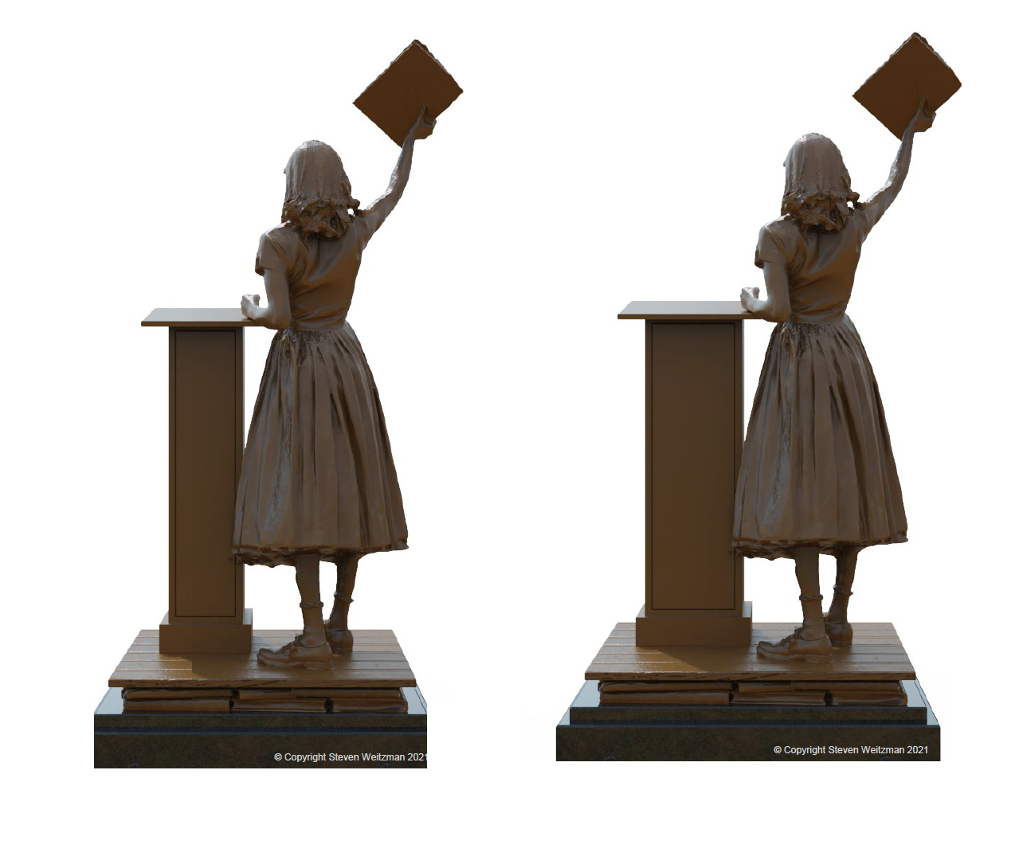

Slide 12
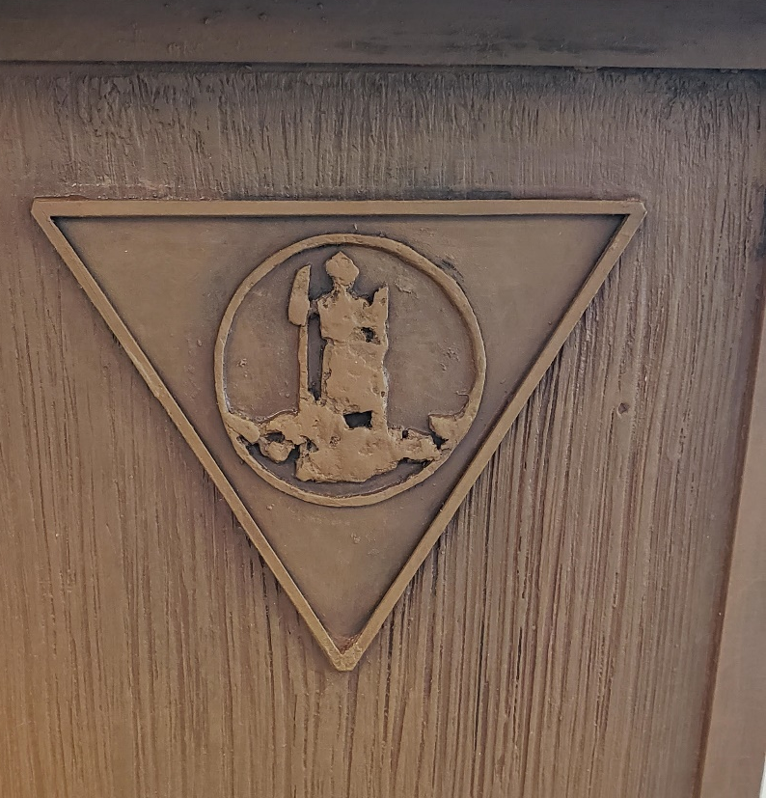


Lectern
Commission for Historical Statues
in the United States Capitol

Slide 13
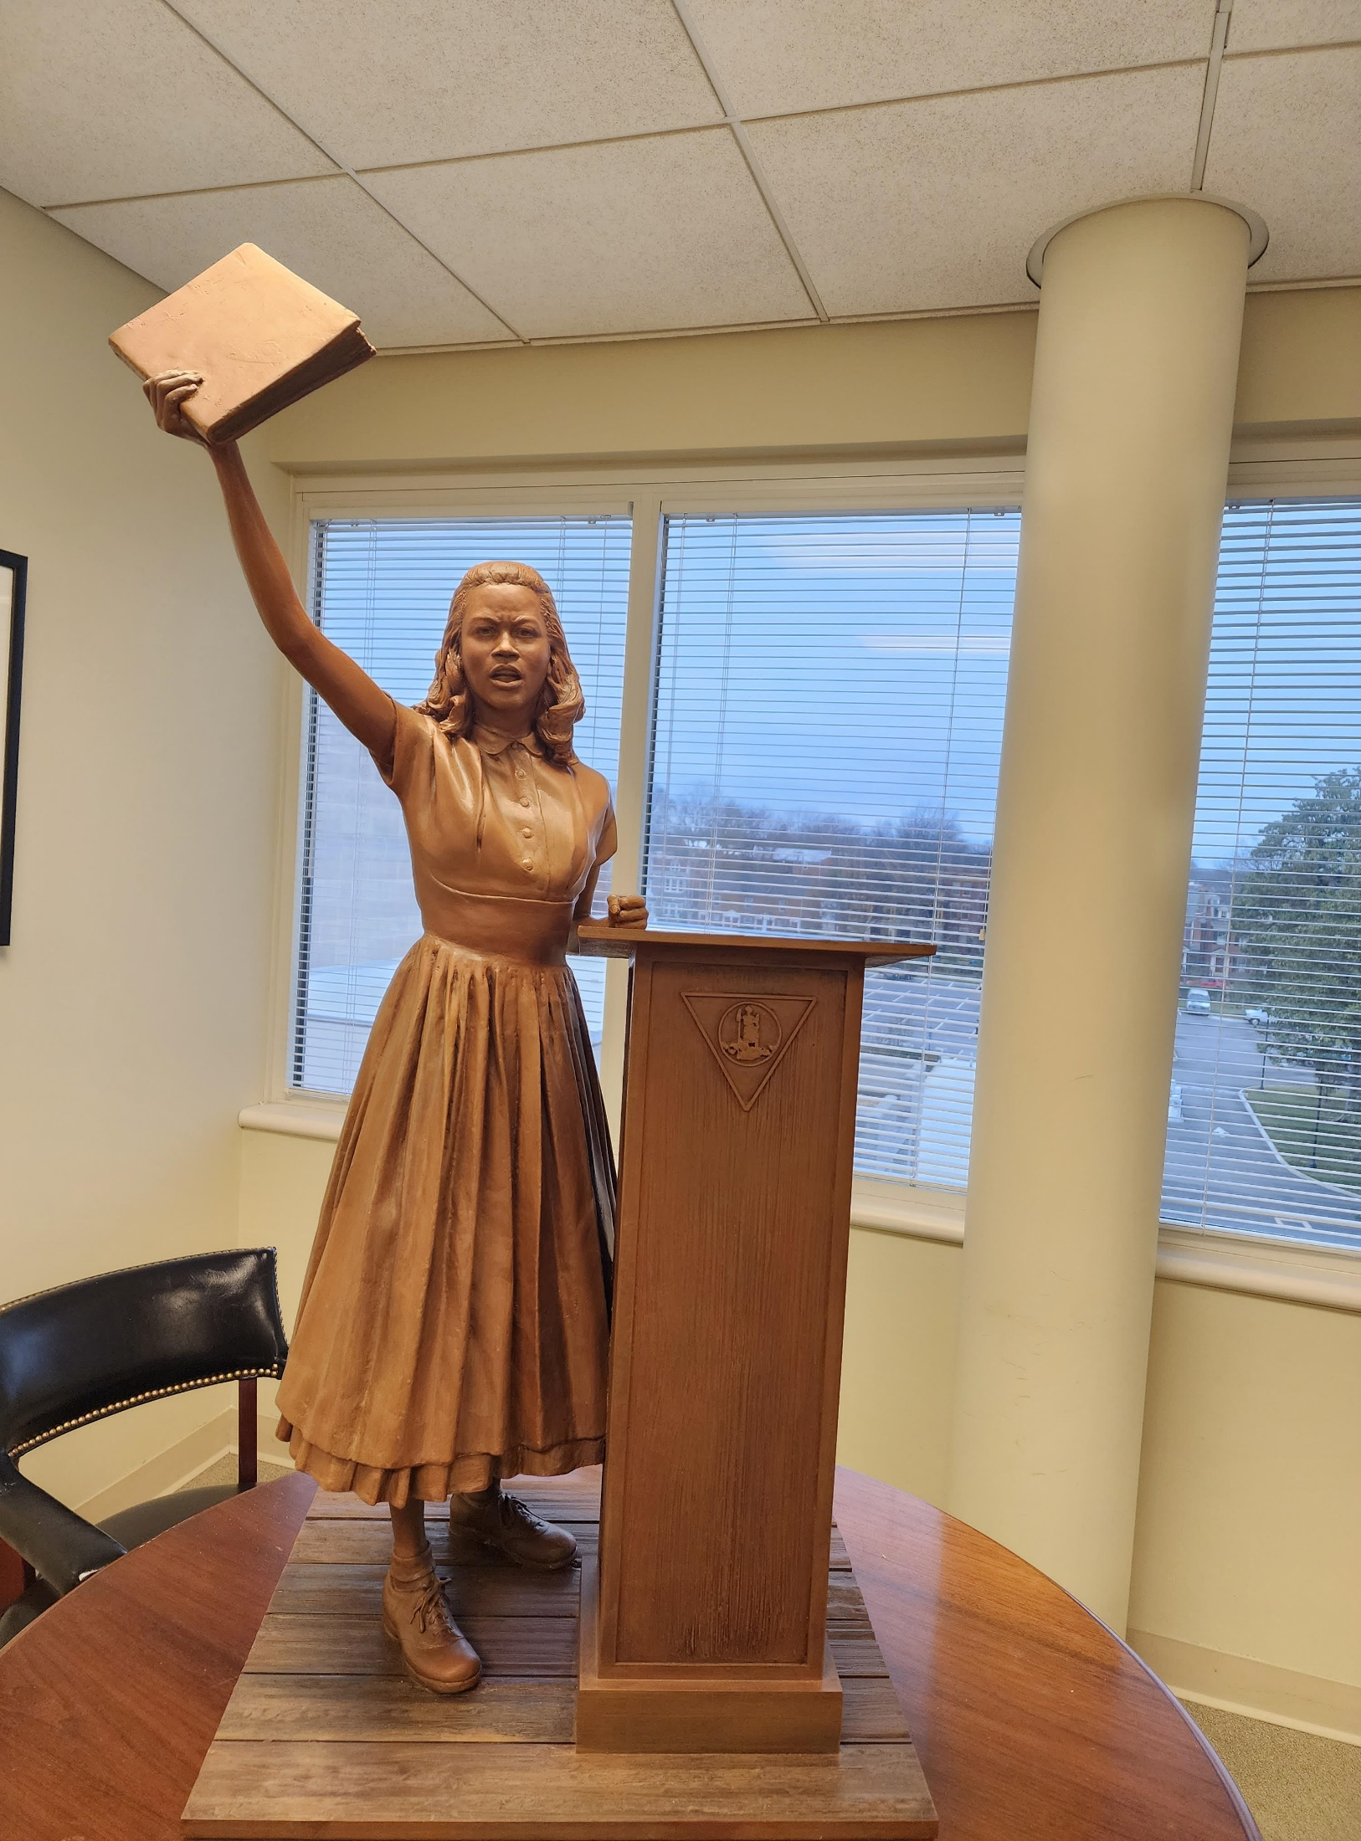
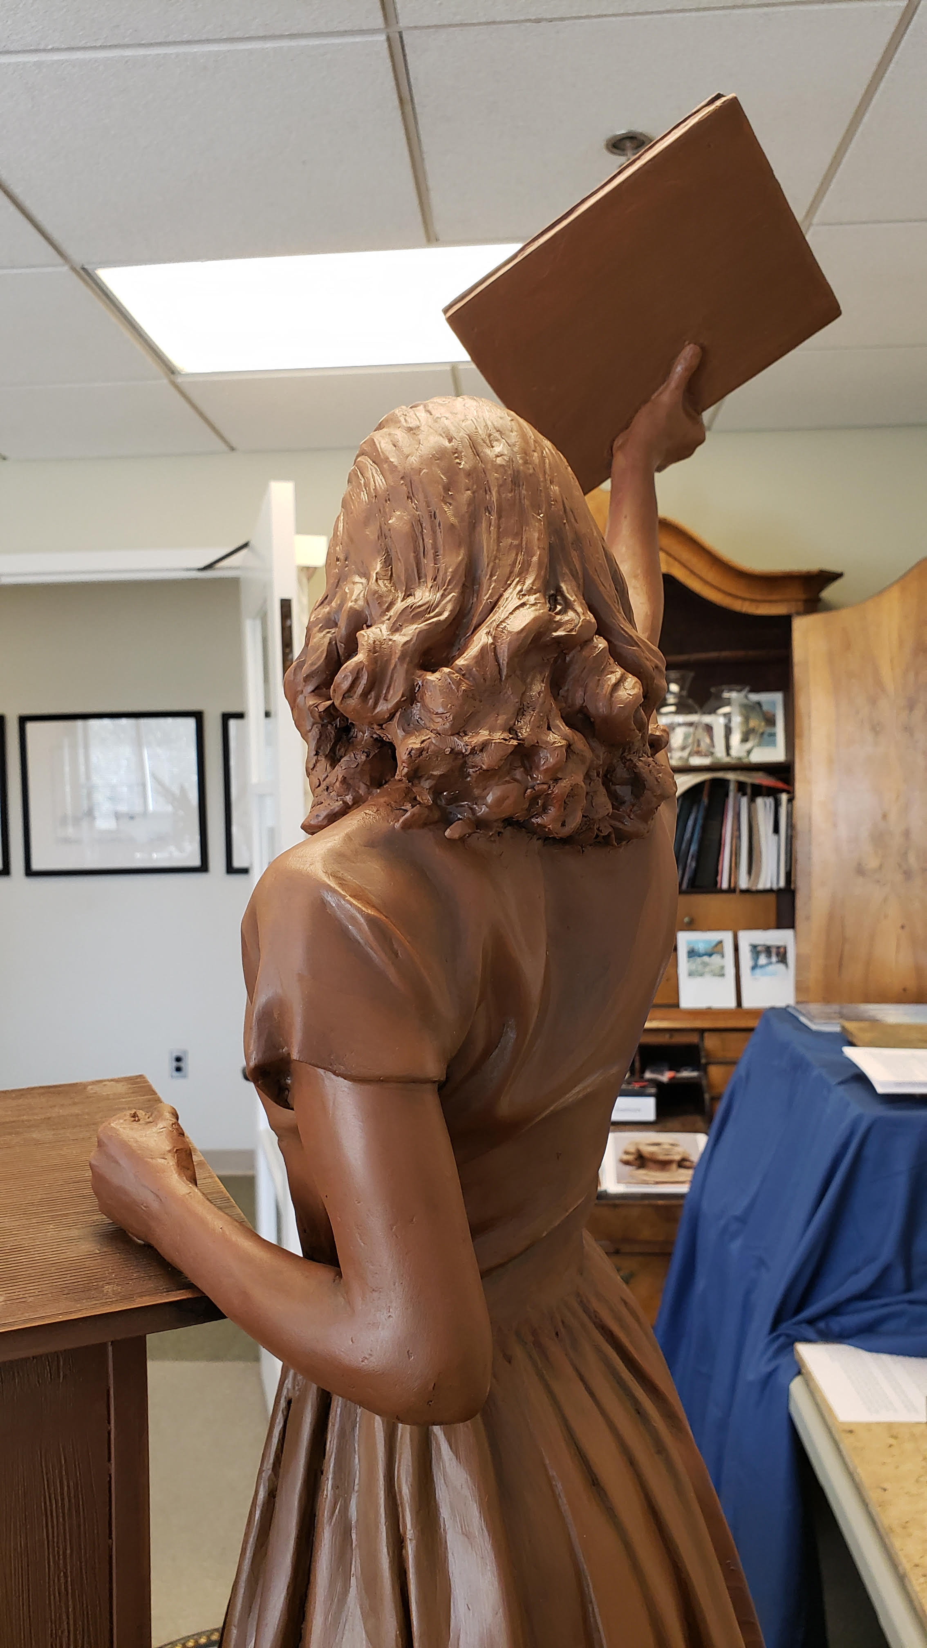
POSE
Commission for Historical Statues
in the United States Capitol

Slide 14
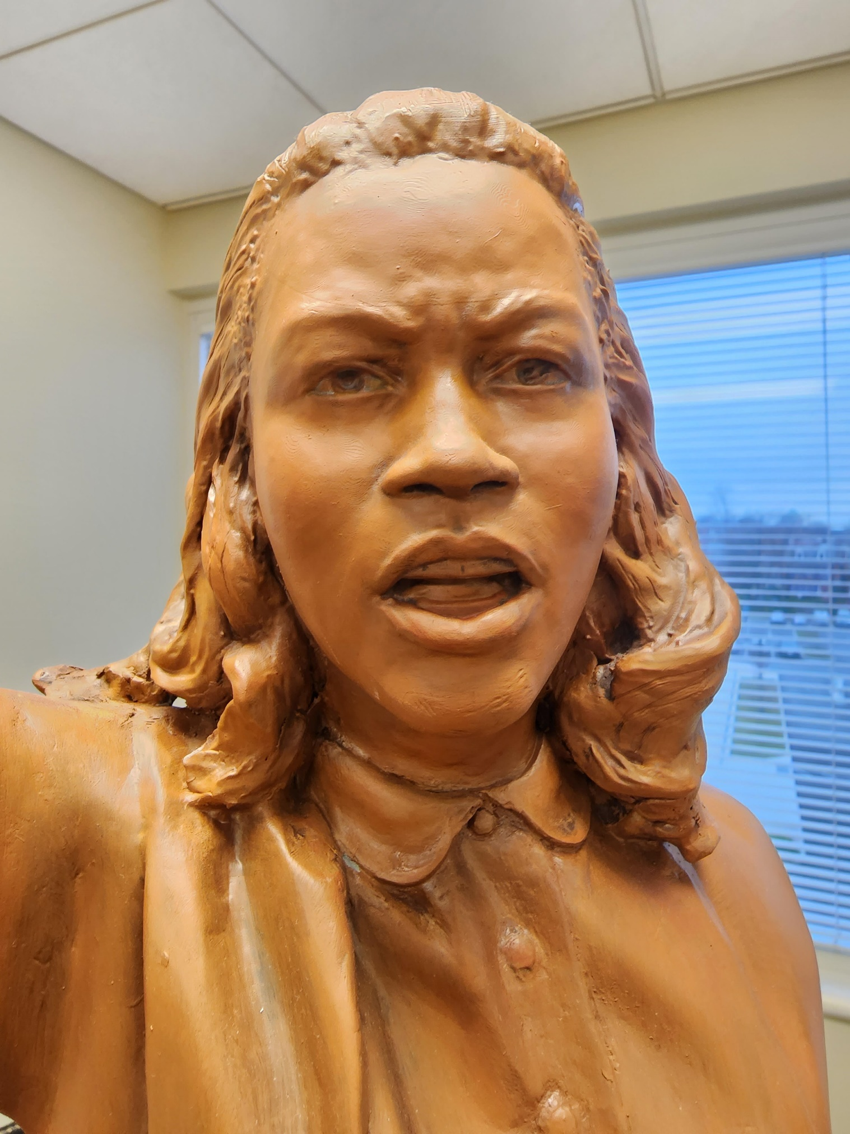
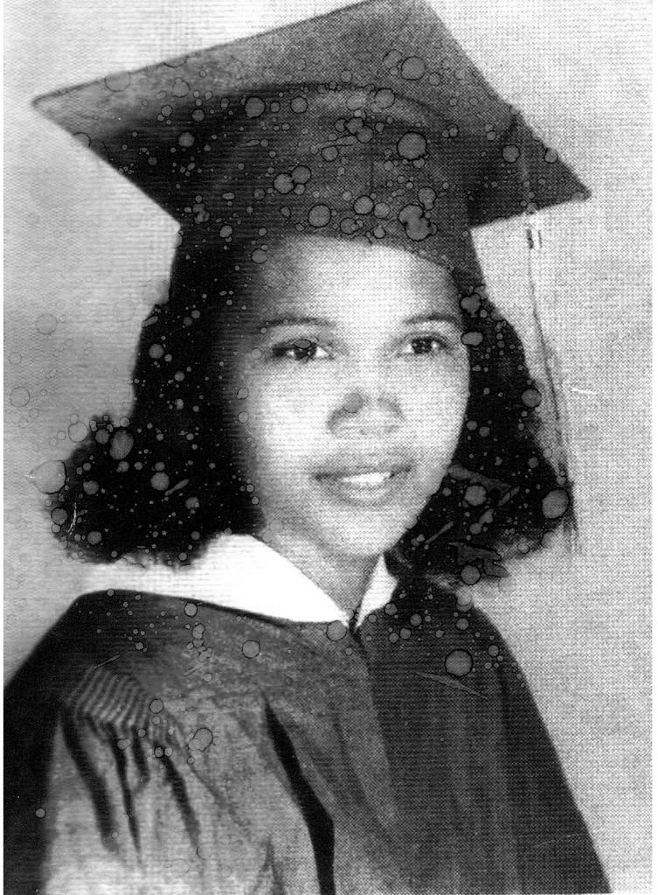
EXPRESSION
Commission for Historical Statues
in the United States Capitol

Slide 15
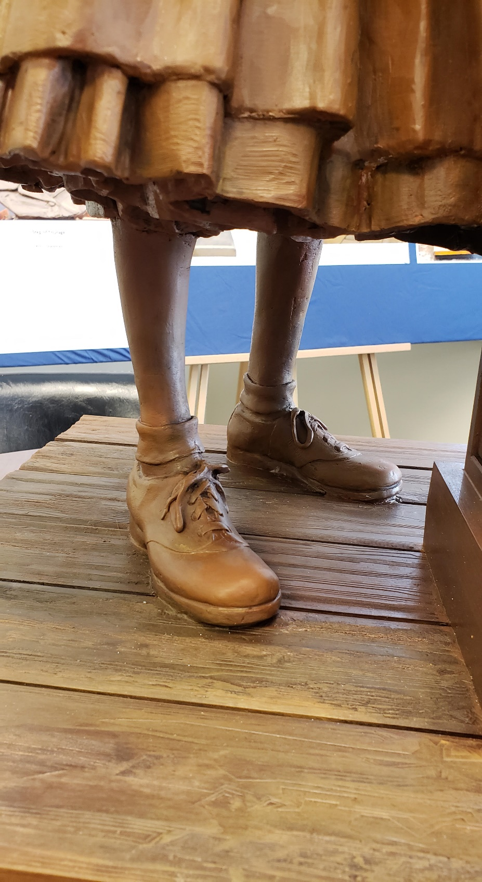
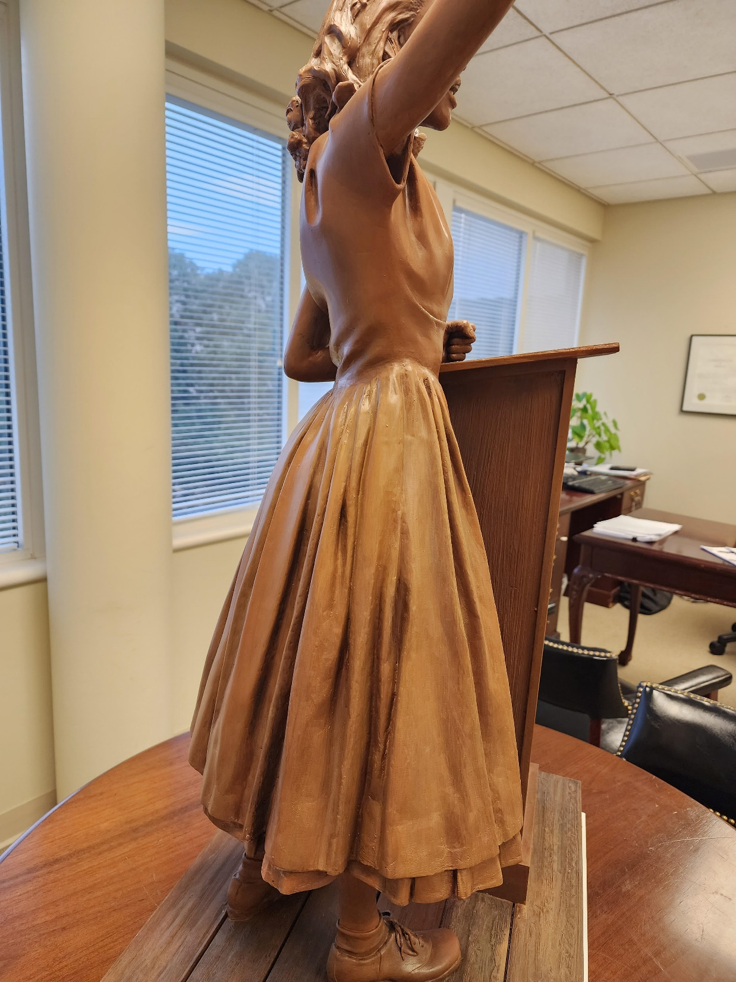
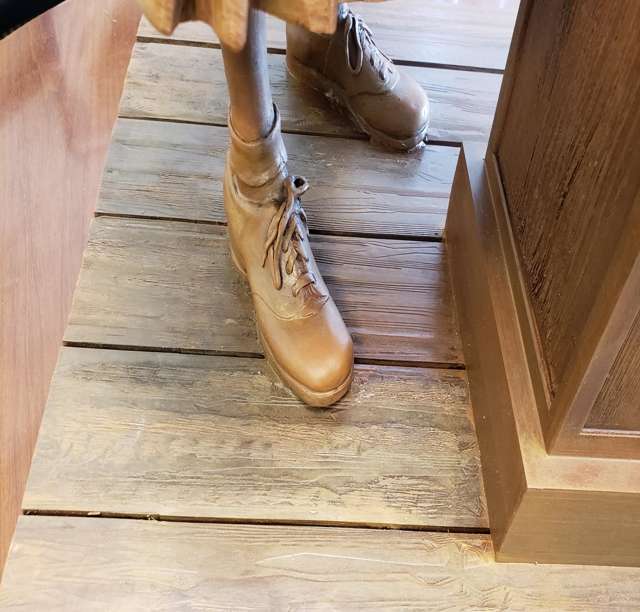
ATTIRE
Commission for Historical Statues
in the United States Capitol

Slide 16
Proposed Book Titles
Frederick Douglas - My Bondage and My Freedom
W. E. B. DuBois, Black Reconstruction in America (1935)
WEB DuBois – The Souls of Black Folks
WEB DuBois – The Talented Tenth
Langston Hughes, The Weary Blues (1926)
Zora Neal Hurston – Their Eyes Were Watching God
John Mercer Langston - From the Virginia Plantation To The National Capitol
Robert Russa Moton, What the Negro Thinks (1929)
Jean Toomer - Cane (1923)
Booker T. Washington – Up From Slavery
Carter G. Woodson - Miseducation of The Negro
Carter G. Woodson - The Negro in Our History (1922)
Richard Wright – Native Son
Commission for Historical Statues
in the United States Capitol

Slide 17
PEDESTAL DESIGN & INSCRIPTIONS
TBD at future meeting
Commission for Historical Statues
in the United States Capitol

Slide 18
Adjourn
Commission for Historical Statues
in the United States Capitol

