Slide 1
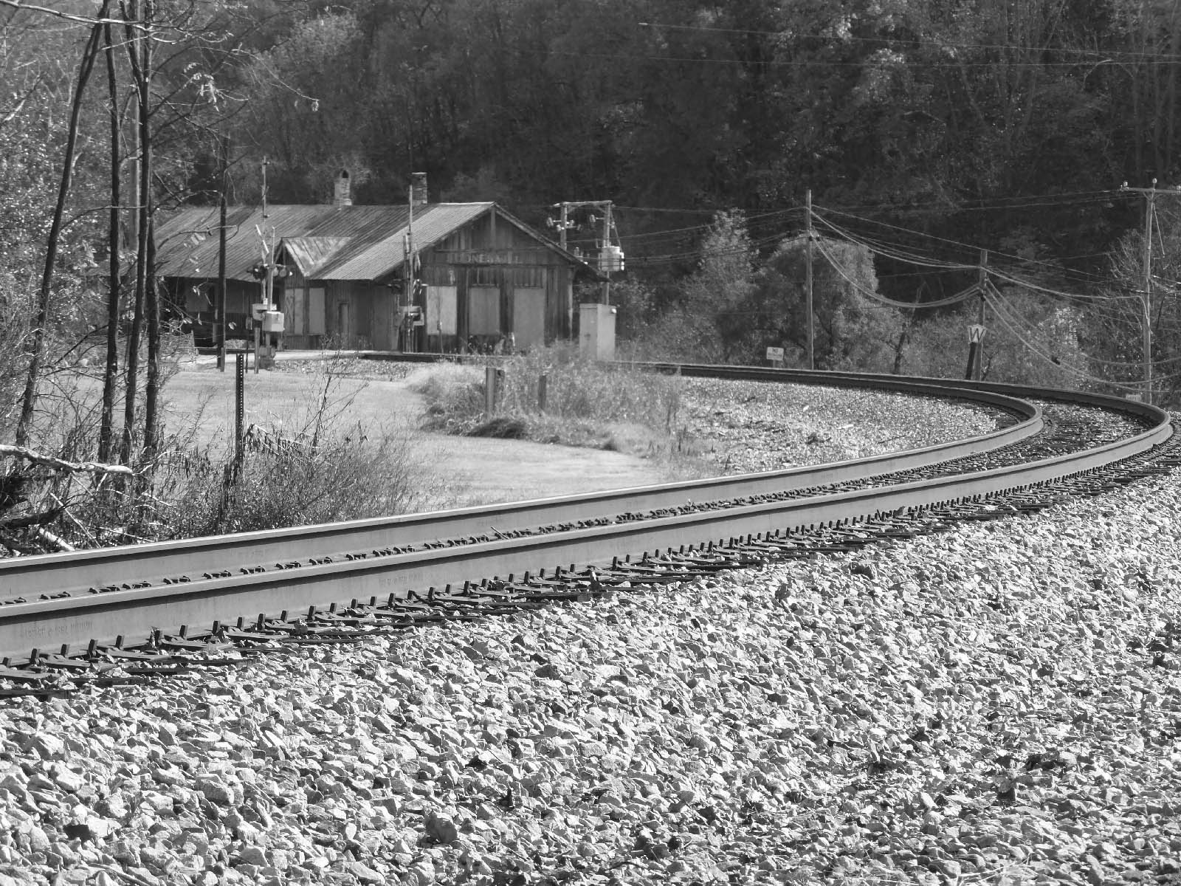
Historic Districts in Virginia
Department of Historic Resources
Richmond, Virginia
June 2014
Notes:
This presentation provides an overview of the four different types of historic districts that can be found in Virginia: local, National Historic Landmark, National Register, and Virginia Landmarks Register (VLR) districts. The regulatory and legal authority for designating historic districts also is summarized, as well as what each type of district designation means for property owners. Particular emphasis is placed on National Register and VLR districts, as the Department of Historic Resources (DHR) is responsible for administering these two programs.

Slide 2
Basics of Historic Districts
What are historic districts and how did they come into being?
What are the different levels of historic district designation and what are their consequences and benefits?

Slide 3
What is a Historic District?
Significant concentration or linkage of resources
A place important for many reasons—Architecture, History, People, Archaeology, etc.
The whole captures the feel of an era or the evolution of many eras
Notes:
The National Park Service defines a historic district as having “a significant concentration, linkage, or continuity of sites, buildings, structures, or objects united historically or aesthetically by plan or physical development.” A historic district can be important for one or more reasons, such as its architectural design, history, inhabitants, and archaeology. Typically, a district contains a number of resources that are relatively equal in importance (such as a downtown business center, a neighborhood or a shipyard) or it has large acreage with a variety of resources (such as a park, battlefield, large farm, mine, or military installation). A district also may contain resources that, although linked by association or function, were separated geographically (such as a 19th century canal system made up of locks, dams, turning basins, towpaths, and other features).
The National Park Service further adds that “a district derives its importance from being a unified entity, even though it is often composed of a wide variety of resources. The identity of a district results from the interrelationship of its resources, which can convey a visual sense of the overall historic environment or be an arrangement of historically or functionally related properties. For example, a district can reflect one principal activity, such as a mill or a ranch, or it can encompass several interrelated activities, such as an area that includes industrial, residential, or commercial buildings, sites, structures, or objects. A district can also be a grouping of archeological sites related primarily by their common components; these types of districts often will not visually represent a specific historic environment.”

Slide 4
Local, State, and National
Historic District Designations
Four Types of Historic Districts
Locally Designated
National Historic Landmarks
National Register of Historic Places
Virginia Landmarks Register
Notes:
Each type of historic district is authorized under different federal and/or state laws and each serves a different purpose. Local governments are responsible for designating local historic districts. DHR also manages the VLR. The National Park Service (NPS) manages the National Historic Landmarks and National Register of Historic Places programs; in Virginia, DHR is authorized to administer the National Register on behalf of NPS. Each type of district is intended to provide a way to encourage preservation of significant historic resources, but their legal basis and regulatory authority are not identical.

Slide 5
Legal Basis for Local, State, and National Historic District Designations
Local Historic Districts
- adopted pursuant to §15.2-2306 of the Code of Virginia
Virginia Landmarks Register
- procedure established in §10.1-2206 of the Code of Virginia
National Historic Landmarks
- Historic Sites Act of 1935
- Code of Federal Regulations - 36 CFR 65.5
National Register of Historic Places
- National Historic Preservation Act of 1966, as amended
- Code of Federal Regulations - 36 CFR 60
Notes:
The current authorization for Virginia’s local historic districts is in the Code of Virginia, which can be found online at http://leg1.state.va.us/000/src.htm. In 1966, the Virginia General Assembly authorized the Virginia Landmarks Register (VLR), and its procedures are in the Code of Virginia. The National Historic Landmarks program was authorized by the Historic Sites Acts of 1935. Regulations for the National Historic Landmarks program are found in the Code of Federal Regulations in Title 36, Part 65.5. In 1966, the National Historic Preservation Act created the National Register of Historic Places. Regulations for the National Register program are found in the Code of Federal Regulations in Title 36, Part 60.

Slide 6
How to Find State and Federal Regulations
A searchable database of the Code of Virginia is online at http://leg1.state.va.us/000/src.htm
A searchable database of the Administrative Code of Virginia is online at http://leg1.state.va.us/cgi-bin/legp504.exe?000+men+SRR
The full text and searchable version of federal regulations for the National Historic Landmarks and National Register programs is online at http://www.ecfr.gov/cgi-bin/text-idx?c=ecfr&rgn=div5&view=text&node=36:1.0.1.1.26&idno=36 and at http://www.cr.nps.gov/nr/regulations.htm
Notes:
Local districts, VLR districts, National Historic Landmark districts, and National Register districts are not all the same! If you have questions about the purposes of the different types of districts, please contact DHR’s regional staff or Register Program staff. The following review of the different regulations and administrative codes that have been established for each type of district also will provide ample illustration of their differing purposes.

Slide 7

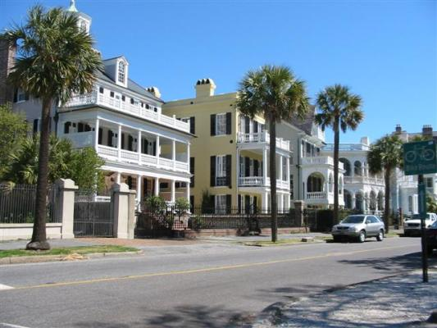
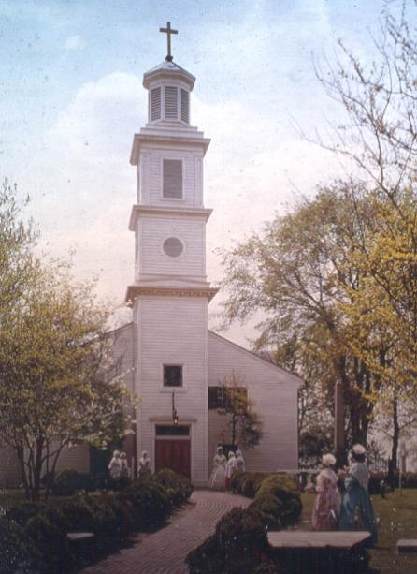
Thumbnail History of Historic Districts
Local Districts:
Charleston 1931
New Orleans French Quarter 1937
Old and Historic Alexandria 1946
St. John’s Church Old and Historic District 1957
National Historic Landmark Districts:
Williamsburg Historic District 1960
National and State Register Districts:
More than 450 in Virginia and counting!
Notes:
The first historic district established in the United States was in Charleston, South Carolina, in 1931. This was a “locally designated district,” authorized by the Charleston city government to protect the city’s iconic architecture through a local board of architectural review. New Orleans followed suit in 1937 with designation of the French Quarter historic district. In Virginia, the first locally designated district occurred in 1946 with the Old and Historic Alexandria district. In 1957, the City of Richmond designated the St. John’s Church Old and Historic District.
Designation of National Historic Landmarks (NHLs) first were authorized by Congress in 1935 and began to be administered by the National Park Service in 1960 when it became a more formal program. NHLs are nationally significant historic places designated by the U. S. Secretary of the Interior because they possess exceptional value or quality in illustrating or interpreting the heritage of the United States. On October 9, 1960, Virginia’s Williamsburg Historic District was among the first 92 NHLs designated nationwide under the formalized program. NHL designation is honorary.
In 1966, the National Historic Preservation Act created the National Register of Historic Places. The same year, the Virginia General Assembly created the Virginia Landmarks Register (VLR). Both of these authorized the designation of historic districts that were strictly honorary in nature.
Thus, locally designated historic districts are the only historic districts in Virginia that can include a regulatory aspect, such as architectural review. NHL, National Register and VLR designations do not restrict or regulate private property owners and development within historic districts.

Slide 8
Local Historic Districts:
Authority in Code of Virginia
In Virginia, local historic district ordinances are adopted pursuant to §15.2-2306 of the Code of Virginia.
This is “enabling legislation” that provides a framework for a local government to pass an ordinance. Local governments are not required to adopt historic district ordinances if they do not wish to designate such districts.
Ordinances should consider a community’s unique resources and character.
Avoid “search and replace” approach
Notes:
The Virginia General Assembly has authorized local governments to designate local historic districts, as specified in the Code of Virginia §15.2-2306. The state legislation is “enabling legislation,” meaning that it enables a local government to take this action if local governments choose to do so by adopting a historic district ordinance. Local governments are not required to designate local historic districts for any reason. Designation of a NHL, National Register or VLR historic district will not mandate that a local government also designate a local historic district.
If local governments choose to adopt a historic district ordinance, the ordinance should be tailored to their community’s unique history, resources, and character. A “one-size-fits-all” approach is not suitable. Although local governments can look to other localities’ preservation ordinances for inspiration, they should not adopt one wholesale and only “search and replace” in the ordinance to include their locality’s name. DHR staff are available to advise local governments on researching and determining if a local historic district ordinance is appropriate for their community.

Slide 9
Uses of Local District Designation
Tool for managing change while maintaining the character of a district through use of planning, zoning, and permitting processes.
Recognizes the value of existing places and helps to preserve a sense of place.
Encourages re-investment and redevelopment of older building stock; also can help to curb sprawl development.
Protects property owner and local government investments in property maintenance and infrastructure.
Helps to encourage better design through design guidelines and/or architectural review.
Connects residents and visitors to an area’s history and architecture.
Can be linked to plaques, signage and local tax abatements programs.
Notes:
Local historic districts are designated by the local government to suit their community’s unique needs and goals. Although a local district designation can advance a number of goals as listed above, officials and community residents alike must understand that by their nature, local districts often restrict certain aspects of private property owners’ options when it comes to making alterations, additions, demolitions, or other changes to their historic property. This is accomplished through planning, zoning, permitting, and architectural review processes designed to protect the historic character of a property.
DHR does not participate in any way in local government designation programs. Although available to offer technical assistance, DHR does not play a role in formulating local historic district ordinances or design guidelines, nor is DHR involved in the operations of local architectural review boards. Under the National Historic Preservation Act, through the Certified Local Government (CLG) program, DHR can recognize local governments that have put key elements of a sound local preservation program in place in their communities. For more information about the CLG program, please see http://www.dhr.virginia.gov/clg/clg.htm.

Slide 10
Essentials of the NHL Program
Requirements for NHL designation are similar to those for the National Register of Historic Places, with a few key differences:
A property owner seeking NHL designation works directly with NHL program staff.
NHL staff assist the property owner with preparing a nomination that details the property’s significance and integrity.
Experts from across the nation review the NHL nomination.
The Landmarks Committee reviews the NHL nomination and makes a recommendation to the National Park System Advisory Board.
The National Park System Advisory Board reviews and makes a recommendation to the Secretary of the Interior.
The Secretary of the Interior considers the recommendations and determines if the property will be designated an NHL.
Further information is available at http://www.nps.gov/nhl/learn/intro.htm.
Notes:
Currently, there are about 2500 NHLs that have been designated nationwide. These properties tell stories that are of importance to the history of the entire nation, not just local communities or states. All properties designated as NHLs are automatically listed in the National Register of Historic Places, if not previously listed.

Slide 11
Protection of NHLs
NHL designation is honorary, but can help to recognize, preserve, and protect important locations in American history.
NHLs may have additional protections from development (depending on local preservation laws).
NHLs may be eligible for preservation grants from a variety of sources.
NHLs are eligible for federal tax incentives and, in Virginia, are eligible for easements and state tax incentives.
The National Park Service offers extensive technical assistance to owners of NHLs.
Further information is available at http://www.nps.gov/nhl/learn/benefits.htm, or contact DHR staff.
Notes:
Although NHLs unquestionably are highly significant historic properties, NHL designation does not guarantee their preservation in perpetuity. An NHL designation is honorary and does not automatically impose regulations to protect the property or restrict owners’ usage of the property. The NHL’s online database, http://www.nps.gov/nhl/find/database.htm, can be searched for a current list of NHLs that are considered to be threatened.

Slide 12
National Historic Landmark
Historic Districts in Virginia
As of June 2014, Virginia has 122 NHLs, of which 13 are designated as historic districts:
Alexandria HD; Bremo HD; Fort Myer HD; Green Springs HD; Jackson Ward HD; Monument Avenue HD; Potomac Canal HD; Thunderbird Archaeological District; University of Virginia HD; Virginia Military Institute HD; Washington and Lee University HD; Waterford HD; and Williamsburg HD.
Virginia also has 10 battlefields that are NHLs; battlefields are generally understood to be a type of historic district as they typically encompass large acreage with a variety of resources.
Notes:
NHLs are owned by private individuals, universities, non-profit organizations, corporations, tribal entities, local and state governments, or, in some cases, the Federal government. Owners of NHLs are not required to open their properties to the public or to adhere to particular standards for maintenance, repairs, additions, or alterations to the property. NHL and DHR staff are available to advise owners with any questions they may have about their property.

Slide 13
National Register and
VLR Historic Districts
The Virginia Landmarks Register mirrors the National Register of Historic Places. Both programs use the same Criteria for evaluation, nomination form, and review and approval processes.
Both types of historic districts are strictly honorary:
No imposition of design guidelines or architectural design review processes.
No restrictions on use of property
No requirements to maintain, rehabilitate, or restore a historic property to a particular standard.
No change in property taxes or value
No automatic protection from development, demolition or other potential threats.
Notes:
National Register and VLR historic districts are occasionally confused with locally designated districts. This may be because the National Historic Preservation Act requires the Federal government to consider the effects of all federally licensed, funded, or permitted projects on historic properties listed in or eligible for the National Register. Virginia law has some similar guidelines for properties listed in or eligible for the National Register or VLR. The process of determining effects is commonly known as the “Section 106 Review process,” after the section of the National Historic Preservation Act that contains this requirement. DHR works with the agencies and applicants who must adhere to the Section 106 Review process in Virginia. Additional information about the review process is available here - http://www.dhr.virginia.gov/review/orc_home.html.
It is important to remember that the Section 106 Review process limits the actions of the Federal government, not private property owners. National Register and VLR listing, in and of themselves, do not impose any restrictions on private property owners. Property owners are, of course, required to adhere to any local government regulations (planning, zoning, building permits, etc.), regardless of whether their property is new or historic.

Slide 14
What National Register and VLR Designation Does
Officially recognizes the historic significance of a site or area
Encourages but does not require preservation
Requires a review process to identify historic properties that may be harmed by harmful federally funded, licensed, and permitted activities
May qualify owners for state and federal rehabilitation tax credits and for easement donations
Notes:
As mentioned earlier, both federal and Virginia law require federal and state governments to consider the impacts of their actions on historic properties listed in or eligible for the National Register and/or VLR.
Additional information about the rehabilitation tax credit program is available here - http://www.dhr.virginia.gov/tax_credits/tax_credit.htm. Additional information about Virginia’s easement program for historic properties is available here - http://www.dhr.virginia.gov/easement/easement.htm. DHR administers both of these programs.

Slide 15
National Register and VLR Thresholds
1. Property typically must have achieved significance within the last 50 years, or be of exceptional importance
2. Property must meet one of the Register Criteria
3. Property must retain physical integrity
Notes:
The basic program requirements for nominating a historic property to the National Register and VLR are that it has achieved significance at least 50 years ago, or is of exceptional importance; that it meets at least one of the 4 Register Criteria; and that it has physical integrity (or intactness) such that the property still conveys its historic character and associations.
The term “significance” has a particular meaning when it comes to the National Register and Virginia Landmarks Register. The quality of significance in American history, architecture, archeology, engineering, and culture is found to be present in districts, sites, buildings, structures, and objects that possess integrity of location, design, setting, materials, workmanship, feeling, and association, and that meet at least one of the four Register Criteria.
Please note that reaching 50 years of age does not automatically mean that a property has achieved significance. Properties less than 50 years old can be significant. By the same token, a 200-year-old property may be found to have achieved significance only within the last 50 years. Significance is unique to the particular property, and is not based solely on the property’s age.
The Register Criteria are summarized on the following slides, followed by an explanation of the various aspects of integrity. A property must meet one of the Register Criteria and have integrity in order to have significance as defined by the National Register program. It is possible for a property to meet a Register Criterion but lack integrity, in which case it will not be significant; conversely, a property can have integrity but if it does not meet a Register Criterion, it will not have significance.

Slide 16
Criteria for National Register and VLR Listing
Criterion A - Associated with events that have made a significant contribution to broad patterns of our history;
Criterion B - Associated with the lives of persons significant in our past;
Criterion C - Represent distinctive architectural style, period or method of construction; or the work of a master; or represent a significant and distinguishable entity with many components (historic districts); or
Criterion D - Likely to yield information important in prehistory and history
Notes:
The same Criteria are used for the National Register program and the VLR. They are commonly referred to by their alphabetical designation – Criterion A, Criterion D, etc.
There also are Criteria Considerations for properties that typically are not considered eligible for the Registers, such as burials, cemeteries, properties less than 50 years old, religious properties, commemorative properties, etc. For more information on evaluating a property’s eligibility for the Registers, please see “The Virginia Landmarks Register and National Register of Historic Places: DHR’s Register Program; Benefits of Listing; and Evaluating a Property for Historic Designation,” which also is available on DHR’s website.

Slide 17
Evaluating Integrity
Integrity is the ability of a property to convey its significance
Before you can evaluate the integrity of a property you have to know why, where, and when a property is significant.
Next, define the essential physical features that must be present for a property to represent its significance.
Finally, determine which aspects of integrity are most essential to the property being eligible for the National Register and VLR.
Notes:
Integrity is the property’s ability to convey its significance. Before integrity can be evaluated, it must be known why a property is being considered for National Register and VLR designation. Is it for the architectural style? Because it was the location of an important battle? Did a scientific discovery happen here? Is there a prehistoric village site here?
When it is known why a property is significant, then it can be decided what physical features are needed for the property to express its significance. The property may not have every feature, but if it has the ones that are essential, then it probably can be considered to have integrity. A property that does not have integrity will not be recommended eligible for the National Register and VLR.

Slide 18
Physical Integrity
Properties must retain the ability to communicate their significance through some combination of the seven aspects of integrity:
  Location
  Design
  Setting
  Materials
  Workmanship
  Feeling
  Association
Notes:
The seven aspects of integrity address specific elements, such as materials and setting, but also general ones, like feeling, or the overall impression. All 7 aspects of integrity do not necessarily apply to every kind of historic property. For example, a Civil War battlefield is not something that was designed in advance of the military engagement (although certain features, such as fortifications or artillery emplacements, may have been designed before the engagement). Integrity of workmanship may not be applicable to a landscape design. In those instances, integrity of the aspects that do apply is what is evaluated.
A holistic view is taken with all elements, but if some have changed it may not spell disaster, as each property is considered based on its unique circumstances. The balance of integrity and significance is very important.

Slide 19
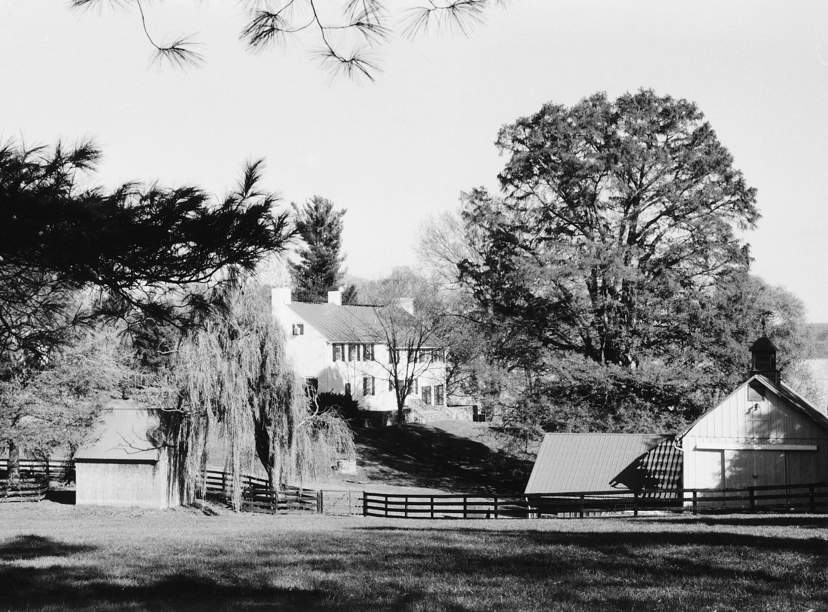
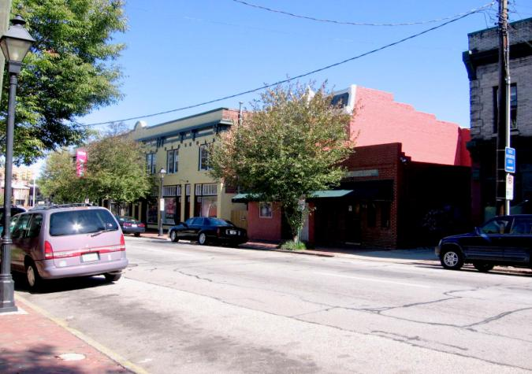
What Can be Nominated as a Historic District?
An entity that is “a significant concentration, linkage, or continuity of sites, buildings, structure, or objects united historically or aesthetically by plan or physical development” can be nominated to the National Register and VLR.
For example, districts can range from rural to urban settings:
Goose Creek Rural HD, Loudoun County
Broad Street Commercial HD, Richmond
Notes:
This definition of historic districts is, by design, a broad definition meant to encompass a great swath of historic property types, such as residential, commercial, manufacturing, maritime, military, transportation, religious, recreational, agricultural, educational, and mining properties, to name just a few.

Slide 20
In Rural Historic Districts…
Landscape is of primary importance.
Acreage is usually much larger than urban districts.
Influence of the natural environment is visible.
Number of man-made structures is relatively low by comparison.
Common types: Agricultural, Maritime, Recreational, Military (battlefields).
Notes:
Broadly speaking, historic districts in Virginia fall into two different types of settings – rural and urban (or suburban). Virginia is home to rural historic districts large and small, such as the 83,000-acre Southern Albemarle Rural Historic District in Albemarle County to the more diminutive 4,400-acre Carter’s Run Rural Historic District in Fauquier County. Scenic and/or cultural landscapes are defining features of rural historic districts; indeed, landscape qualities are often a unifying feature that provide the necessary linkages among disparate resource types to define a historic district.

Slide 21
In Urban/Suburban Historic Districts…
Resources may be more densely packed.
Open land area is reduced, so total acreage can be small (but not necessarily).
Natural environment may or may not be important.
Man-made resources will usually dominate.
Common types: Residential, Commercial, Industrial, Government, Educational
Notes:
Urban and, increasingly, suburban settings are the other typical setting for historic districts in Virginia. Such historic districts can have a concentration of a relatively homogenous type of historic resources, such as late-19^{th-}century tobacco warehouses (Shockoe Valley and Tobacco Row Historic District in Richmond), late-19th through mid-20th-century office and bank buildings (Main Street Banking Historic District in Richmond), mid-twentieth century houses (Hollin Hills Historic District in Fairfax County), or an 1860s through 1940s military installation (Fort Myer Historic District in Arlington County).
Alternatively, the historic district may encompass a broad range of historic resources that date from 50 to 250 years ago. For example, the small Boones Mill Historic District in Franklin County has resources dating from 1782 through 1964, with historic functions that include commercial, agricultural, religious, government, transportation, health care, and residential uses.

Slide 22
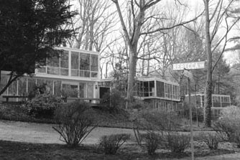
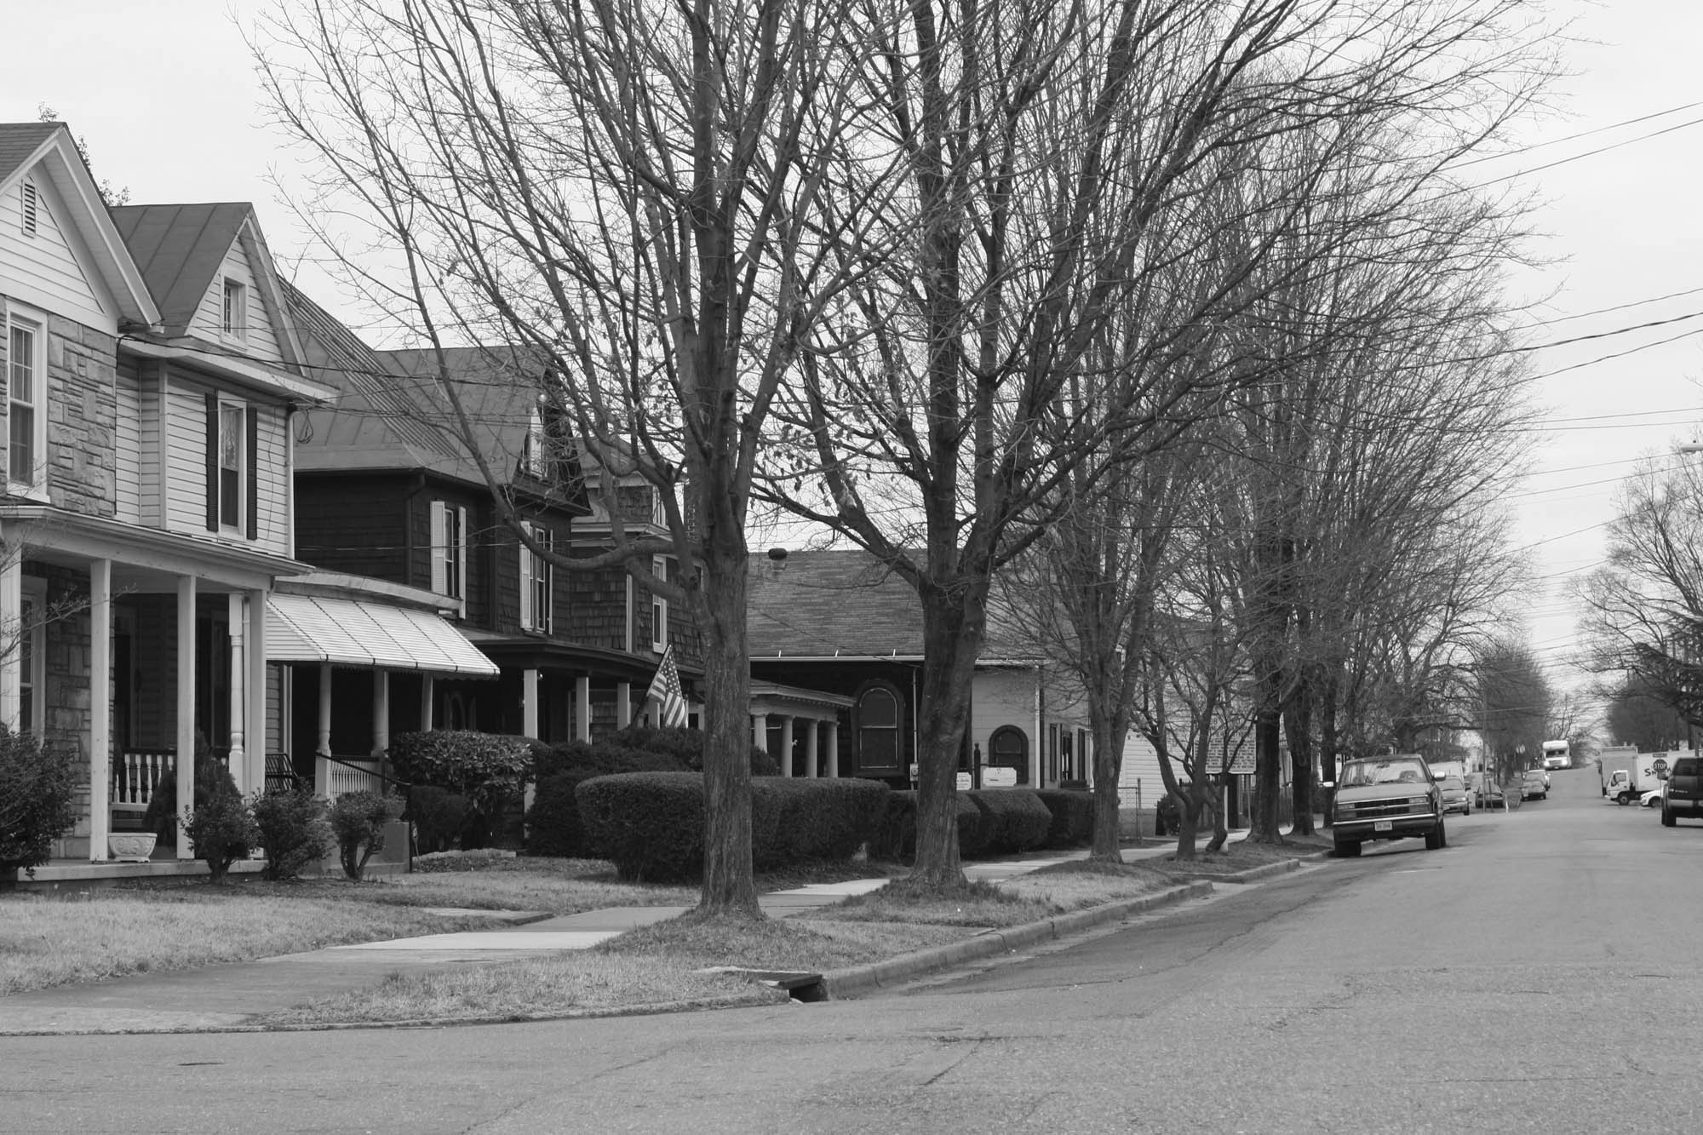
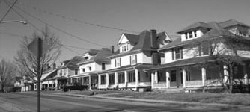
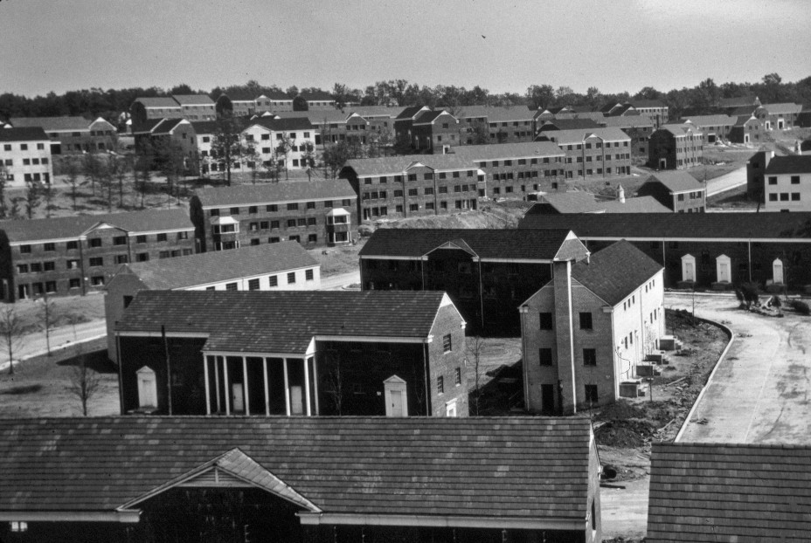
National Register and VLR Historic District Variety
Even among districts of the same general type, such as residential, great variety can be found.
Hollin Hills HD, Fairfax County
Pierce Street HD, Lynchburg
Riverland HD, Roanoke
Parkfairfax, Alexandria
Notes:
All of these historic districts are within residential neighborhoods. During the early twentieth century, the Pierce Street Historic District was a vibrant African American neighborhood and home to major cultural figures such as the poet Anne Spencer, educators Clarence William Seay and Margaret Pauline Fletcher, and aviator Chauncey Edward Spencer. Developed between 1949 and 1971, the Hollins Hills Historic District is nationally significant as the work of renowned Modern architect Charles M. Goodman. In Alexandria, Parkfairfax is an excellent representative example of rental garden apartment complexes constructed during World War II to house employees of the expanding federal government and military operations. It also was the home of two future American presidents, Richard M. Nixon and Gerald R. Ford. The Riverland Historic District was developed between 1900 and 1930 to provide housing during Roanoke’s industrial boom and it is a fine showcase of typical early twentieth century residential suburban planning and development.
These four historic districts barely scratch the surface of the immense complexity and variety of Virginia’s historic districts, which range from colonial-era plantations to nineteenth century courthouse villages to Civil War battlefields, and far beyond. For countless hours of research, links to the nominations for all of DHR’s listed properties are available at http://www.dhr.virginia.gov/registers/register_counties_cities.htm.

Slide 23
What Resources Make Up a
Historic District?
Resources within historic districts may consist of buildings, sites, structures, and/or objects.
Resources are either contributing or non-contributing to the historic district.
Streets, landscaping, vegetation, paths, walkways, piers, open spaces, vacant lots, and other features are generally considered part of the district’s setting.
Notes:
When preparing a National Register historic district nomination, a complete inventory of the contributing and non-contributing resources within the historic district is compiled. Other features, such as streets, piers, and open spaces, are included in the narrative description of the district. When examined collectively the resources within the historic district should demonstrate clear spatial, architectural, historic, and/or functional linkages, thus making the district a distinguishable entity.

Slide 24
What does “Contributing” mean?
A resource contributes to the historic character of the district because:
It was present during the time when the district gained its significance (period of significance)
It relates to the significant historic themes of the district
It retains historic integrity from the period of significance (physically still appears as a historic building)
Notes:
Resources that are contributing to a historic district are listed in the National Register and VLR the same way as an individually nominated property is listed. An individually listed property is not listed at a “higher level” than a contributing resource. Contributing resources in historic districts and individually listed properties have the same honorary designation and are eligible for the same programs, such as historic tax credits and easements.

Slide 25
What does “Non-contributing” mean?
The resource does not add to the historic character of the district because:
It was built outside the district’s period of significance (after or before).
It does not relate to the historic theme(s) of the district.
Due to alterations, changes, or additions, it no longer retains historic integrity (no longer conveys its historic associations).
Notes:
Resources that are categorized as non-contributing to a historic district are not listed in the National Register or VLR. This does not necessarily mean that they are not eligible for the National Register in their own right, but only that they do not have the same historic associations to contribute to the historic district being nominated. A resource that is non-contributing to a historic district may still be individually eligible for listing in the National Register and VLR. One example is the Seaboard Air Line Railway Building in Norfolk, which was individually listed in the Registers in 2012-2013 but is a non-contributing resource to the West Freemason Historic District because it postdates that district’s period of significance.
Resources that are non-contributing to historic districts and that are not individually listed in the National Register or VLR are not eligible for the tax credit and easement programs that DHR administers, nor to any of the other benefits accrued to Register-listed properties.

Slide 26
How are Historic District Boundaries Chosen?
Historic district boundaries may be based on one or a combination of factors, the most typical including:
Physical, natural boundaries: rivers, lakes, hills, valleys, etc.
Man-made features: roads, highways, etc.
Political boundaries: corporation lines, wards, etc.
Age of buildings.
Architectural style.
Associations with historical events or persons.
Integrity—how much has been lost to demolition or incompatible development?
Cultural relationships (particularly archaeological districts).
Notes:
Historic district boundaries are drawn to encompass, but not to exceed, the full extent of the significant resources and land area making up the district. “Buffer zones” are not permitted, nor is acreage that does not contribute directly to the district’s significance. Peripheral areas that lack integrity also are excluded from historic district boundaries. However, “donut holes” within the district are not allowed. A resource that lacks integrity that is located in the center of a historic district will not be excluded from the district by drawing a boundary around it; instead, it will be categorized as a non-contributing resource.
National Register and VLR regulations do not include an “opt-in” or “opt-out” provision that would allow individual property owners to choose whether they want their property included in a historic district boundary. For more information on property owners’ participation in historic district designations, please refer to the following documents, all of which are on DHR’s website: Notification and Public Participation Processes for National Register Nominations; Key Points about the National and State Register Process for Property Owners; and Property Owners’ Frequently Asked Questions about the National Register of Historic Places and the Virginia Landmarks Register.

Slide 27
What is DHR’s role in Nominating National Register and VLR
Historic Districts?
Residents/locality works with DHR to achieve designation and technical assistance afterward.
DHR reviews and processes nomination, and notifies all owners and adjacent owners of the nomination.
Board of Historic Resources reviews nomination and places it in the VLR; State Review Board reviews nomination and recommends it to be sent to the National Park Service to inclusion in the NRHP.
If more than half of owners object, nomination does not go forward.
Notes:
For historic properties in Virginia, DHR administers the VLR on behalf of the Commonwealth and the National Register on behalf of the National Park Service. DHR staff serve as the first point of contact for property owners, scholars, historic organizations, local governments, and volunteers who seek Register listing for a historic district. DHR has four regional offices across Virginia to facilitate our ability to offer technical assistance. The Capital Region Preservation Office is located in Richmond, the Northern Region office in Stephens City, the Tidewater Region office in Newport News, and the Western Region office in Salem.
DHR’s regional staff and Register program staff conduct the tasks necessary to complete the nomination process. We provide guidance to nomination authors during the research, survey, and preparation phases of their project, then review and process all nominations that we receive. We complete notification of proposed nominations to property owners within the proposed district and to owners of property adjacent to the district. For historic district nominations, DHR staff host and conduct public hearings to seek public input about the nomination and answer questions from property owners. DHR forwards nominations to the Board of Historic Resources, which lists properties in the Virginia Landmarks Register, and to the State Review Board, which recommends forwarding nominations to the National Park Service for inclusion in the National Register. DHR also is the primary point of contact for property owners within the historic district who wish to comment on the nomination, including opposing the nomination. If more than half of private property owners within the nominated district object to listing prior to the Boards’ joint meeting, the nomination will not proceed to the Board of Historic Resources and State Review Board.

Slide 28
What Can You Do with a
National Register/VLR
Historic District?
Economic Opportunities: tax credits, easements
Heritage Tourism: area pamphlet, walking tour, interpretive trails, website, business owners’ associations, Main Street program, etc.
Smart Growth/Community Identity: local incentives/assistance, local preservation districts, technical assistance available from DHR, encourages responsible growth decisions
Notes:
The primary purpose of listing a historic district in the VLR and National Register is to honor the district’s historic significance. Since the Registers were created in 1966, state and federal government officials have created two programs that offer property owners incentives to preserve their historic property. Federal and state rehabilitation tax credits are available to property owners who seek to offset some of the costs associated with rehabilitating their property. Both programs are administered by DHR. Additional information is at http://www.dhr.virginia.gov/tax_credits/tax_credit.htm. Through DHR’s easement program, a private owner has the opportunity to guarantee the perpetual protection of an important historic resource without giving up ownership, use, or enjoyment of the property. While the landmark remains in private hands and on the tax rolls, its existence and sympathetic treatment are secured for the benefit of future generations. Additional information about easements is at http://www.dhr.virginia.gov/easement/easement.htm.
Virginia is an internationally known destination for tourists who are interested in American history. Some of our most famous historic sites are Jamestown and Colonial Williamsburg, but communities across the Commonwealth have capitalized on their unique heritage to engage with visitors and encourage economic development. Heritage tourism programs can run the gamut from something as simple as a walking tour of a downtown business district to partnerships among business owners, Chamber of Commerce chapters, and local government to attract new growth by redeveloping historic areas. The Main Street program ranks among the most successful preservation-based, economic development programs. More information is available at http://www.dhcd.virginia.gov/index.php/community-partnerships-dhcd/downtown-revitalization/virginia-main-street.html.
Finally, local government leaders can choose to include historic preservation in their planning, economic development, and community building programs by establishing historic tax abatements and local preservation districts to encourage reuse of historic buildings and by incorporating historic preservation into comprehensive planning and zoning decisions.

Slide 29
What is the Impact of a Historic District Designation on Property Values?
Local property values can be influenced by numerous factors, ranging from employment rates and economic activity to consequences of natural disasters. Historic district designation has not been found to influence property values in either a positive or negative way.
A 1992 General Assembly study found that historic designation had no discernible pattern of negative effect on property value
  Property assessments usually follow the market; not dictate to it
  Values within historic districts rose in general accord with other properties
  Any effect of a district designation is usually indirect and partial: historic district properties are often maintained better by concerned owners, therefore property values may go up, therefore taxes may increase —but there is no causal relationship
Notes:
Subsequent to the 1992 study by the General Assembly, other analyses have been conducted to ascertain if historic district designation in and of itself affects property values. Studies to date have included that there is not a causal relationship, meaning that district designation will not inevitably lead either to an increase or a decrease in property values. District designation is but one of many factors that may be used in establishing local property values. For example, see a 1994 article in CRM at http://www.placeeconomics.com/pub/placeeconomicspub1994.pdf and a 2002 follow-up article, http://www.placeeconomics.com/pub/placeeconomicspub2002.pdf. Note that National Register/VLR districts and local districts are compared for their potential impact on property values; please remember that local district designation is a completely different process from National Register/VLR district designation.
Although historic district designation alone may not affect property values, there are programs available to owners of historic properties that can have an economic impact. Foremost among these are the aforementioned state and federal rehabilitation tax credit programs. Since the creation of the state tax credit program in 1997, the two programs have combined to contribute an estimated $3.9 billion to Virginia’s economy. Those rehabilitation expenses and their domino effect have also created more than 31,000 full and part-time jobs during a 17-year period and generated an estimated $133 million in state and local tax revenues. The full report is available for download at http://www.dhr.virginia.gov/pdf_files/VCU_Historic%20Tax%20Credit%20Report_FINAL_21-1-2014.pdf .

Slide 30
Will National Register/VLR Listing Automatically Lead to a Local Historic District Designation?
National Register/VLR historic districts are designated under a different process for local historic districts. One does not necessarily lead to the other.
Nearly 500 VLR/NR districts have been listed in Virginia.
70-80 local districts have been designated.
Different criteria are used for designating local districts.
Though they can coincide, there is no requirement that local and VLR/NRHP district boundaries match exactly.
Notes:
As mentioned earlier, whether to designate a local historic district is a decision made by the local government. DHR does not play a role in local historic district designations. Some local governments may explore local designation if a historic district within their jurisdiction is listed in the National Register and/or VLR, but they are not required to do so. Local district designation remains comparatively rare in Virginia. There are almost 500 historic districts listed in the VLR and National Register, while there are only about 70 to 80 districts that have been designated by a local government.
Because a local district designation serves an entirely different purpose from a National Register/VLR district, there is no requirement that boundaries of a local historic district match those of a National Register/VLR-listed district. The criteria for designating the local historic district does not even have to be based on the VLR or National Register criteria. A property owner may be in favor of a National Register/VLR historic district, but they are not then obligated to support a local district designation as well. Similarly, a property owner within a locally designated historic district may not be in favor of a National Register/VLR designation.

Slide 31
National Park Service Bulletins
The National Park Service has published numerous bulletins to assist researchers and writers with preparing nominations. Following are those most likely to aid with nominating a historic district.
How to Apply the National Register Criteria for Evaluation
How to Complete the National Register Registration Form
Historic Residential Suburbs: Guidelines for Evaluation and Documentation for the National Register of Historic Places
Guidelines for Evaluating and Registering Archaeological Properties
Guidelines for Identifying, Evaluating, and Registering America’s Historic Battlefields
How to Evaluate and Nominate Designed Historic Landscapes
Guidelines for Evaluating and Documenting Rural Historic Landscapes
The full text of these bulletins is available online at http://www.nps.gov/nr/publications/index.htm.

Slide 32
Additional Sources of Information
DHR – Central and Regional Offices:
www.dhr.virginia.gov
National Park Service, National Register of Historic Places:
http://www.nps.gov/history/nr/

