Slide 1

Wythe County
Architectural Survey

Slide 2
Why?
Though sporadic studies have occurred, coverage has been geographically erratic and the level of documentation inconsistent. The …survey is intended to remediate major deficiencies in county-wide survey coverage.

Slide 3
Why?
Data collected from the survey will be used for recognition and protection of important properties in short and long range land use planning, to encourage preservation easements and land conservation, and to help inform the public and serve as an educational tool. The project will support the county's heritage tourism and economic development programs, and will facilitate federally mandated environmental review projects.

Slide 4
Survey History
1938 with the WPA-sponsored Virginia Historical Inventory project, (small number of properties were documented at a cursory level)
Historic American Building Survey and Inventory [HABS] in 1958 and 1967.
Documentation of a few major properties was carried out by the Virginia Landmarks Commission in the late 1960s and early 1970s.

Slide 5
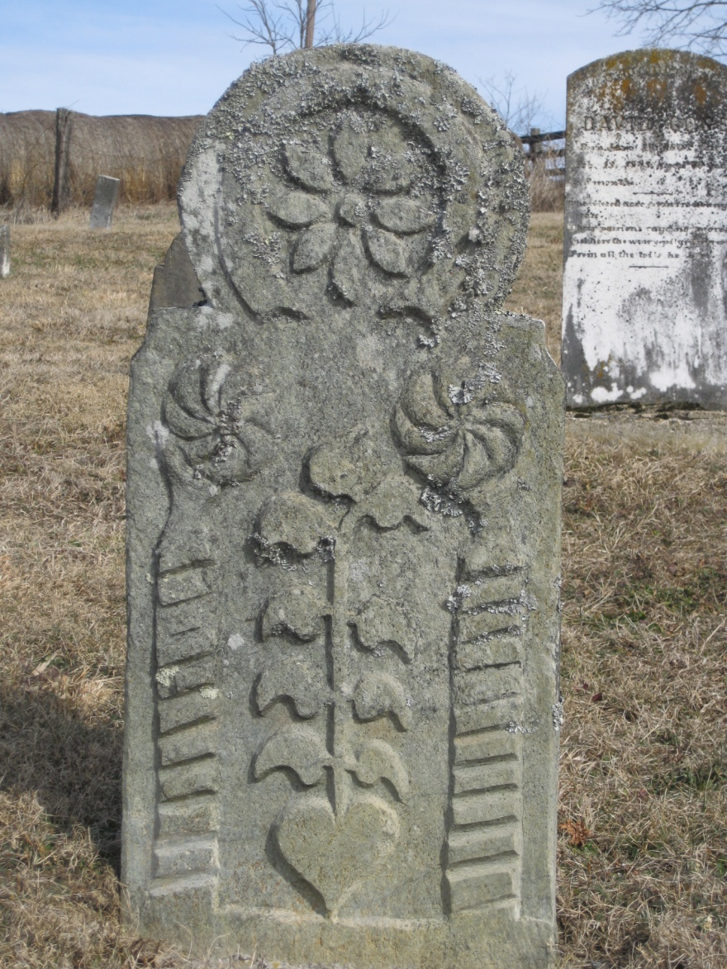
Zion Lutheran Church surveyed in 1979

Slide 6
Survey History
From the 1960s through the 1990s, only seven individual architectural properties in the county were listed on the National Register, although a large portion of the town of Wytheville was listed as a National Register Historic District in 1994.
Wytheville and the village of Foster Falls are the only listed historic districts in the county.

Slide 7
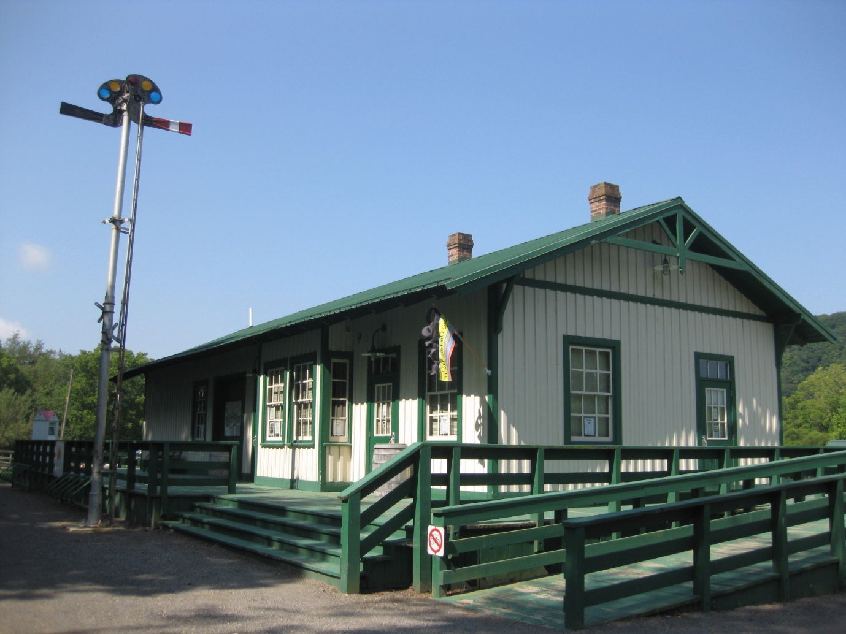

Slide 8
Survey History
With the exception of sporadic Section 106 CRM work in limited areas of the county, no other historic architectural surveys were conducted in Wythe County between 1994 and 2004.
From 2004 to 2011, 43 individual properties have been surveyed by the WRPO.

Slide 9
Previous Survey Status
DHR archives database holds 413 architectural records for Wythe County (outside of Wytheville). Of those, 327 represent primary resources built before 1941; 176 built before 1901, and only 134 built before 1891. It is not known how many of the documented resources are currently extant.

Slide 10
Scope of Work
The project will consist of completion of a countywide architectural survey, chiefly identifying properties dating from circa 1940 and earlier, and in some cases re-surveying significant, previously documented properties with augmentation of existing files held by DHR; but avoiding resources that have been documented with DHR since circa 1990.

Slide 11
Survey Extent
The number of properties surveyed in the course of this project will be no less than 375; 355 of which must be surveyed at the reconnaissance level and 20 at the intensive level.

Slide 12
Survey Priorities
previously undocumented significant structures dating to the 18th and 19th centuries,
buildings and sites of special significance from the first half of the 20th century,
identification of any potentially eligible historic districts
imperiled resources or those threatened by planned development.

Slide 13
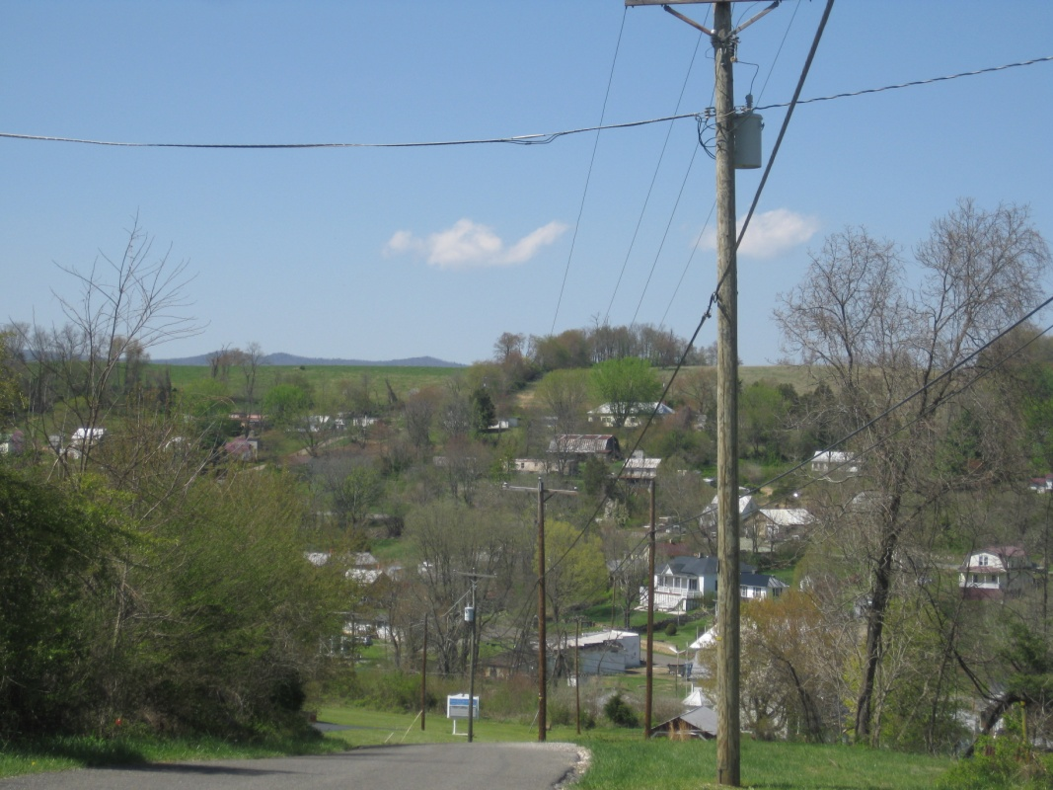
Town of Ivanhoe

Slide 14
Reconnaissance Survey
Exterior Photographs
Mapping
Sketch Site Plan
Architectural Description (Exterior)
Data Entry into database
Statement of Significance

Slide 15
Intensive Survey
Reconnaissance Level Survey
Interior Photographs
Sketch Floor Plan
Expanded Statement of Significance

Slide 16
Findings and Results

Slide 17
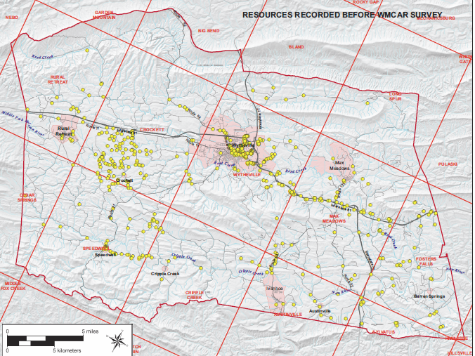

Slide 18
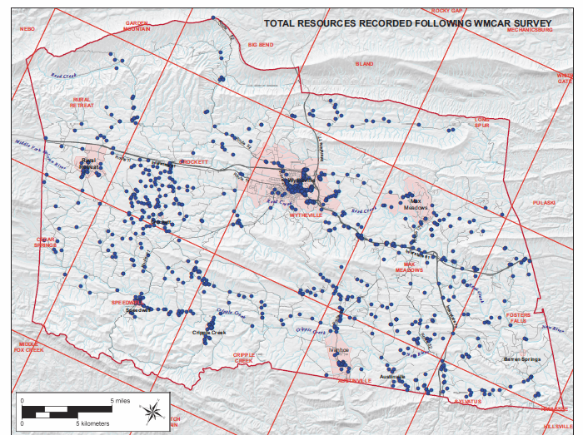

Slide 19
Survey Themes
Domestic
Subsistence/Agriculture
Government/Law/Political
Health Care/Medicine
Education
Military/Defense
Religion
Social
Recreation/Arts

Slide 20
Survey Themes
Transportation/Communication
Commerce/Trade
Industry/Processing/Extraction
Landscape
Funerary
Ethnicity/Immigration
Settlement Patterns
Architecture/Landscape Architecture/Community Planning
Technology/Engineering

Slide 21
Domestic
278 of the resources were classified as domestic
232 were domestic and 46 were domestic and subsistence/agriculture

Slide 22
Domestic
All time periods in the survey represented
Colonial Revival, Craftsman, Federal, Greek Revival, Italianate, Tudor Revival, Vernacular and Victorian
Mostly single family
Included log houses, I houses and tenant houses

Slide 23
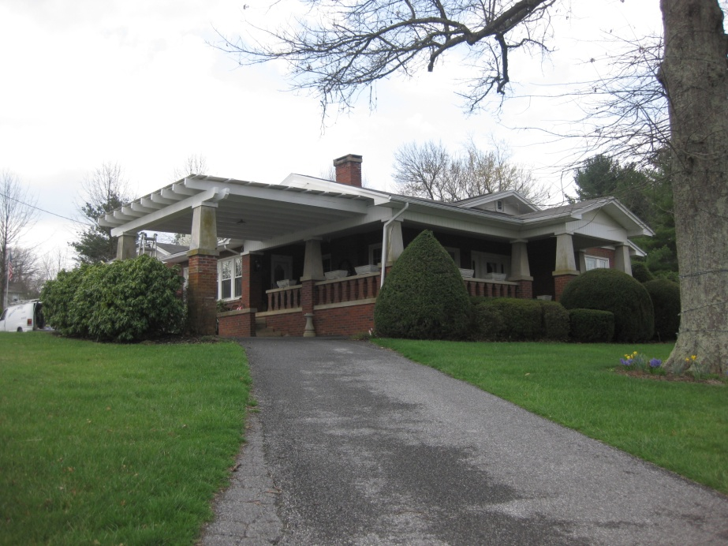
Colonial Revival
Farm, Cripple Creek Road
Craftsman
House, 223 Parsonage Avenue

Slide 24
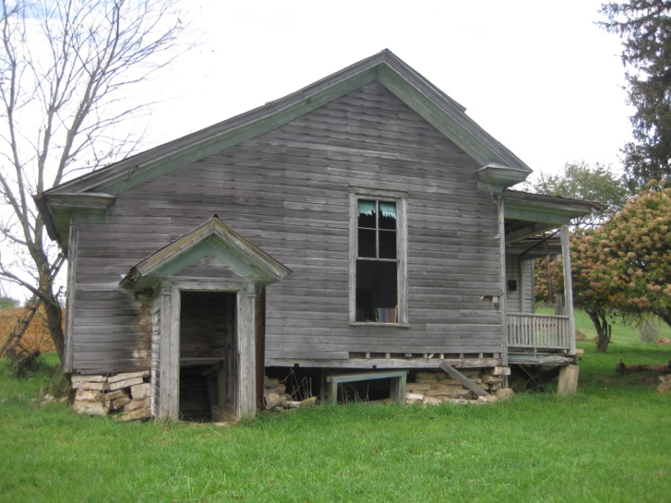
Federal 468 Ward Branch Road
Greek Revival,
House Crocketts Cove Road

Slide 25
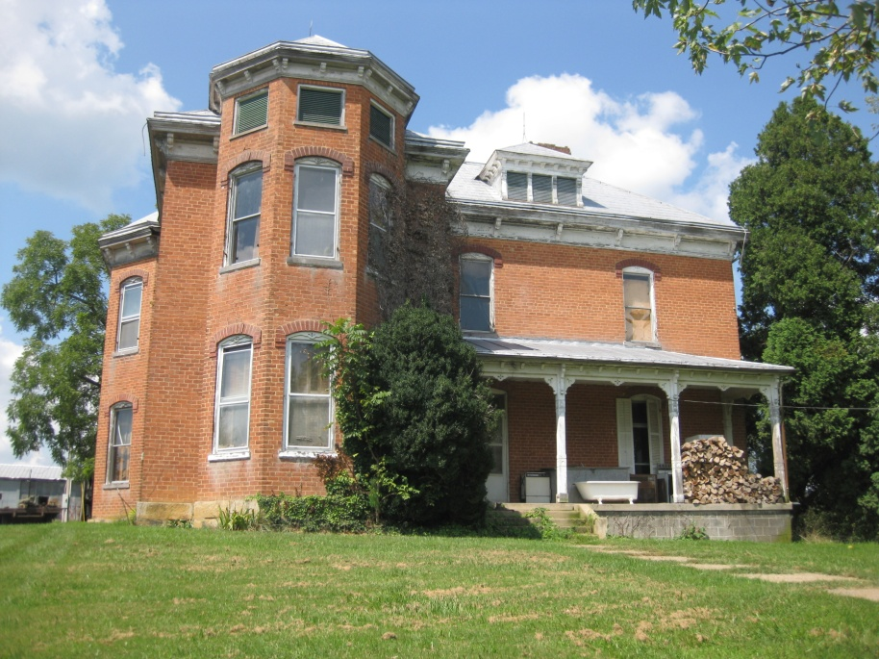
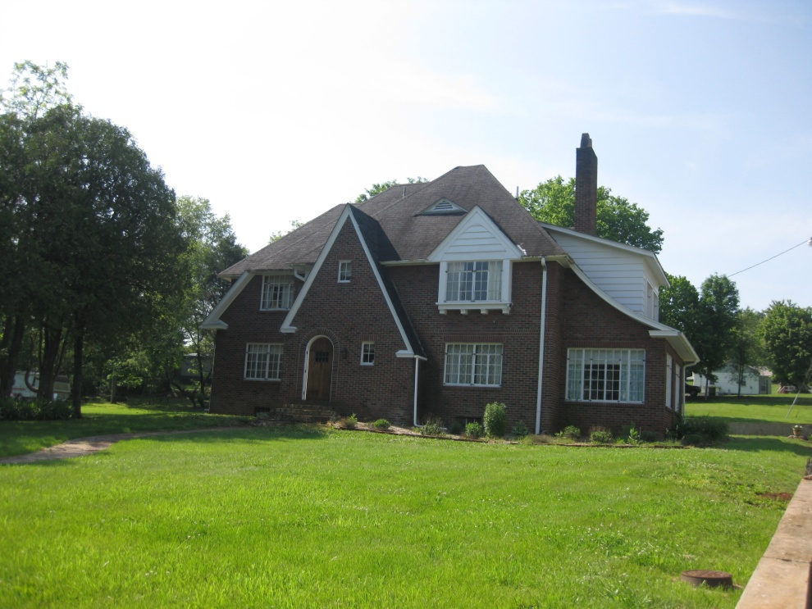
Italianate
6464 Peppers Ferry Road
Tudor Revival
108 Riverview Road

Slide 26
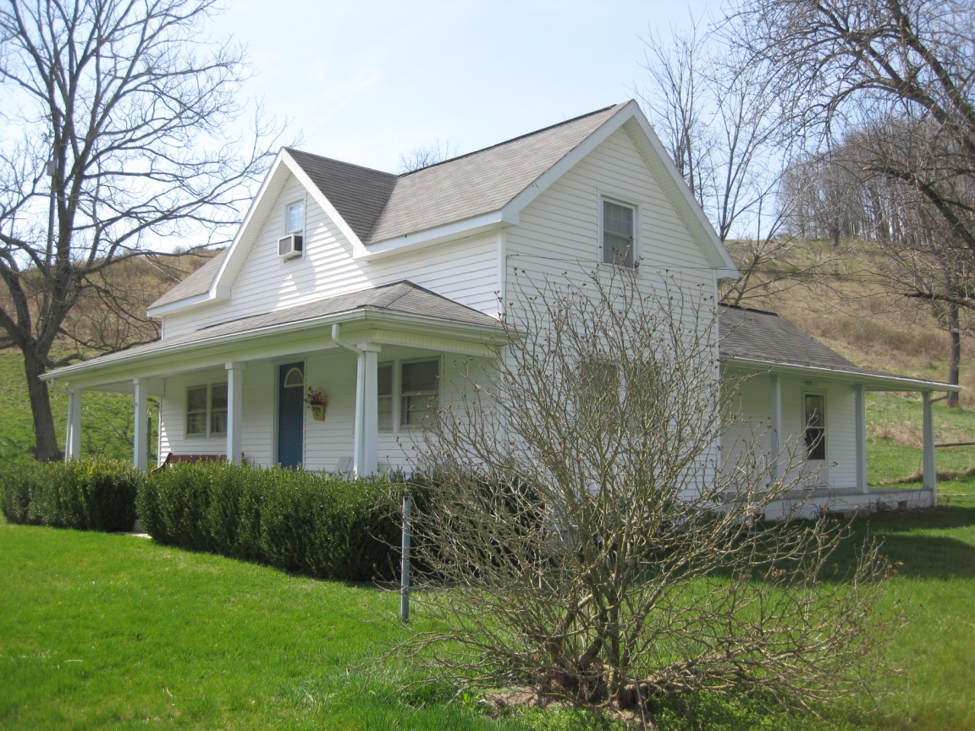
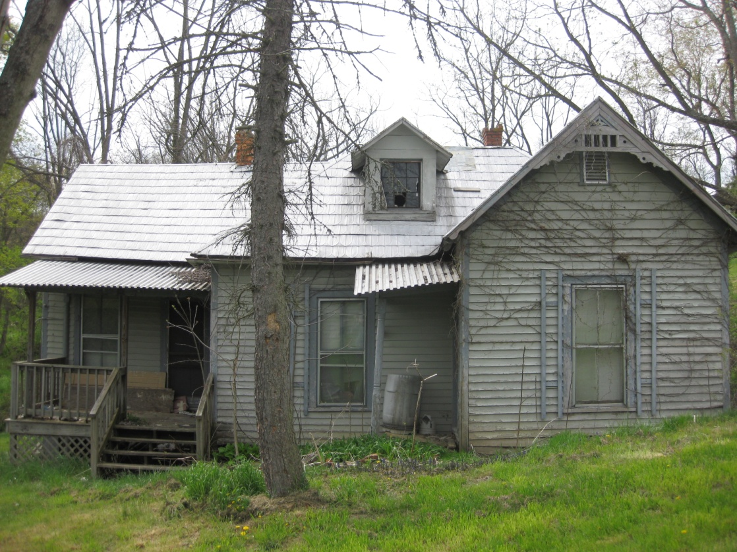
Vernacular
175 Crawfish Road
Folk Victorian
149 Hoke Street

Slide 27
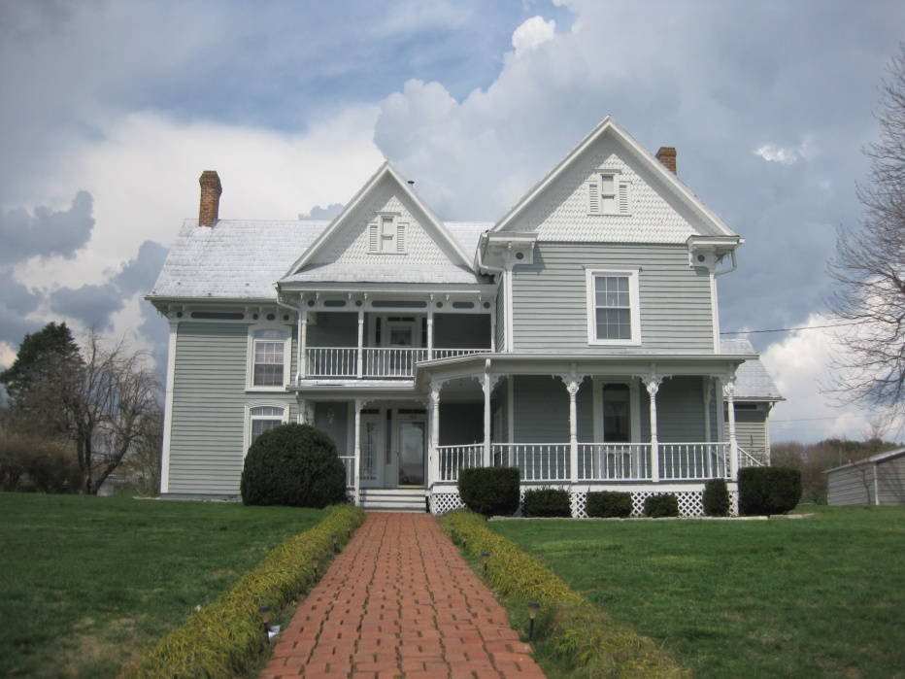
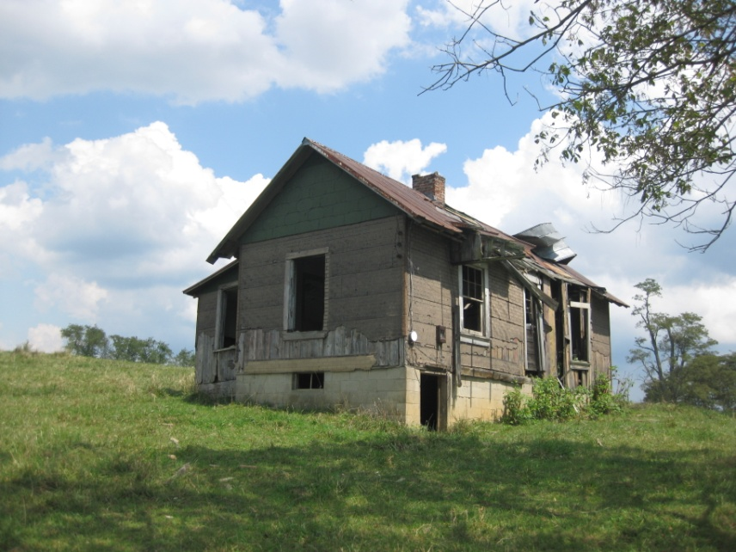
Queen Anne
100 Delp Avenue
Tenant house
Peppers Ferry Rd

Slide 28
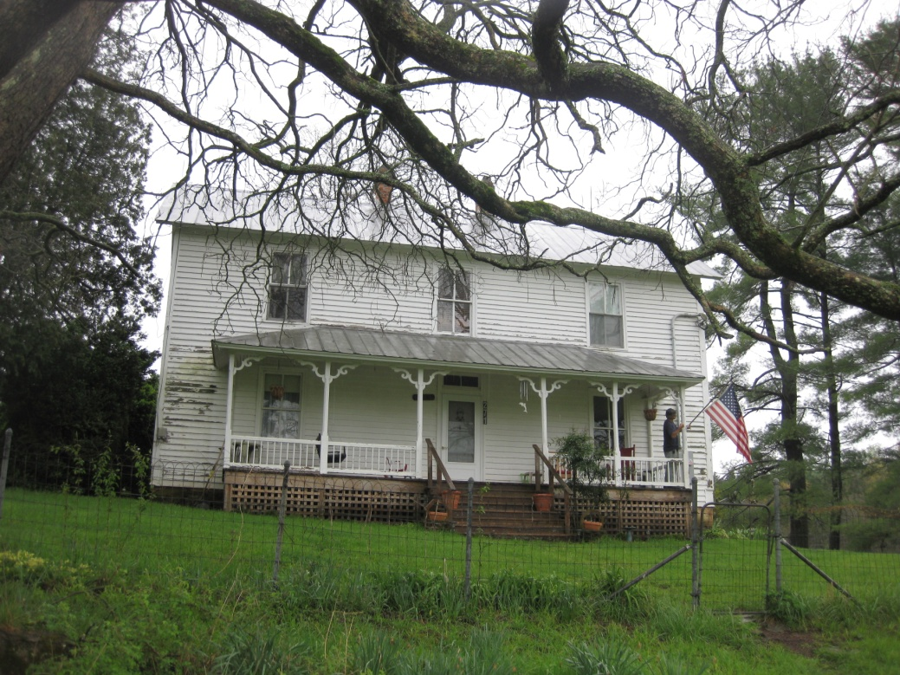
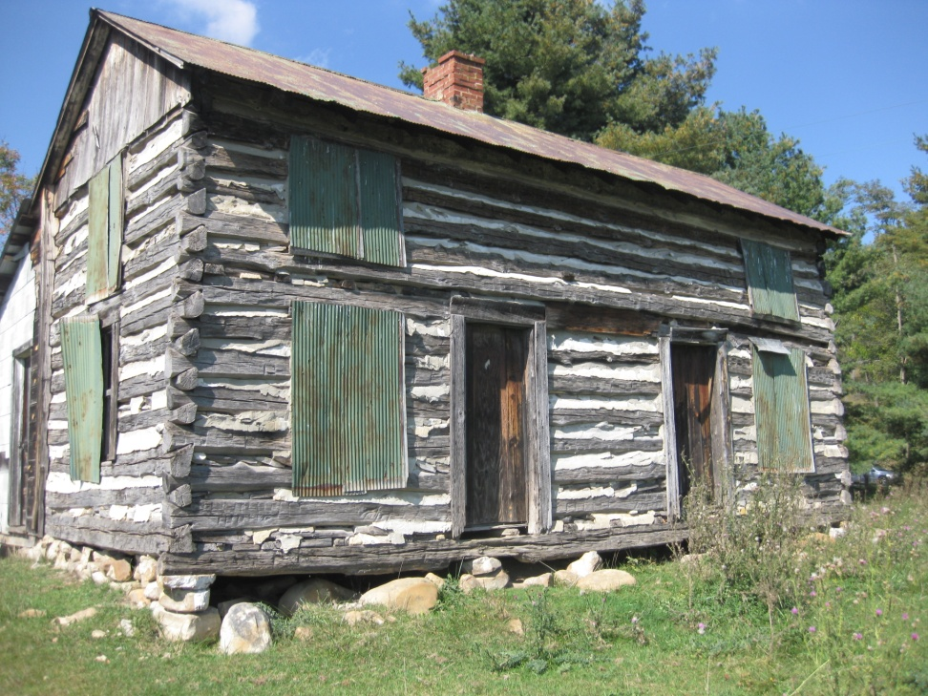
I-house
271 Peridot Lane
Log House
Felts Lane

Slide 29
Subsistence/Agriculture
58 resources total
44 cross referenced with domestic
2 with Industry/Process/Extraction (furnaces)

Slide 30
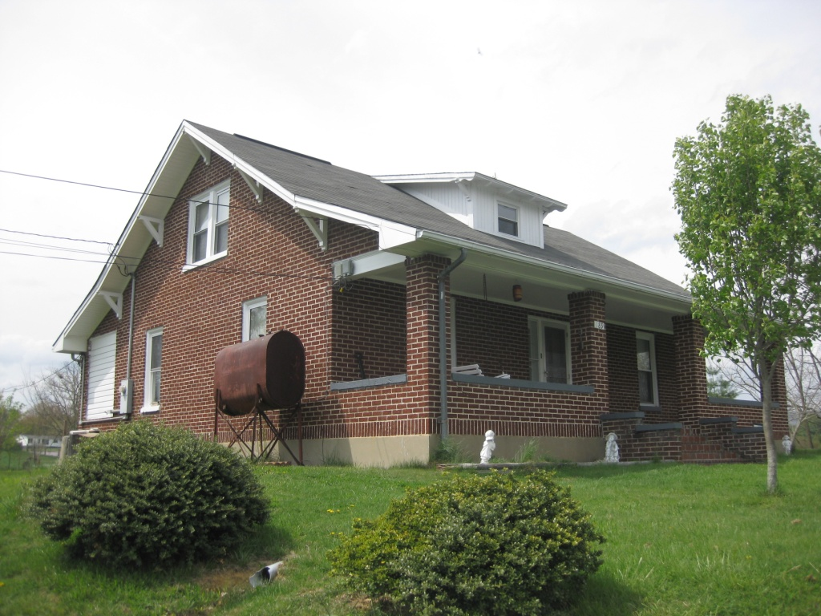
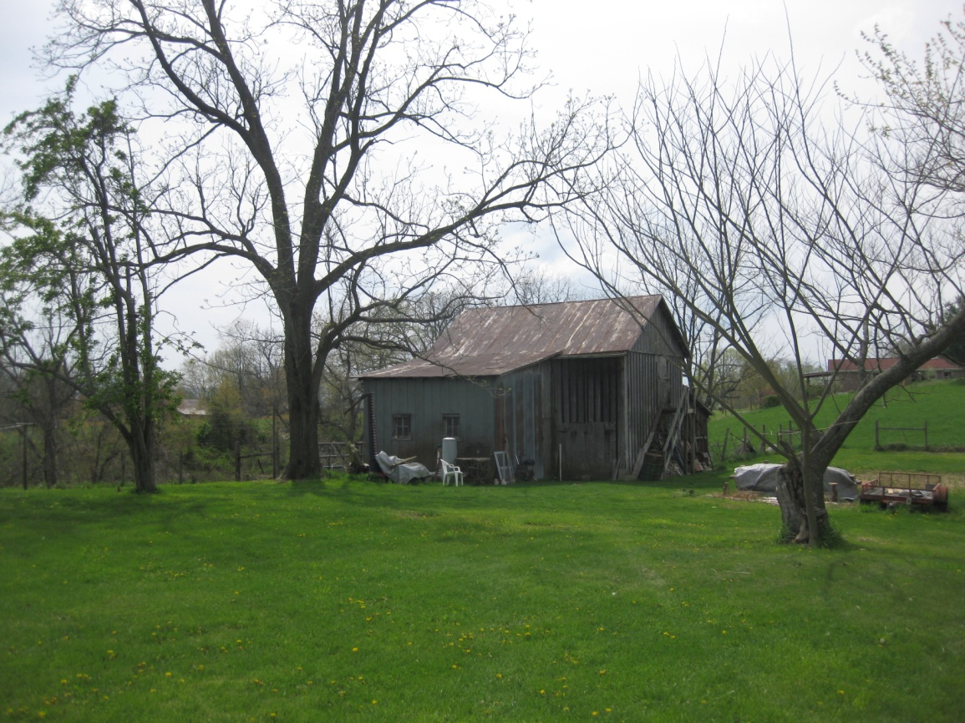
House, 189 Virginia Ave

Slide 31
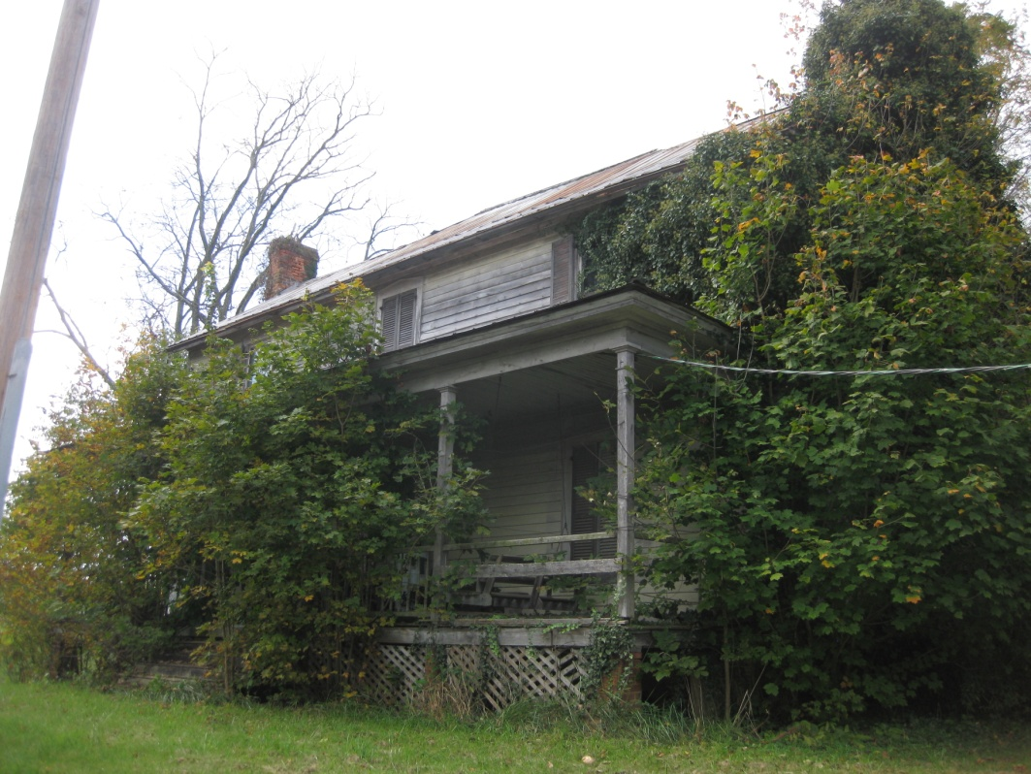
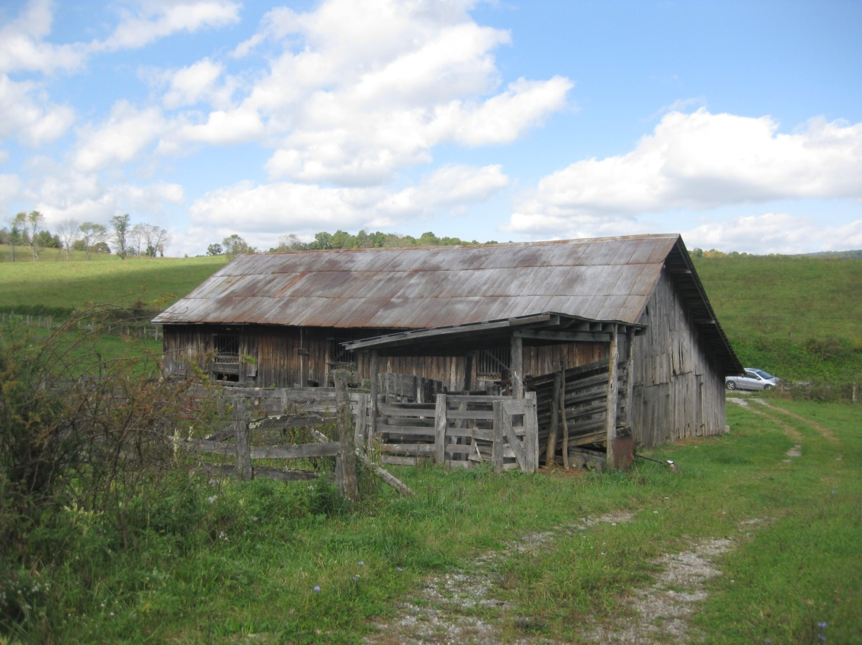
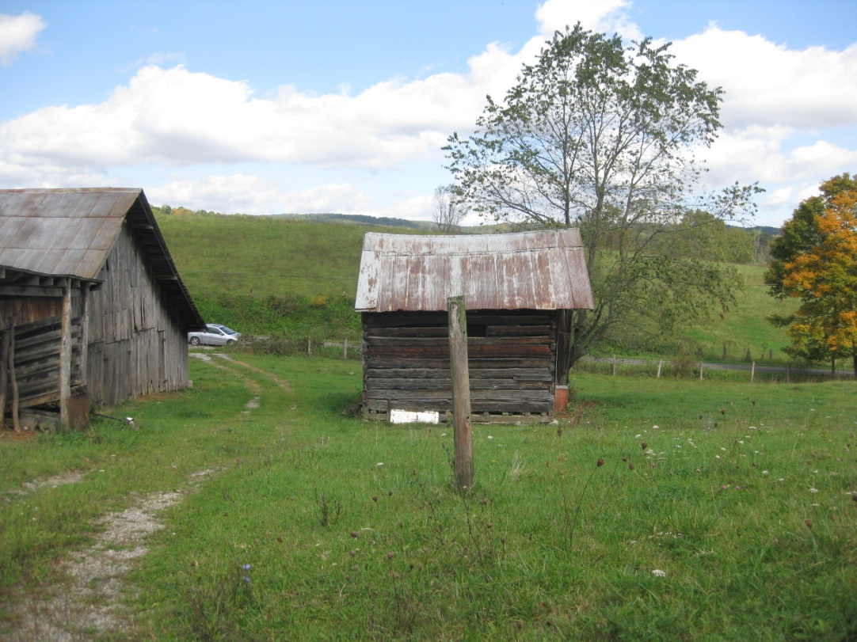
House Peppers Ferry Road

Slide 32
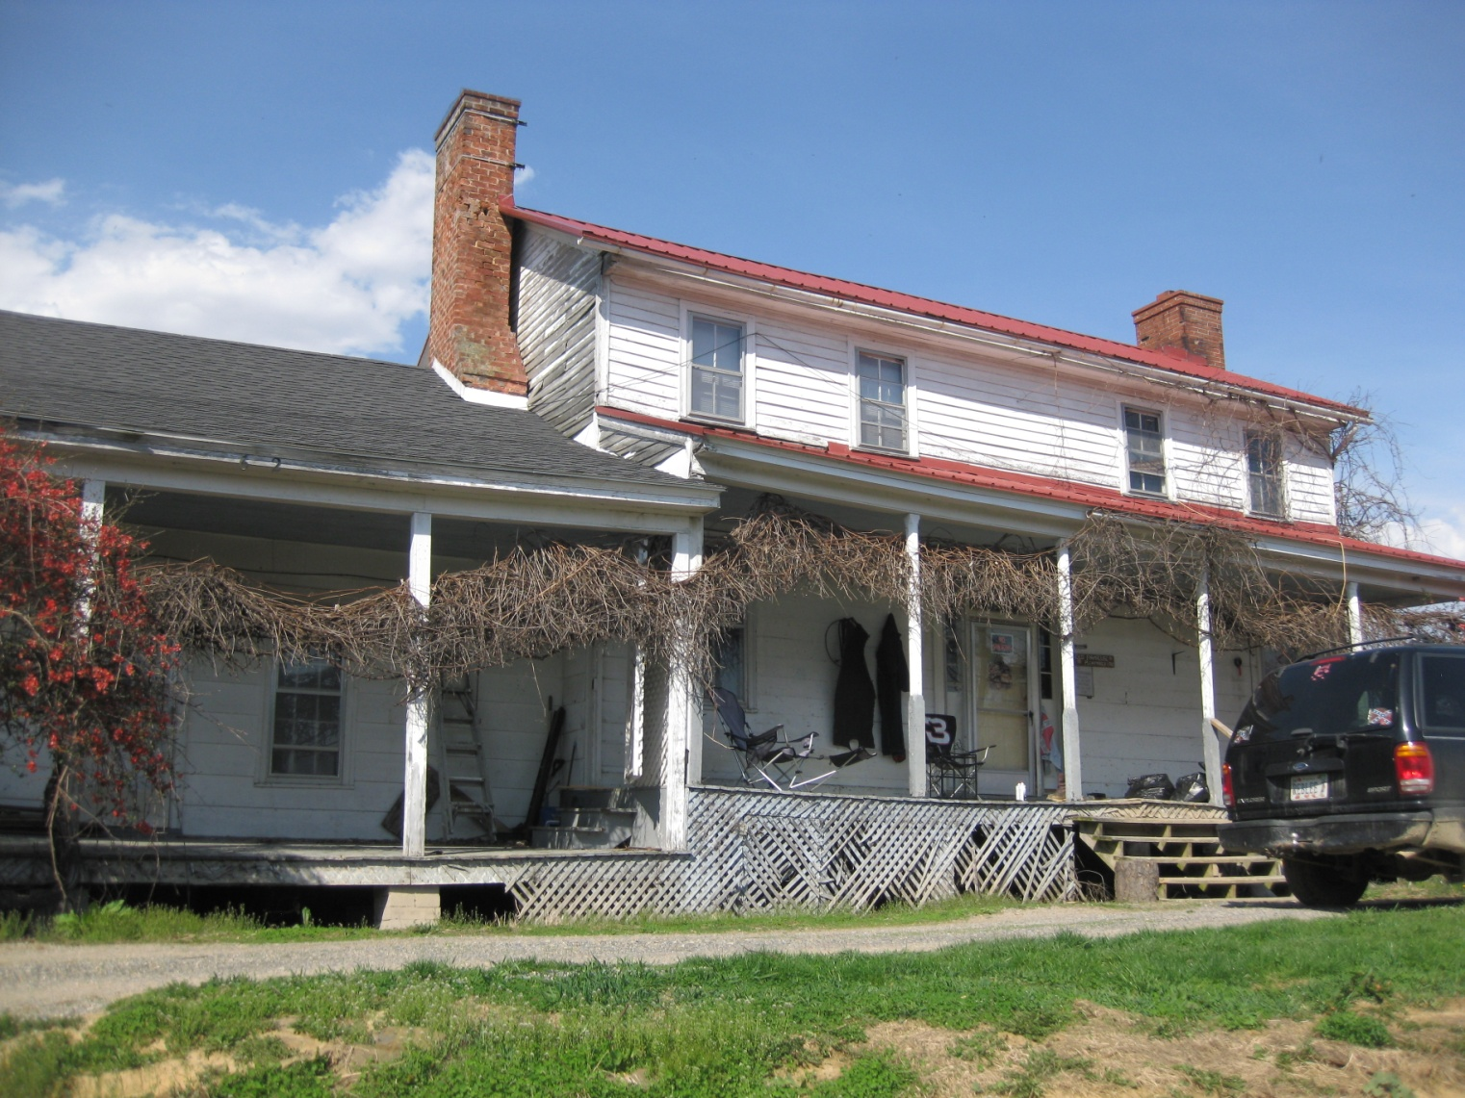
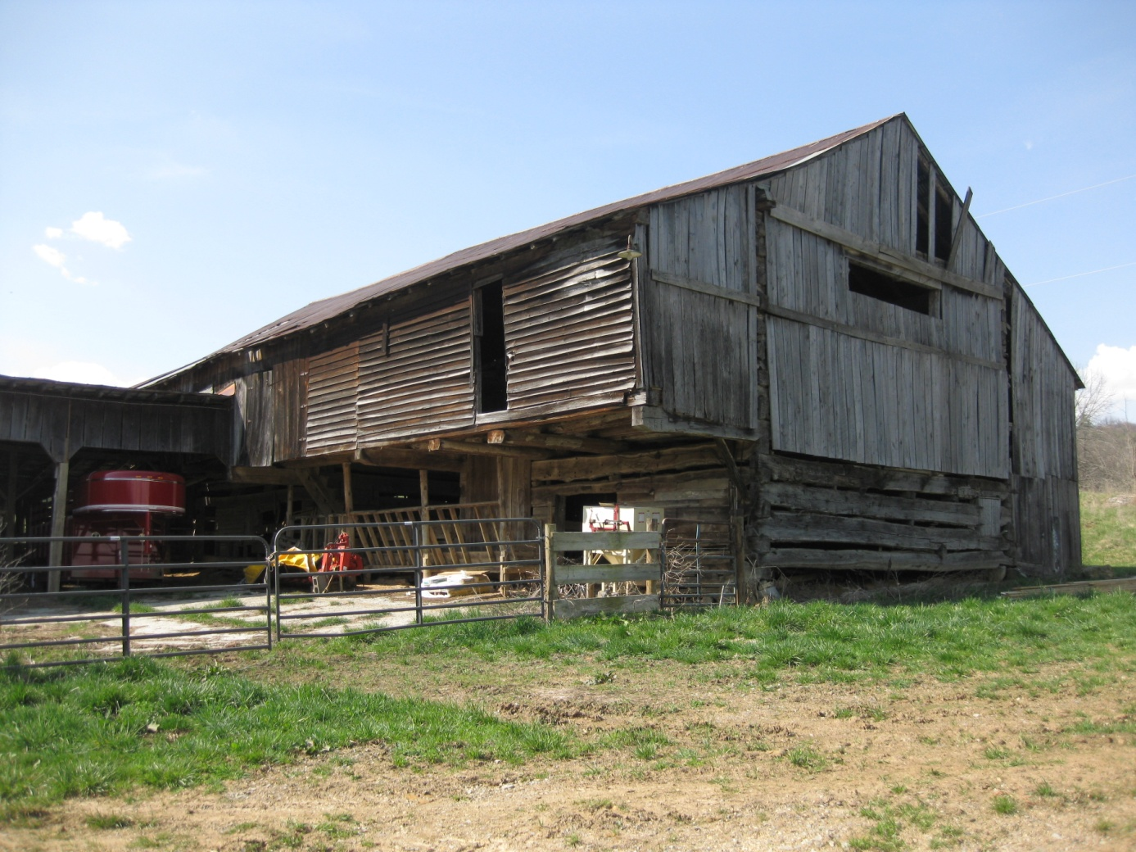
Fracture Creek Farm

Slide 33
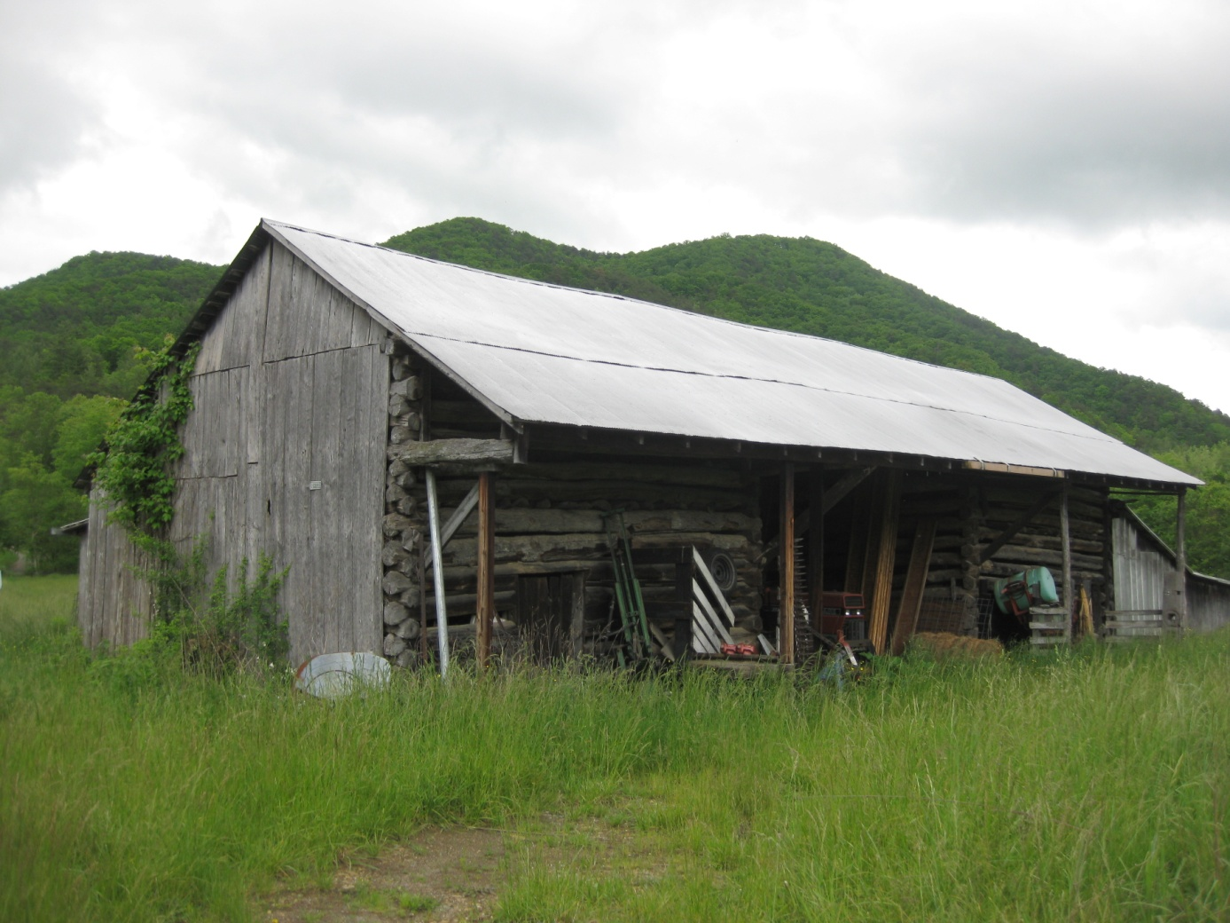
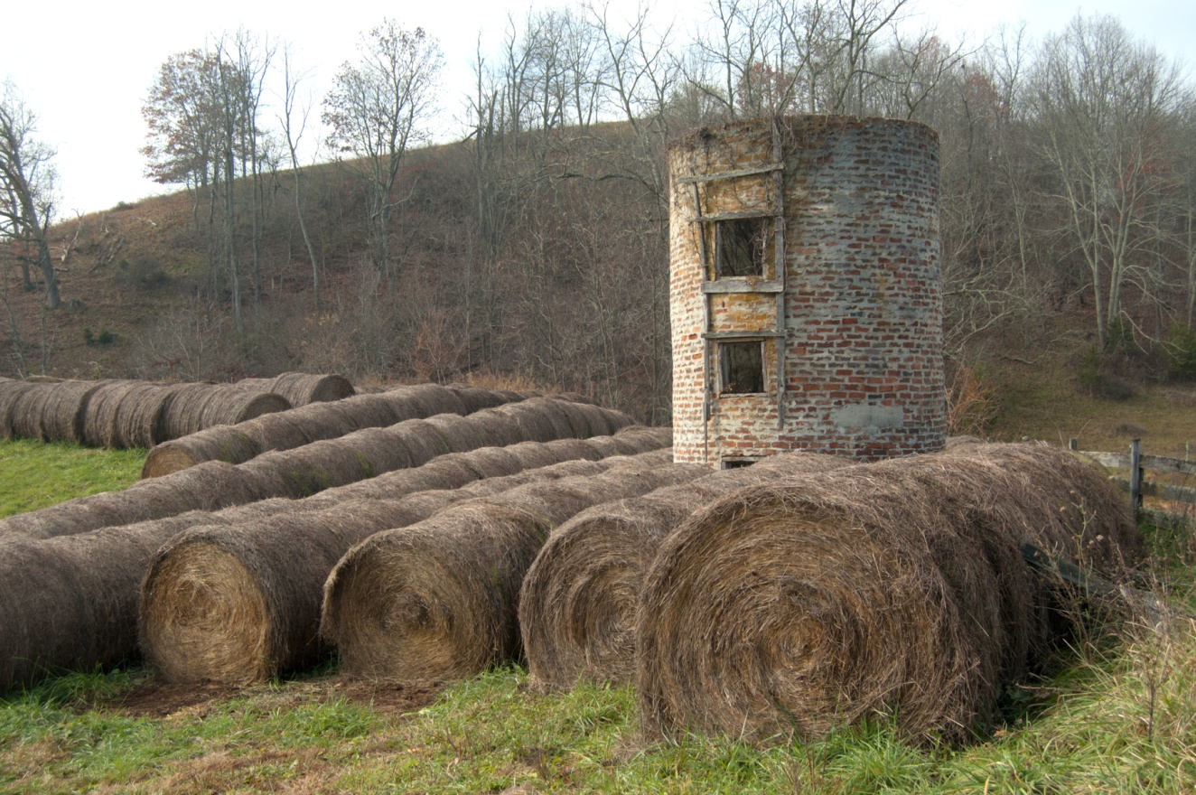
Barn Stony Fork Road
Silo Kiser Road

Slide 34
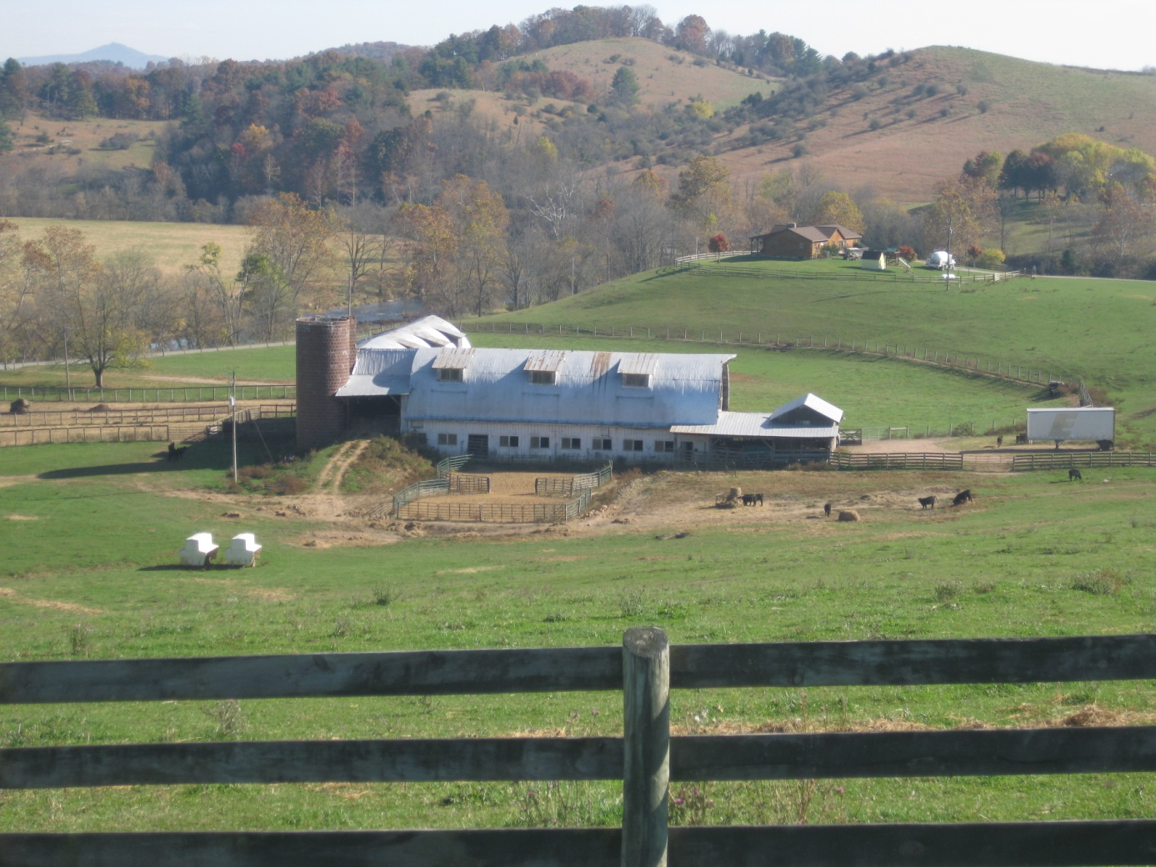
Dairy Barn, Red Hollow Rd

Slide 35
Commerce/Trade
25 were classified as commerce/trade
Stores, commercial buildings, hotel, blacksmith shop

Slide 36
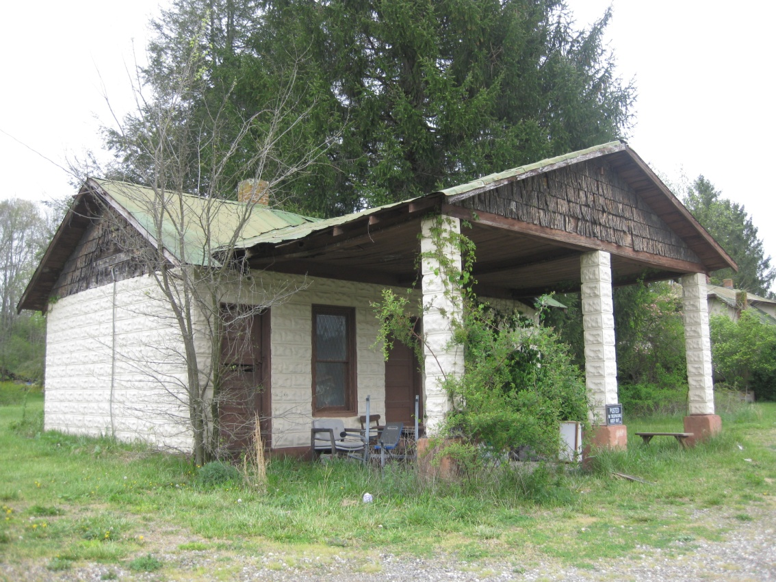
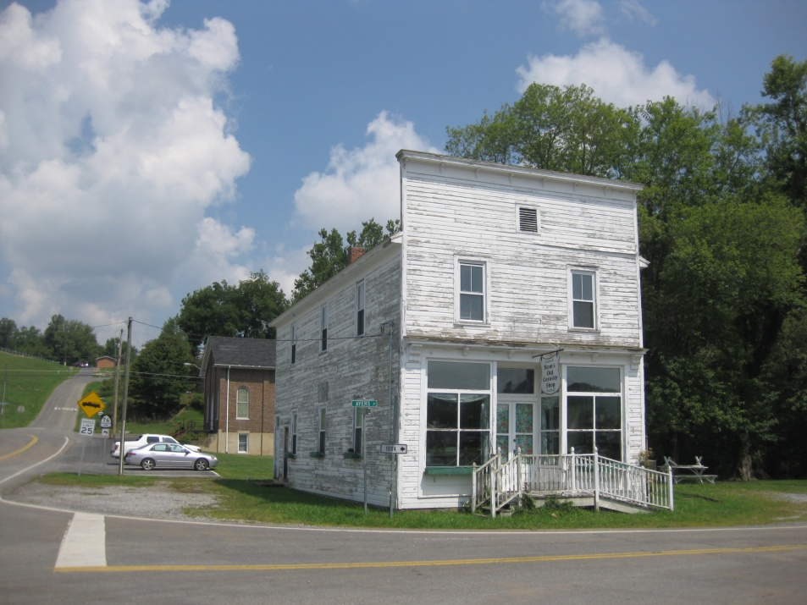
Store Austinville Rd
Mom’s Old Curiosity Shop

Slide 37
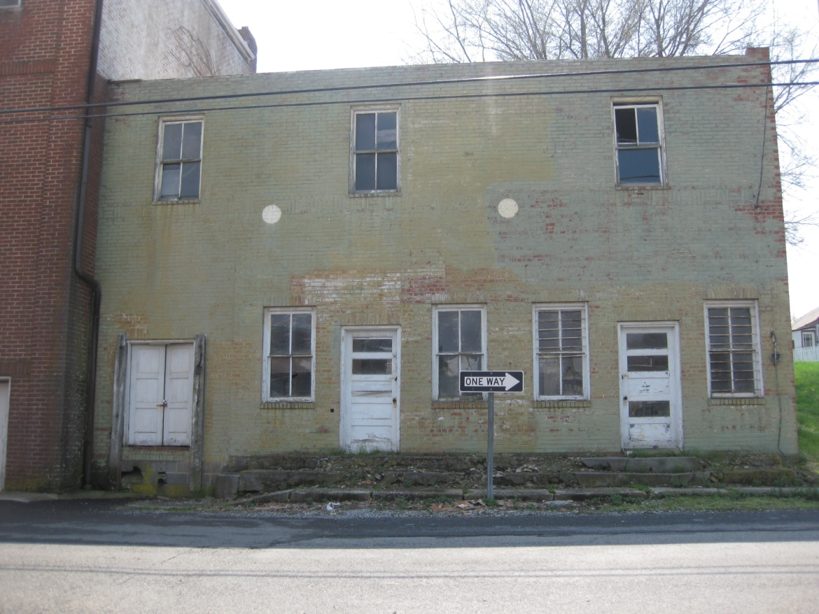
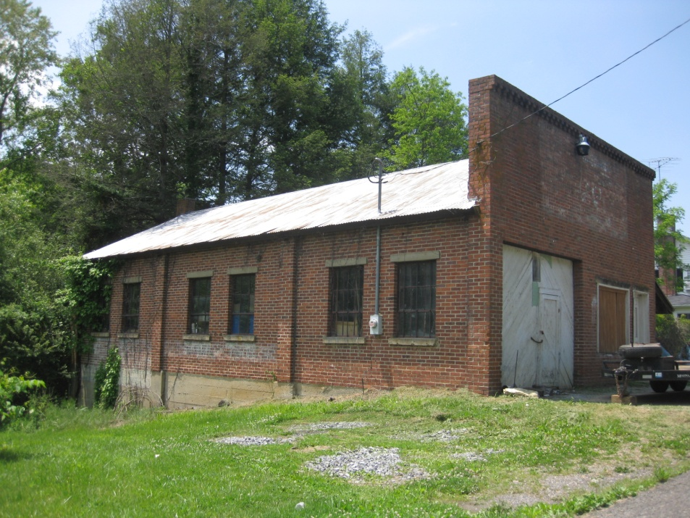
Commercial Building
Baumgardner Ave
Commercial Building, Painters Hill Rd

Slide 38
Blacksmith Shop Francis Mill Rd

Slide 39
Religion
28 resources
All Christian churches
Most between 1850 and 1950
Styles include Greek Revival, Gothic Revival, Victorian, Colonial Revival and Romanesque

Slide 40
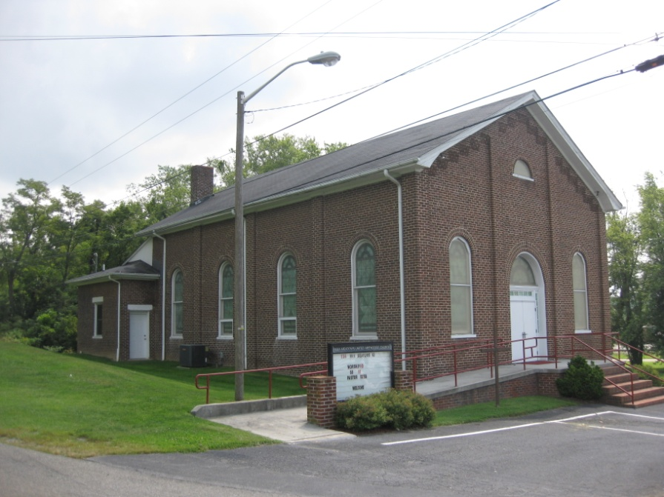
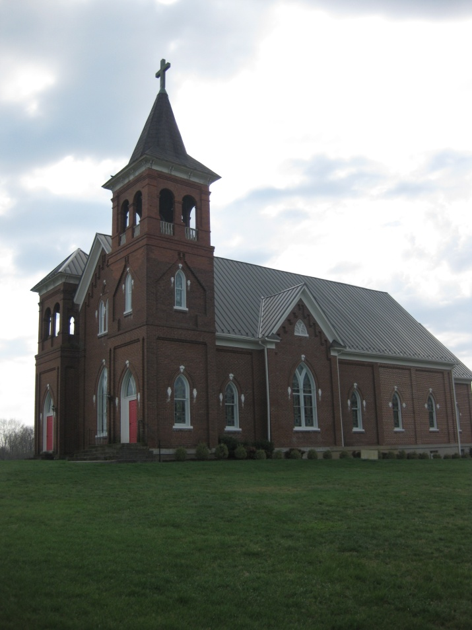
Max Meadows United Methodist Church
Grace Lutheran Church

Slide 41
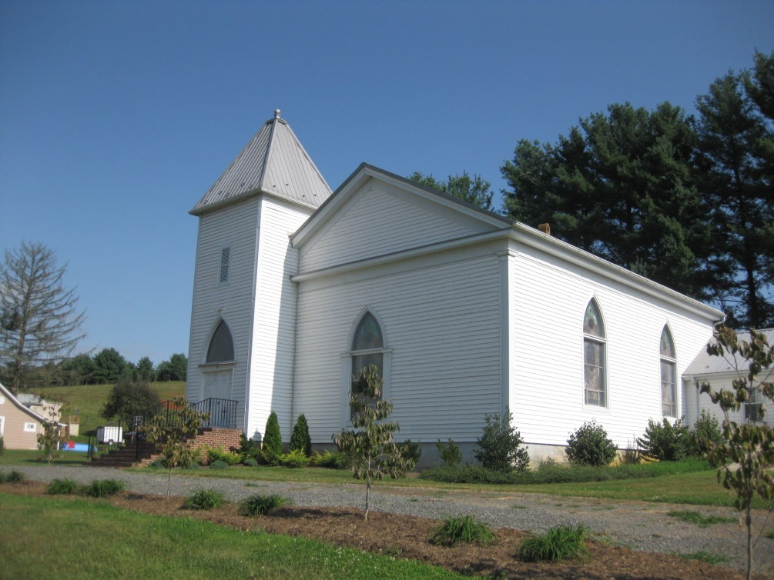
Galena Presbyterian Church
Union Church

Slide 42
Education
14 were classified as education
All from first half of the twentieth century
Some still active
Some re-purposed
Some are vacant

Slide 43
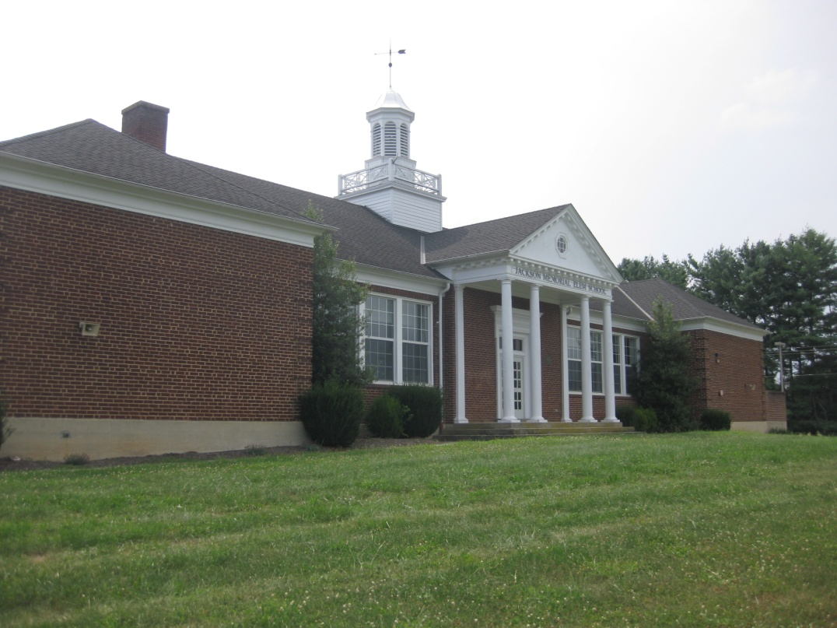
Speedwell Elementary School
Jackson Memorial Elementary School

Slide 44
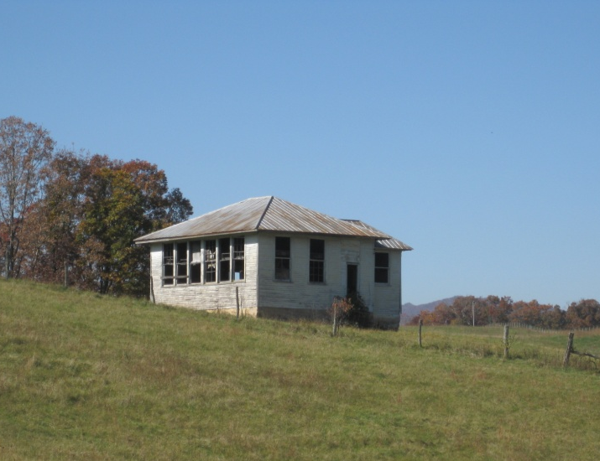
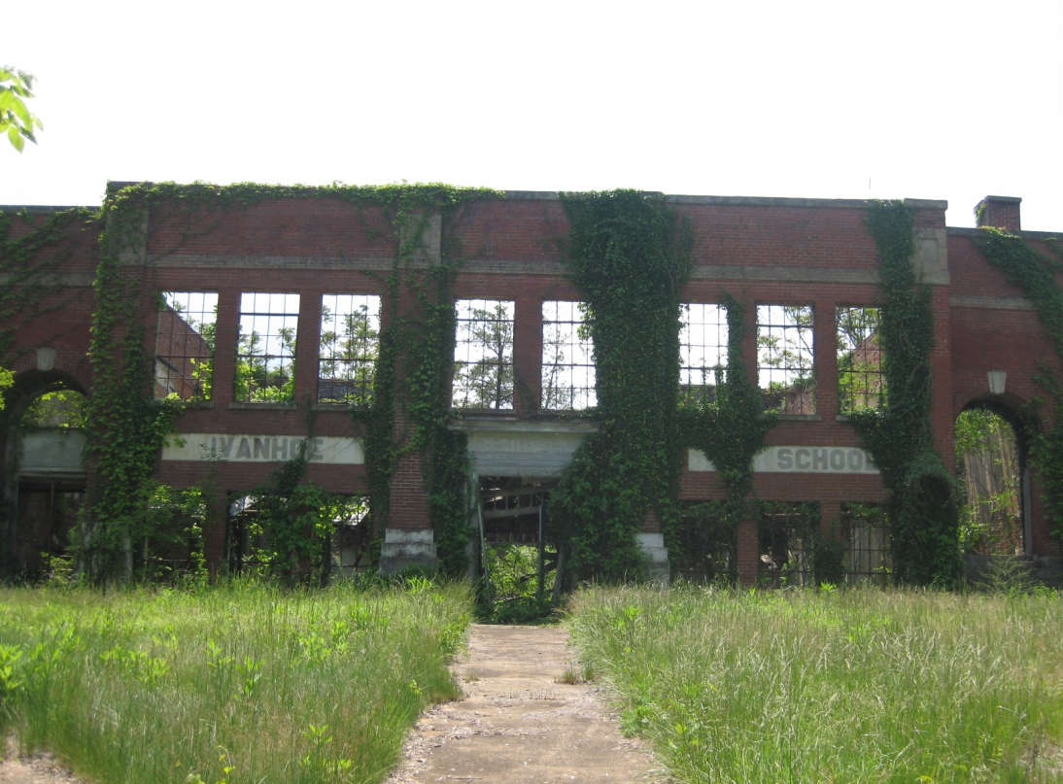
Matthews School
School,
Flemming Road
Ivanhoe School

Slide 45
Funerary
9 were classified as funerary
2 were funerary
7 were funerary and religion

Slide 46
Davis Cemetery
Bethany Hill Cemetery

Slide 47
Government/Law/Politics
6 were government law or politics
2 post offices and 4 rescue squads

Slide 48
Foster Falls Post Office
Speedwell Post Office

Slide 49
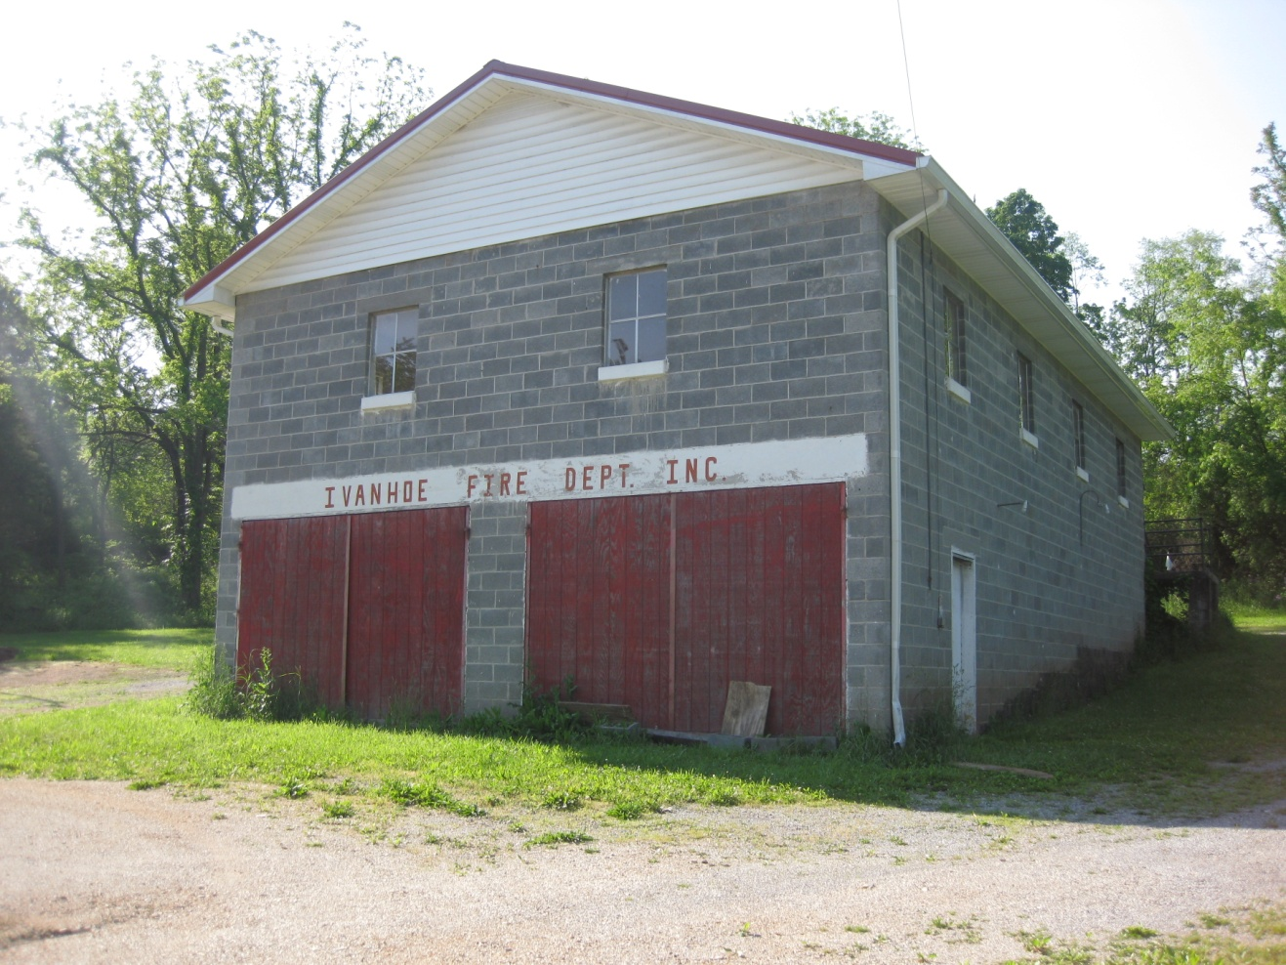
Ivanhoe Fire Department

Slide 50
Industry Processing Extraction
Eight recorded
Three previously recorded Furnaces
One mill
One coal yard
Two company stores
Lumber yard

Slide 51
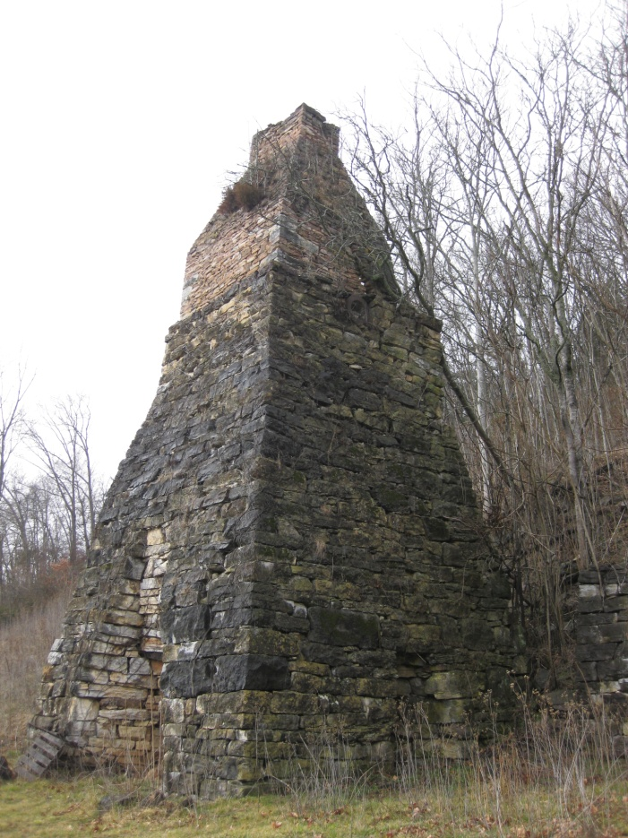
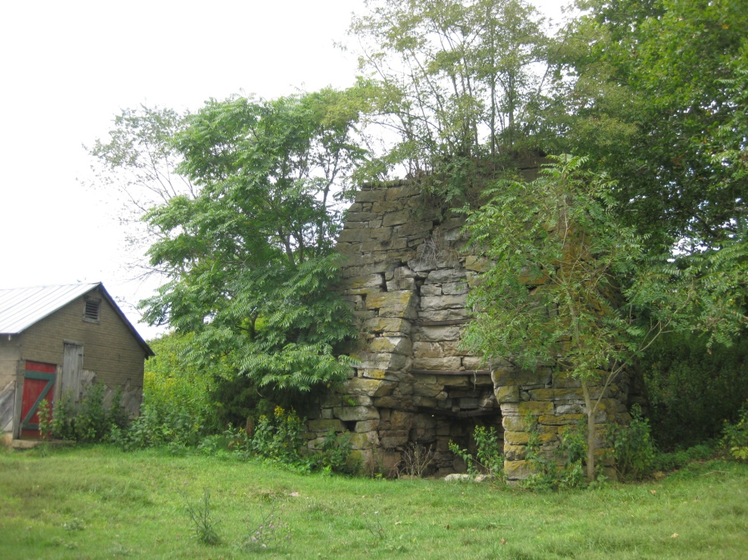
Walton Furnace
Brown Hill Furnace
Noble Furnace

Slide 52
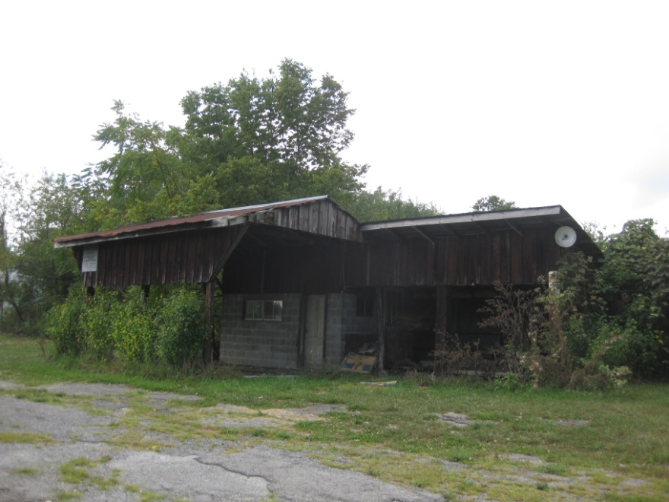
Beverly Mill
Cripple Creek Mill
Thompson Coal Yard

Slide 53
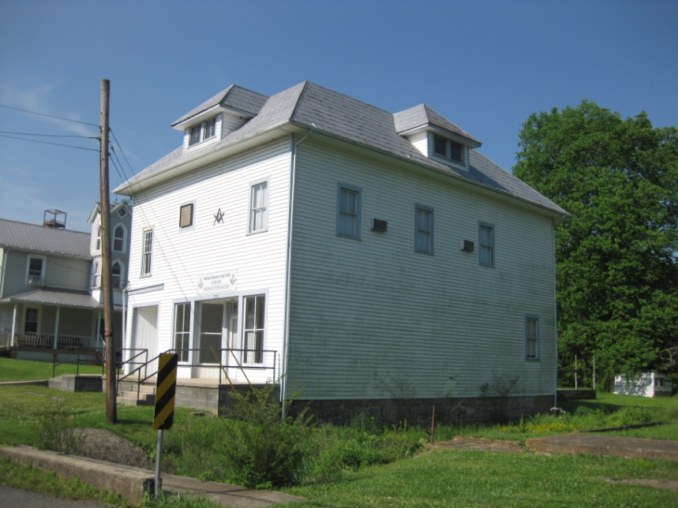
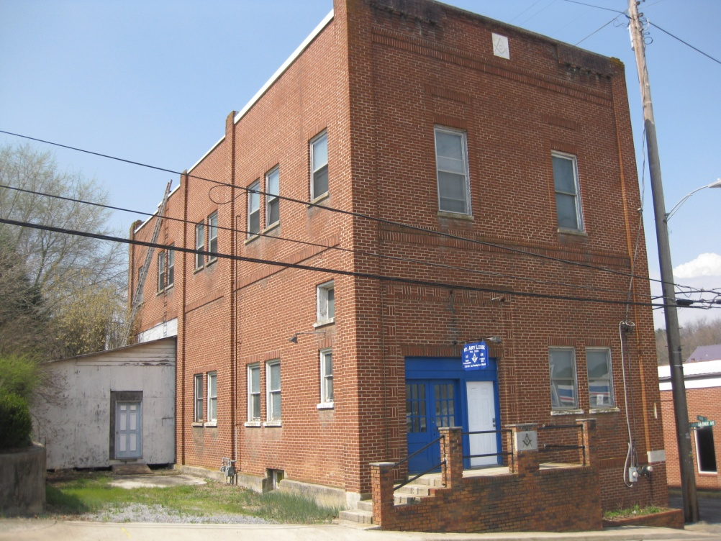
Lodge, Painters Hill Rd
Social
Mount Airy Masonic Lodge

Slide 54
Lead Mines Ruritan Club
Patterson Community Center

Slide 55
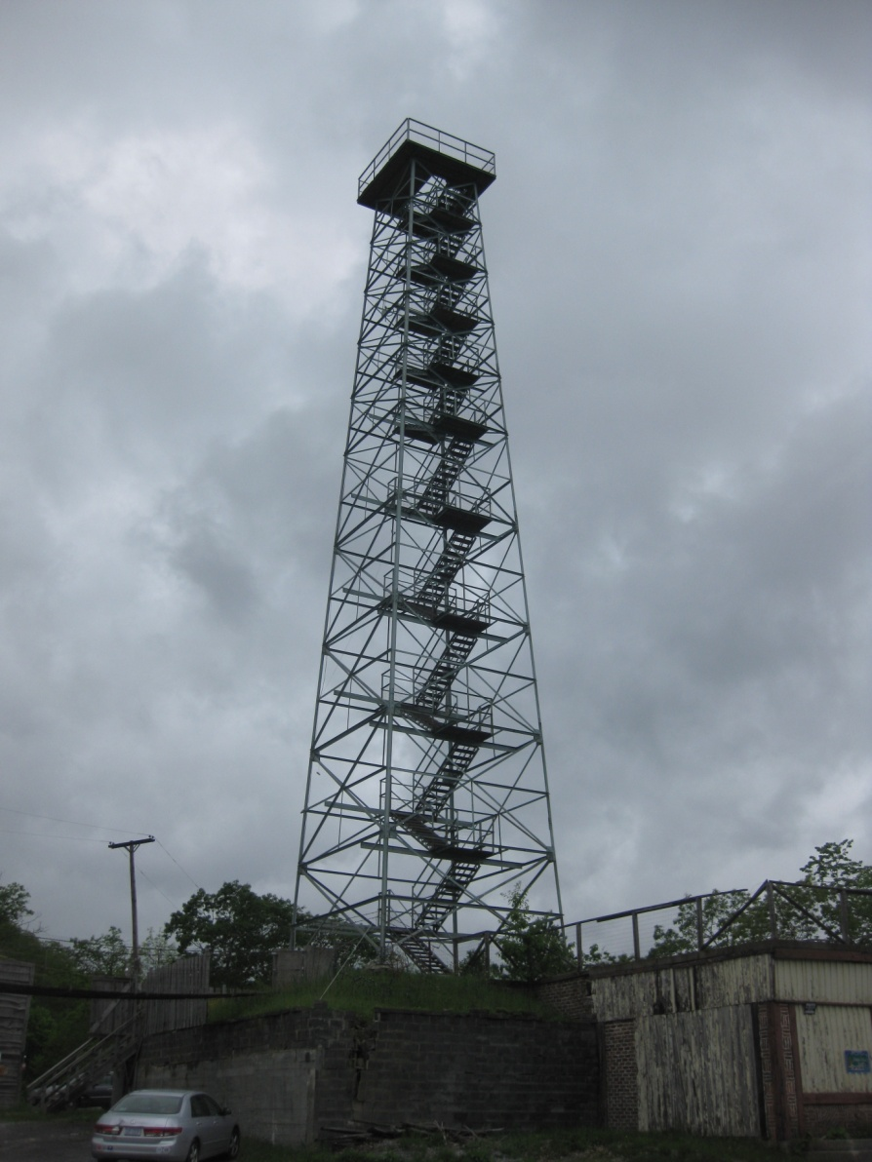
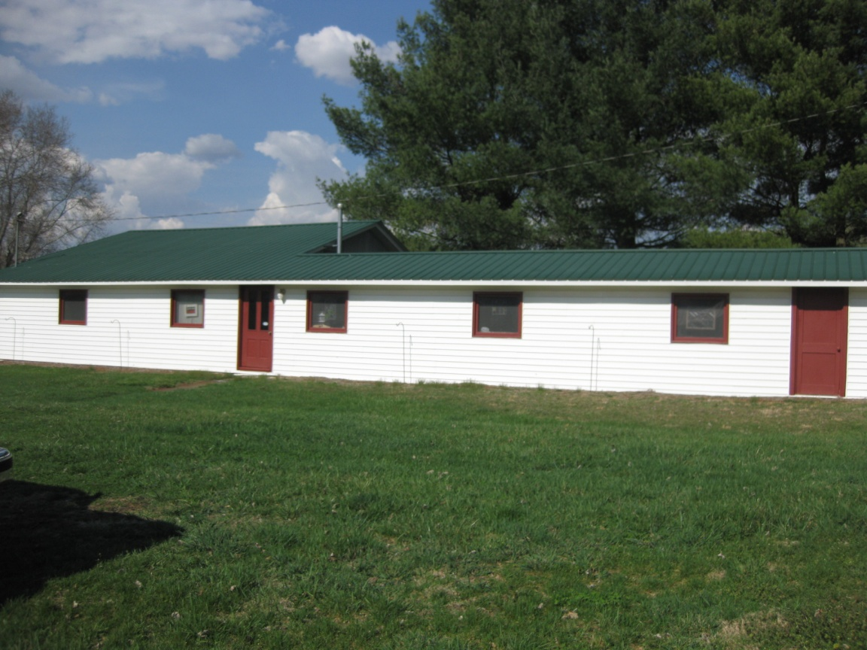
Mill Creek Studio, Weaving Studio
Recreation/Arts
Big Walker Lookout Tower

Slide 56
Healthcare/ Medicine
Dr Grubb’s Office

Slide 57
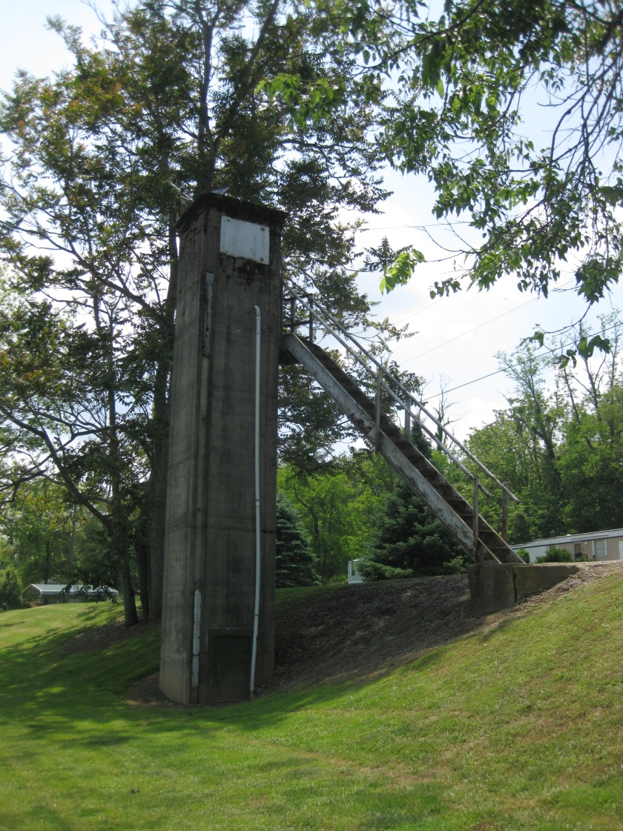
Technology
New River Gaging Station at Ivanhoe

Slide 58
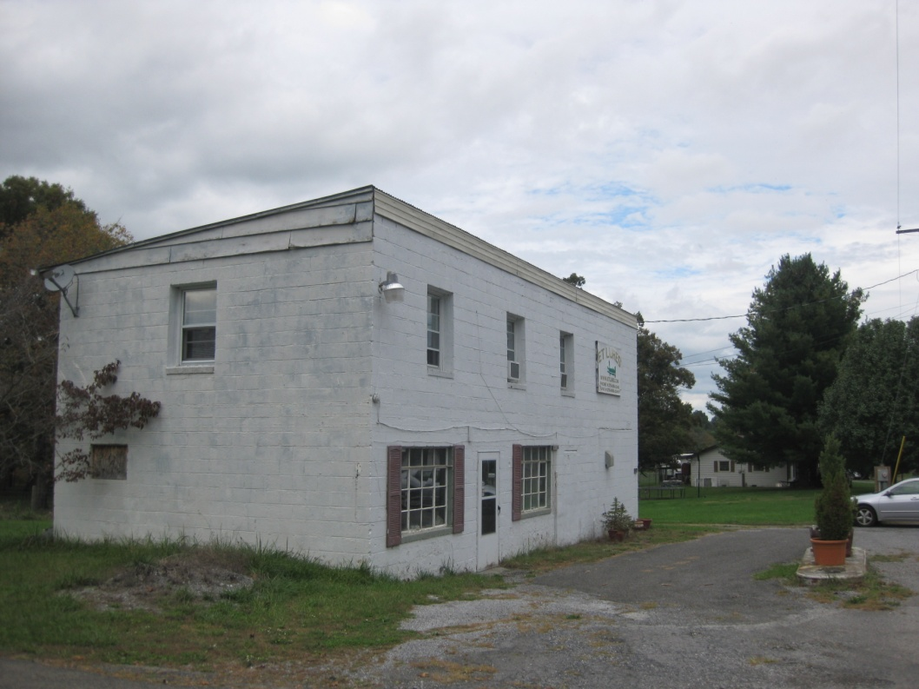
E. T. Lures
Transportation/Communication
Stoots Corner Convenience Store

Slide 59
Intensive Surveys
Twenty chosen
Diversity of type, age, use, style, area
Key significant resources
Access

Slide 60
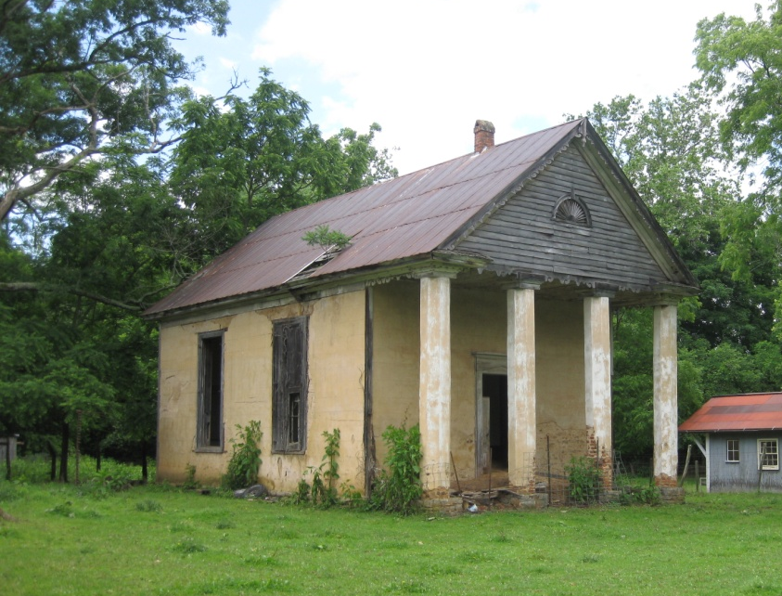
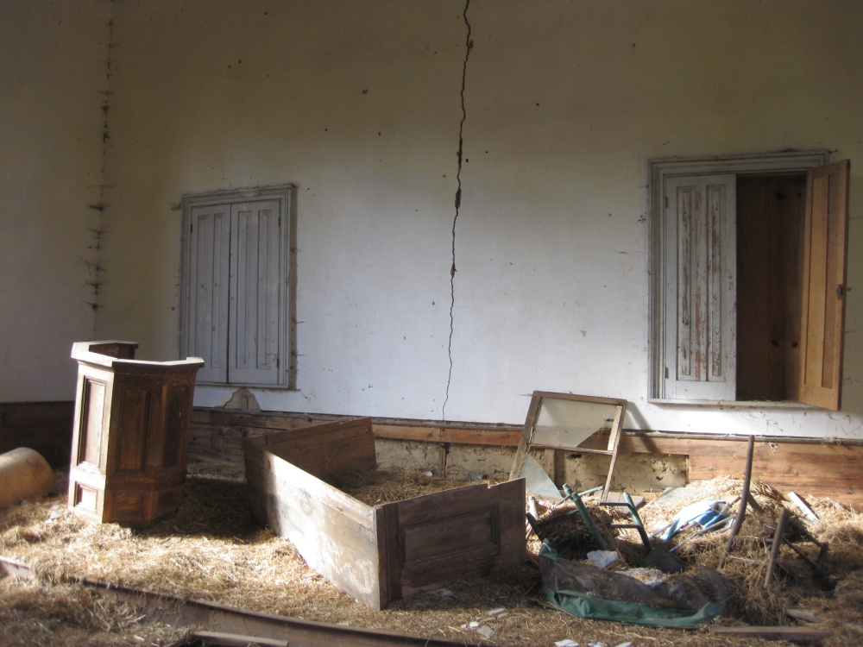
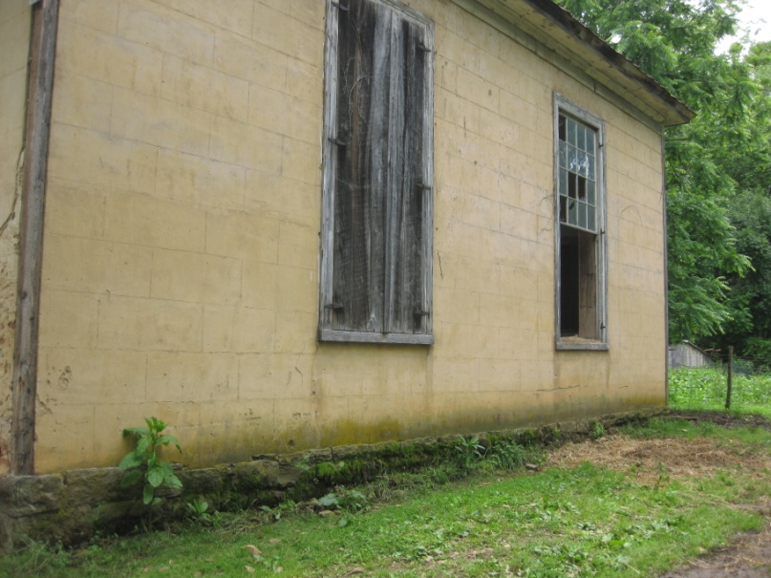
Quaker Meeting House

Slide 61
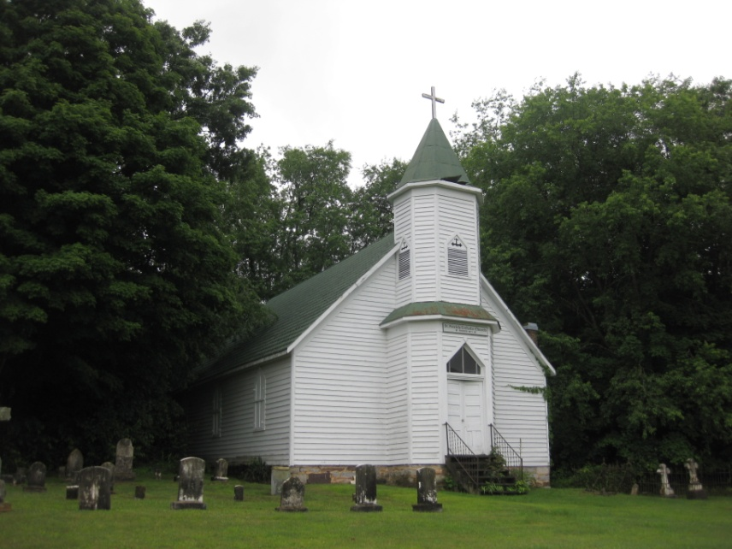
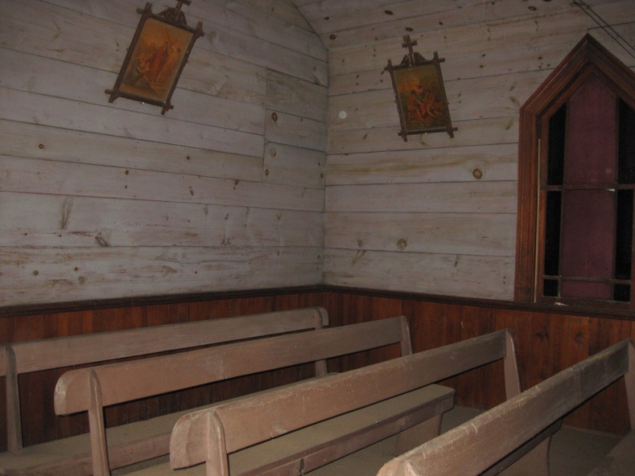

Saint Patrick Catholic Church

Slide 62


Huddle Memorial United Methodist Church

Slide 63



Charity Primitive Baptist Church

Slide 64



Living Hope Bible Church

Slide 65



Rural Retreat United Methodist Church

Slide 66



Corinth School

Slide 67


Barn, Saint Peters Road

Slide 68



Carpenter’s Grocery

Slide 69


Stoots Corner Convenience Store

Slide 70
Huddle Farm

Slide 71

Mill Creek Studio

Slide 72


House 152 Poplar Drive

Slide 73

House, 106 Brown Town Rd

Slide 74


House,1078 Ramsey Mountain Rd

Slide 75


House, 3096 Major Grahams Rd

Slide 76


House,6464 Peppers Ferry Rd

Slide 77


House,301WestBaumgardnerAve

Slide 78


468 Ward Branch Road

Slide 79


John Repass Rock House

Slide 80
Recommendations
Further Comprehensive Survey
Pursue individual National Register designations

Slide 81

Pursue Historic District designations
  Rural Retreat
  Newtown
  Ivanhoe
  Max Meadows

Slide 82
Recommendations
Multiple Property Documentation
  Iron Furnaces
  Schools
Tax Incentives for Rehab
Easements
Heritage Tourism

