Slide 1

Amherst County Architectural Survey
Final Project Presentation
23 June 2010
Amherst County High School
The Antiquaries, LC
&
Landmark Preservation Associates

Slide 2
Taking Stock of Historic Resources
Every state works to compile an accurate and comprehensive database of historic resources
Virginia’s program has been underway for more than 40 years
More than 165,000 architectural and archaeological resources have been documented in Virginia

Slide 3
Not Just Landmarks…
Subjects of a survey are not just court houses, massive churches, and plantation houses
Survey also includes:
  Vernacular architecture
  Farm buildings and outbuildings
  Cemeteries
  Bridges
  Commercial buildings

Slide 4
165,000 Sites…Really?
Survey files are generated by two primary activities:
  Projects that must comply with Section 106 of the National Historic Preservation Act
    Federal and state-funded projects
      Transportation, Community Revitalization, Utilities
  Projects performed under DHR’s Survey & Planning Cost Share Program

Slide 5
DHR’s Survey & Planning
Cost Share Program
Highly competitive program
Locality splits cost 50/50 with DHR
DHR performs administrative functions:
  Securing consultants
  Paying bills
  Monitoring the work
  Ensuring delivery of the products
In this case, Sweet Briar College/ Tusculum Institute is performing some of these functions

Slide 6
Where Does the Data Go?
Survey files are stored in the DHR Archives in Richmond
Data is entered into DHR’s DSS (Data Sharing System) for use in Richmond or remotely by Internet
Copies of the Survey Report are kept by the locality and by DHR in Richmond
GIS data are shared with the locality for use in community planning activities
Survey files are also being provided to the Amherst Museum

Slide 7
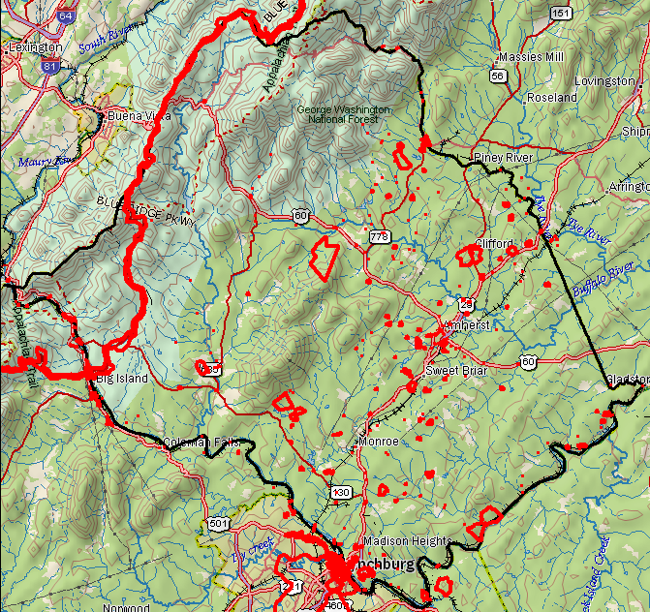
Existing
Resources
As of November, just over 300 architectural resources had been recorded in Amherst County

Slide 8
What is in a Survey File?
Reconnaissance Level Survey
  Exterior photographs
  Basic architectural description
  Site plan of property
  Map showing property location
Intensive Level Survey
  Exterior and interior photographs
  Detailed architectural description
  Basic historical information
  Site plan of property
  Map showing property location

Slide 9

Amherst Survey Goals
Surveyors will drive every public road
At least 275 new properties surveyed at reconnaissance level (292 were actually surveyed)
Development of spatial data for use by DHR and locality
Development of final survey report

Slide 10
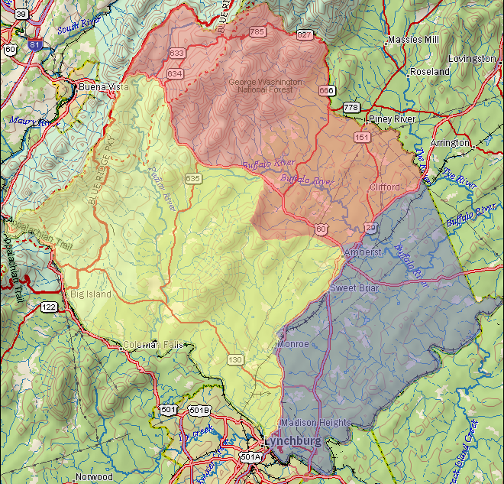
Surveyor
Territories
Pink: Sandi Esposito
Blue: Jesse Adams-Doolittle
Yellow: Scott Smith

Slide 11
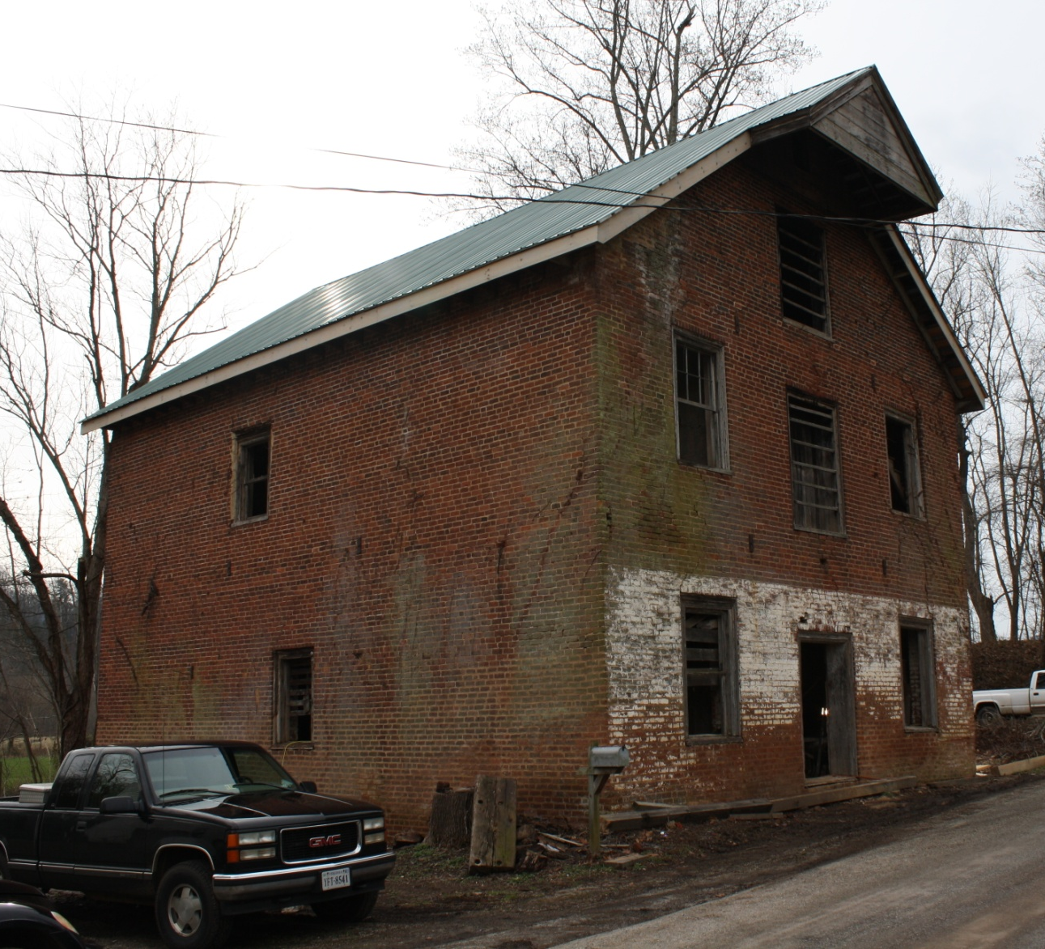
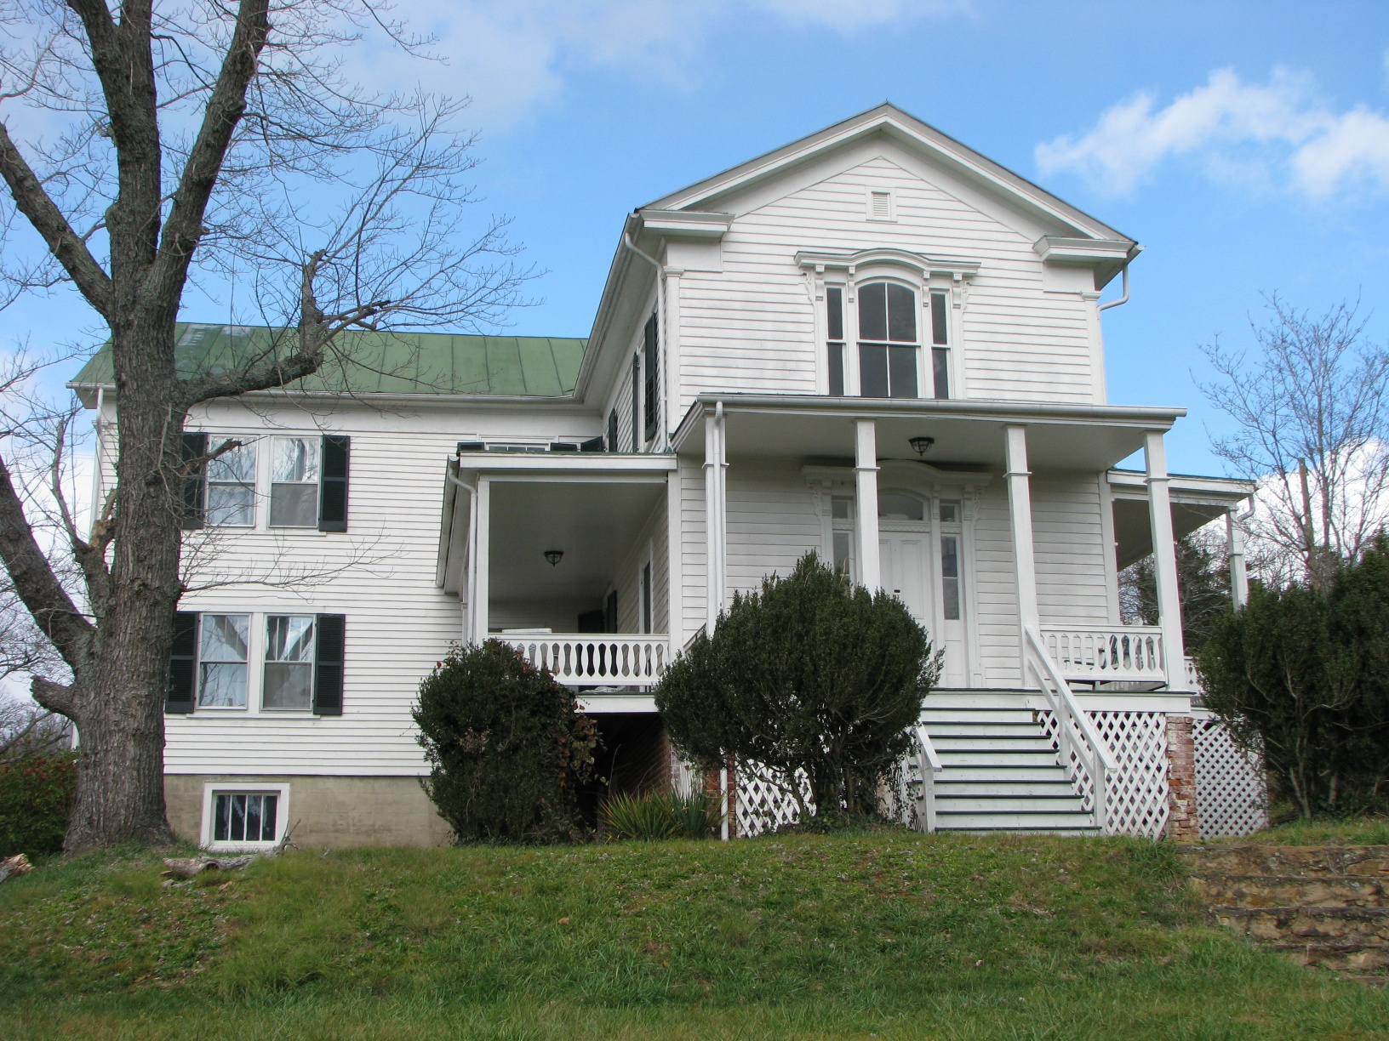
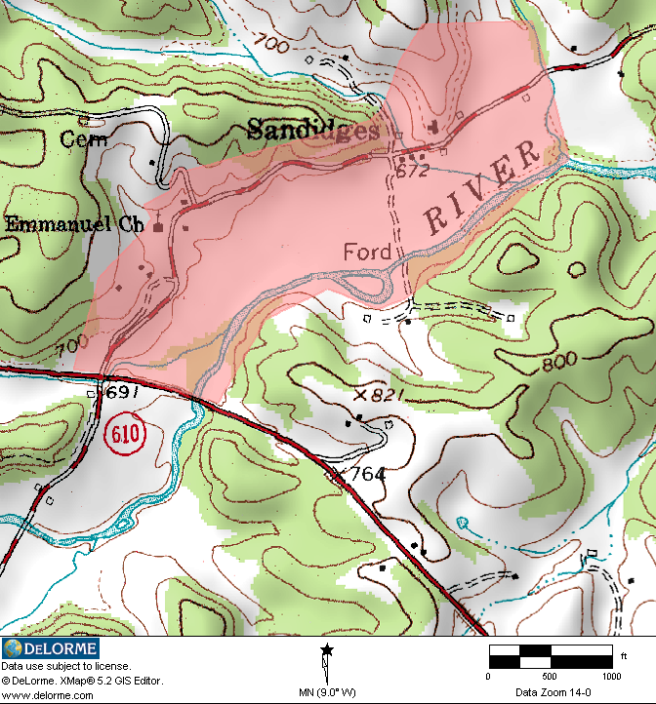
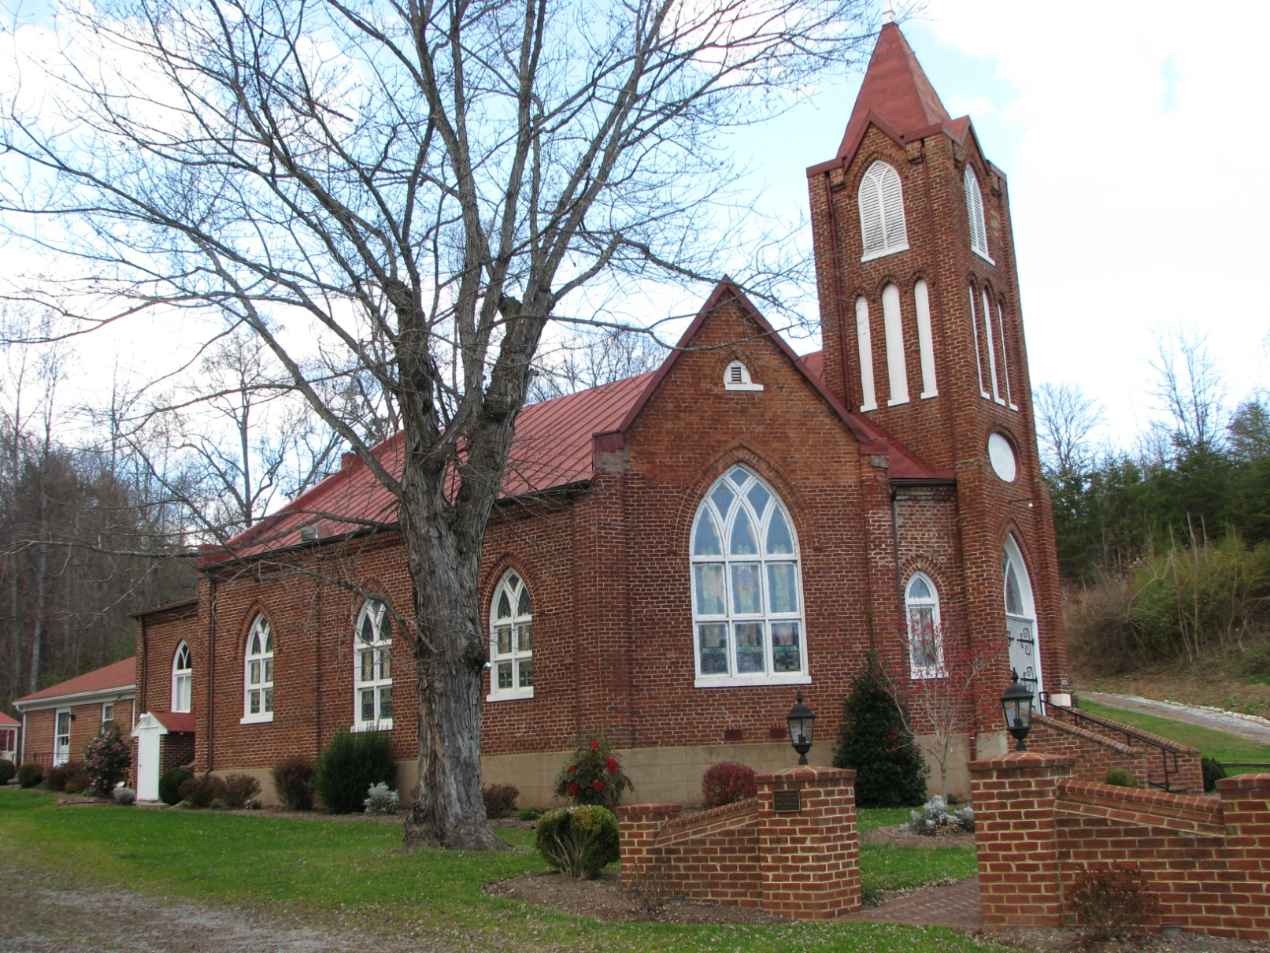
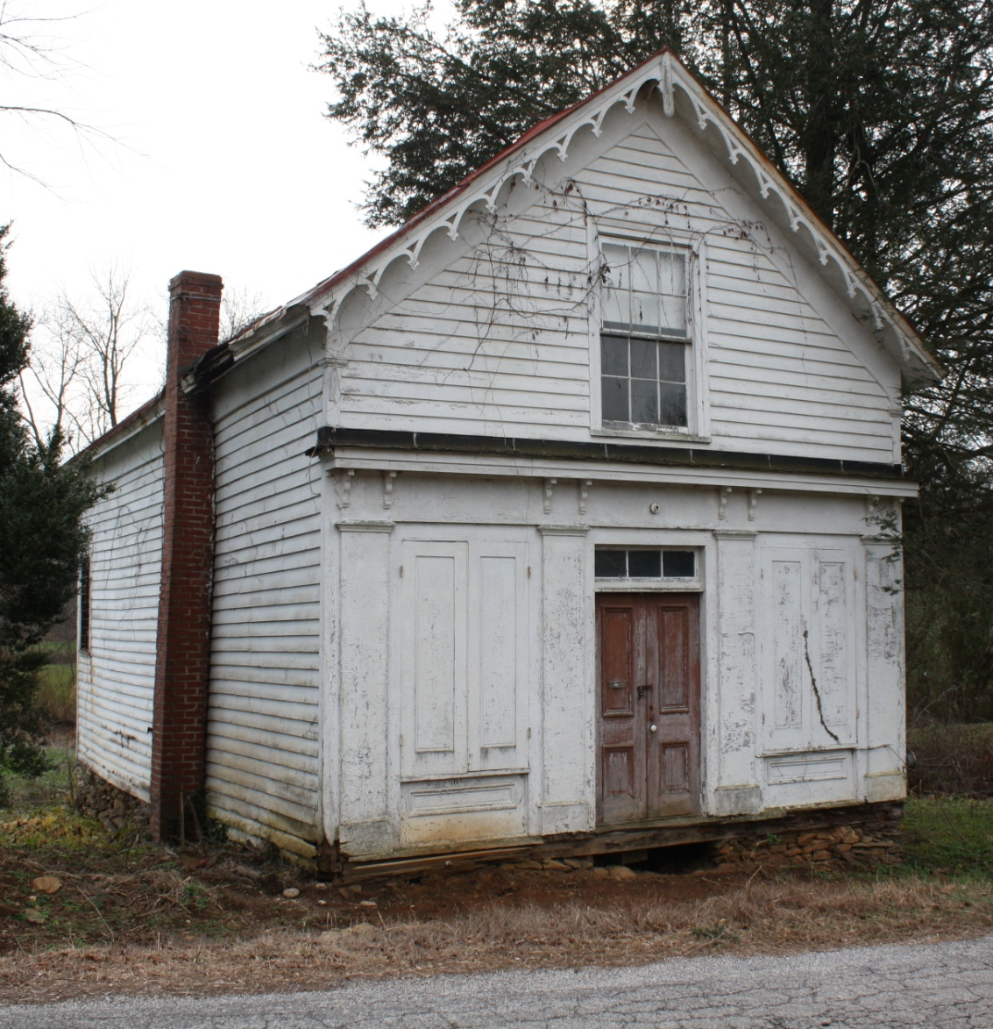
Potential Rural Historic Districts
Sandidges Rural Historic District, Sandidges Road

Slide 12
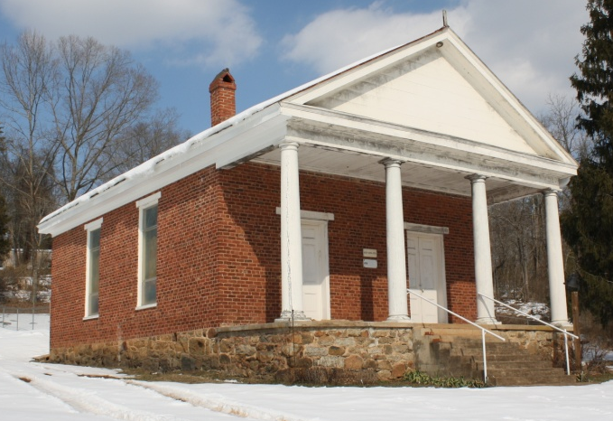
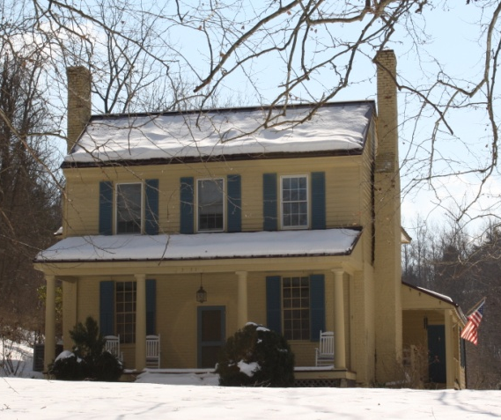
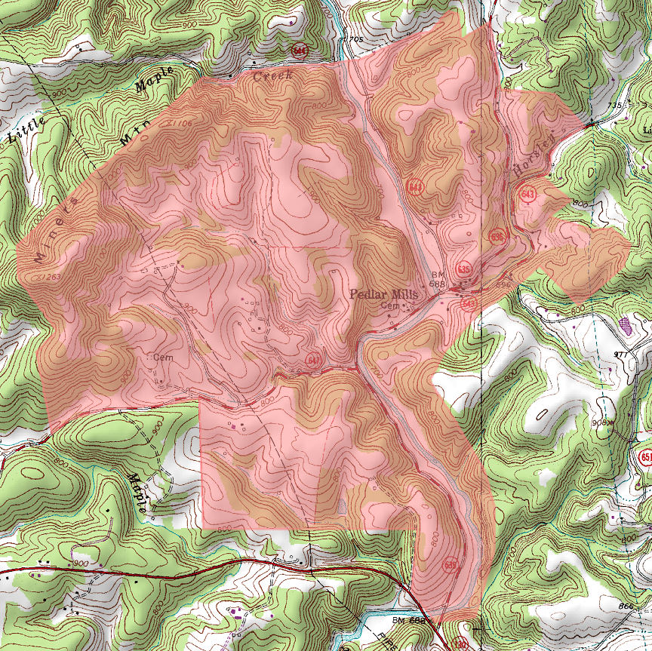
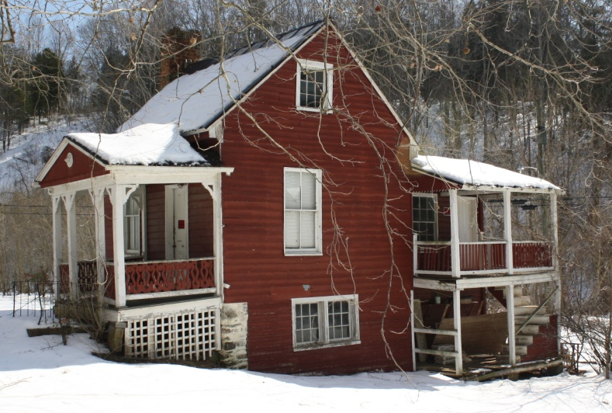
Potential Rural Historic Districts
Pedlar Mills Rural Historic District, Buffalo Springs Turnpike & Wagon Trail Road

Slide 13
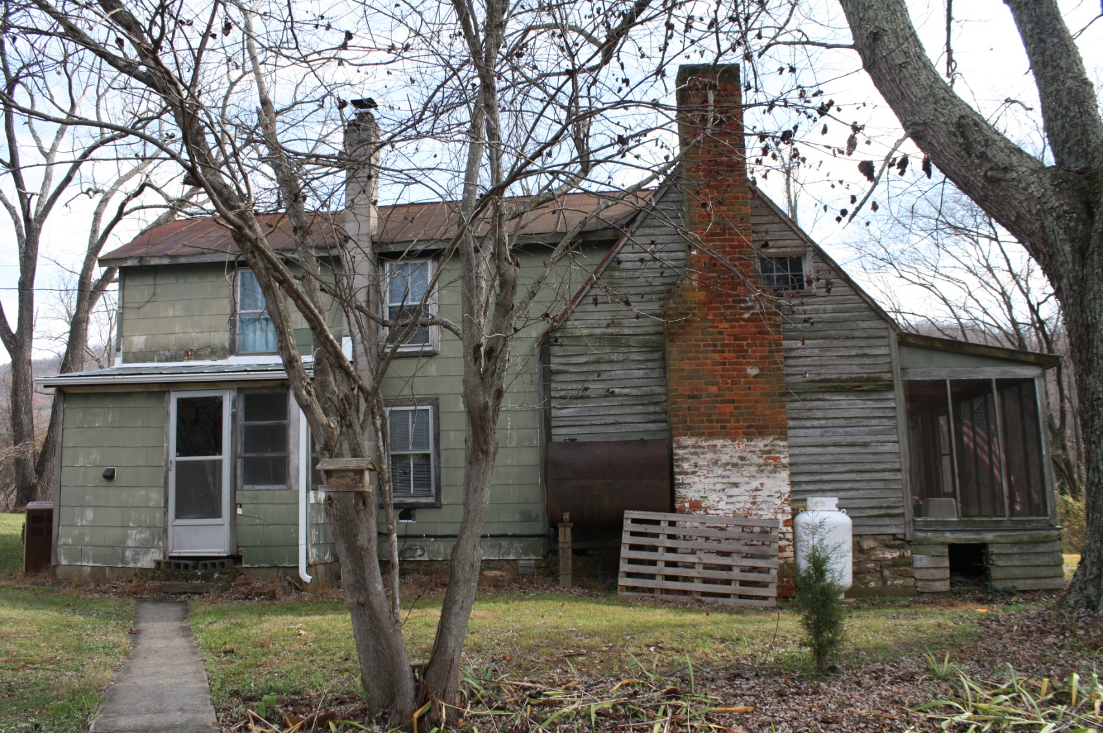
Finds- Houses
005-5082: Brookside Farm, Matohe Road (Hicks’ Store)

Slide 14
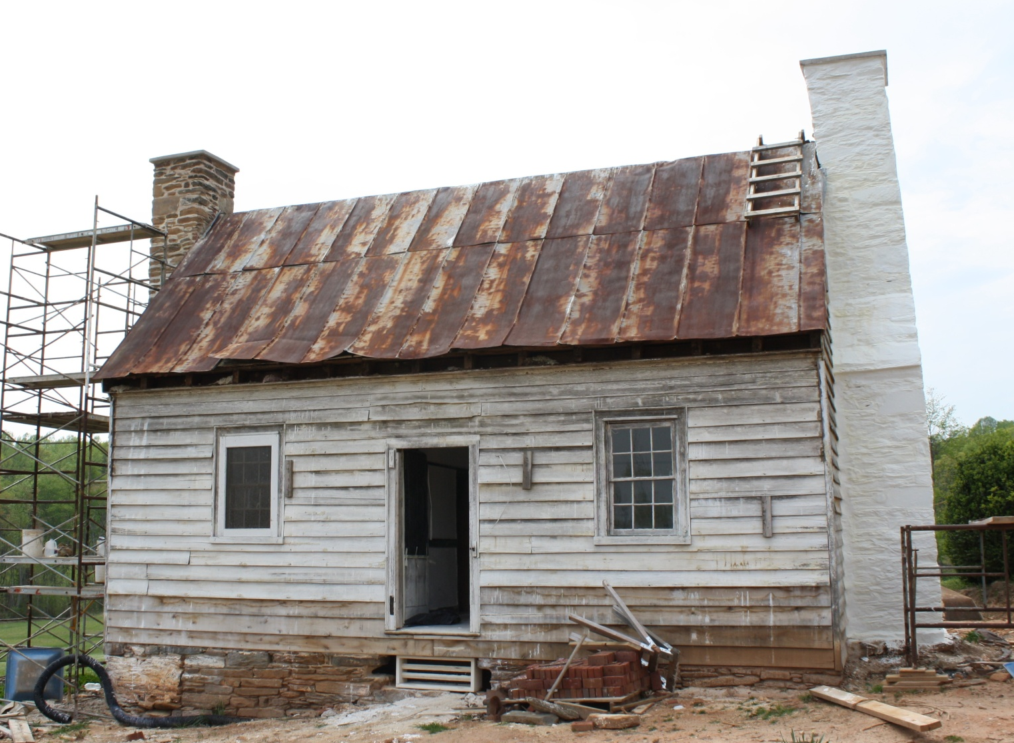
Finds- Houses
005-5318: House, 719 Ebenezer Road

Slide 15
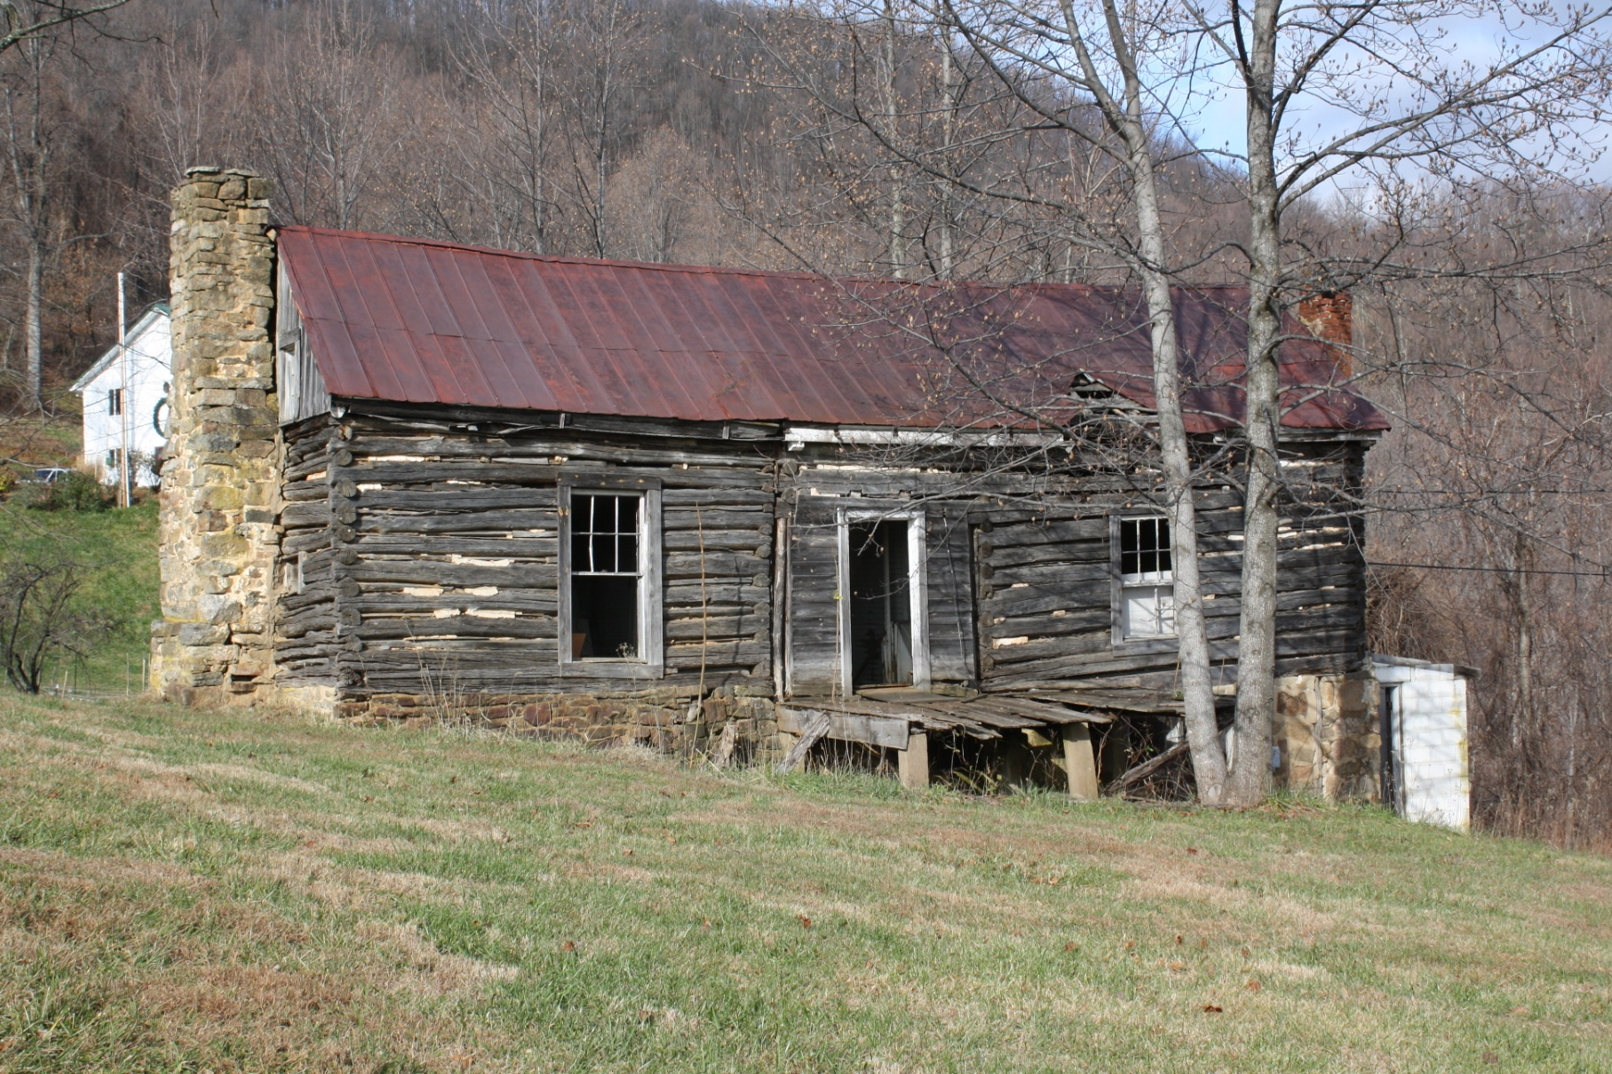
Finds- Houses
005-5104: Burley Cabin, Mistover Drive (Tobacco Row Mountain)

Slide 16
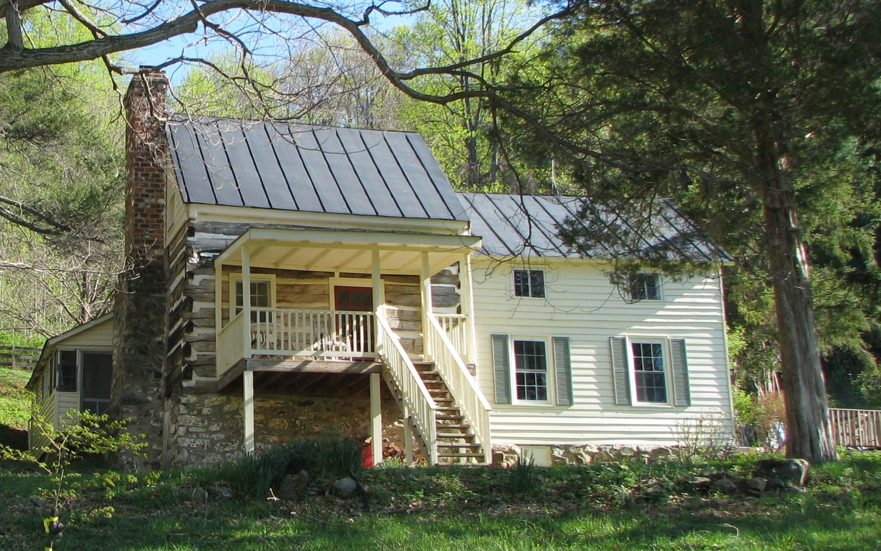
Finds- Houses
005-5281: House, 871 Mount Horeb Road

Slide 17
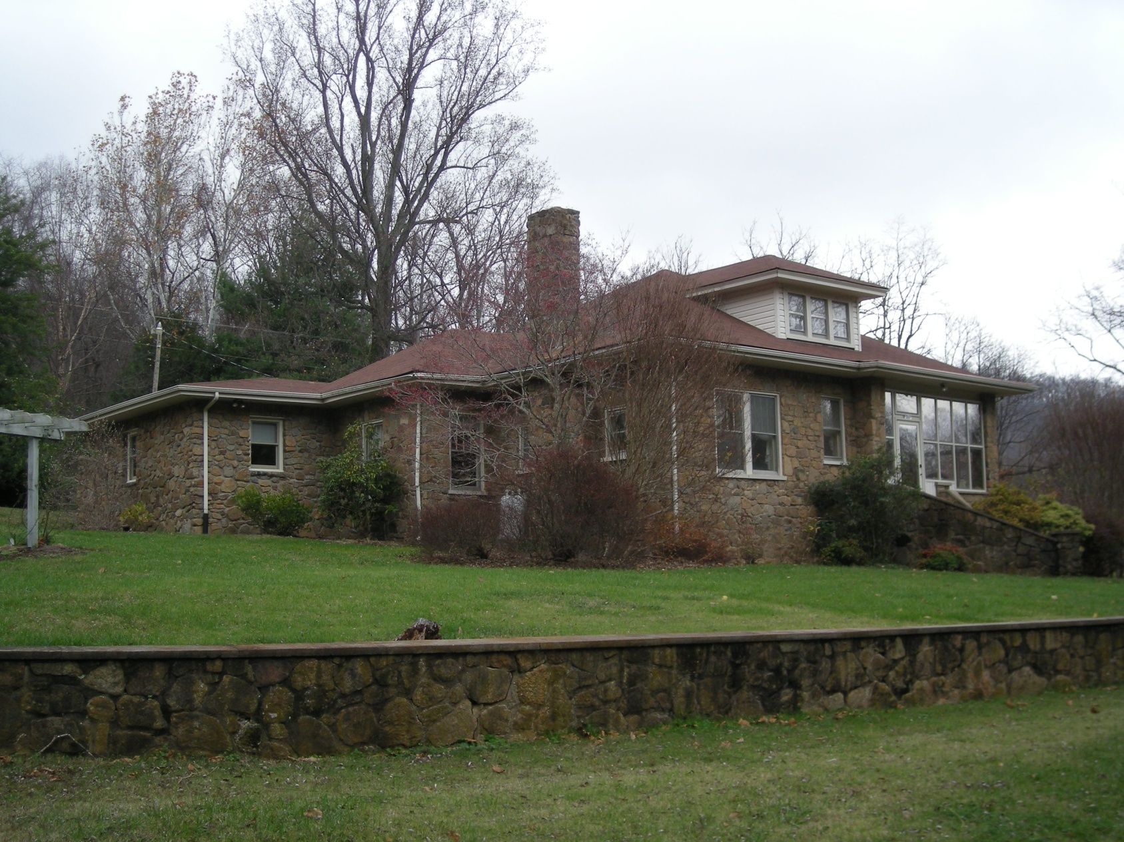
Finds- Houses
005-5096: House, Montrose Road (Tobacco Row Mountain)

Slide 18
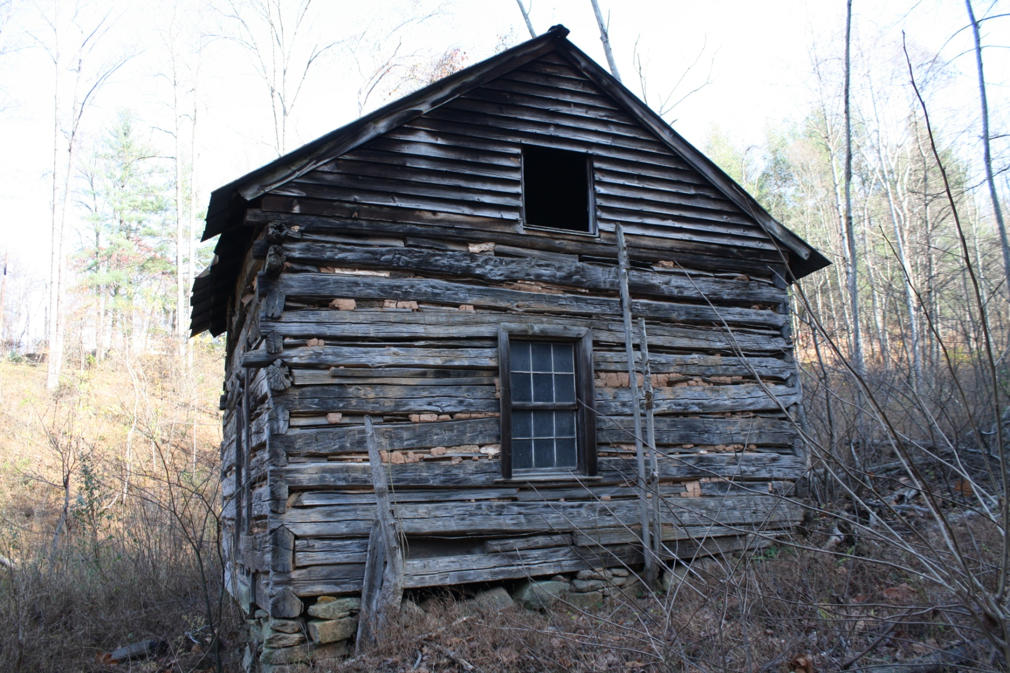
Finds- Houses
005-5088: Cabin, Wares Gap Road, Ware’s Gap

Slide 19
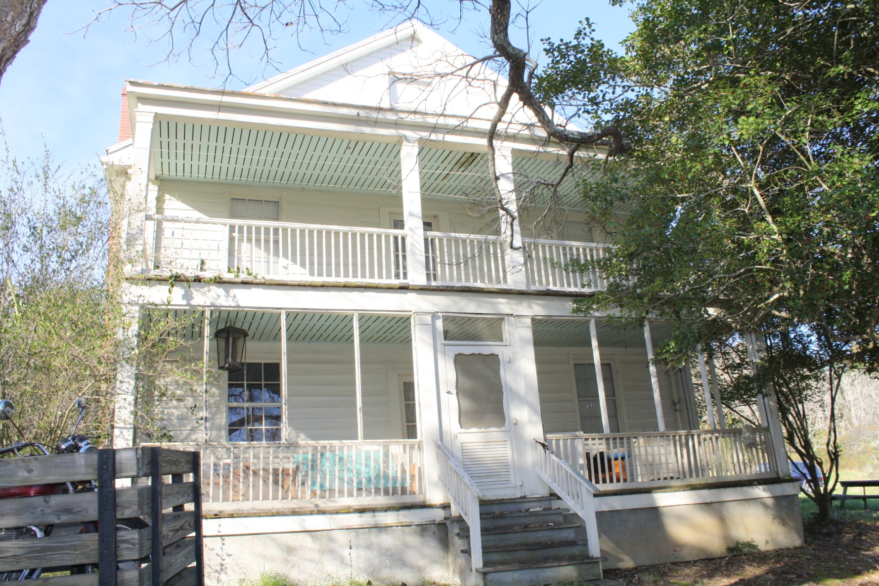
Finds- Houses
005-5119: House, Bateau Lane, Stapleton

Slide 20
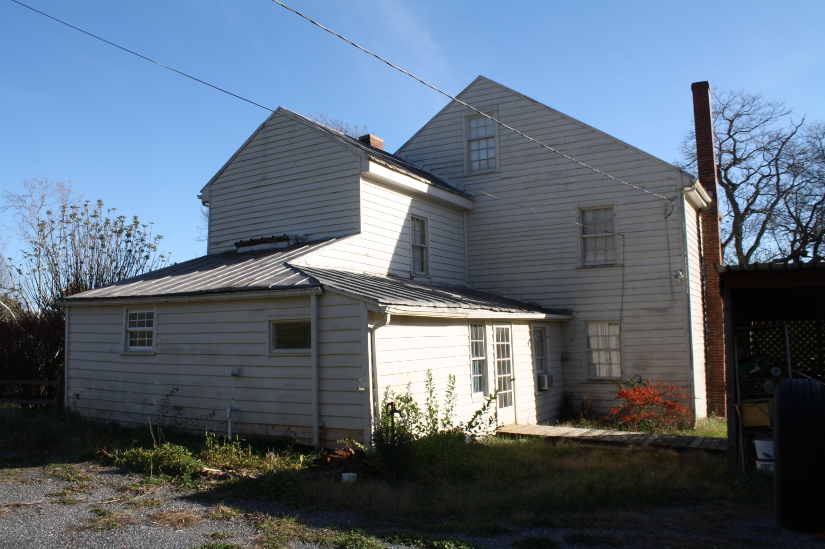
Finds- Houses
005-5119: House, Bateau Lane, Stapleton

Slide 21
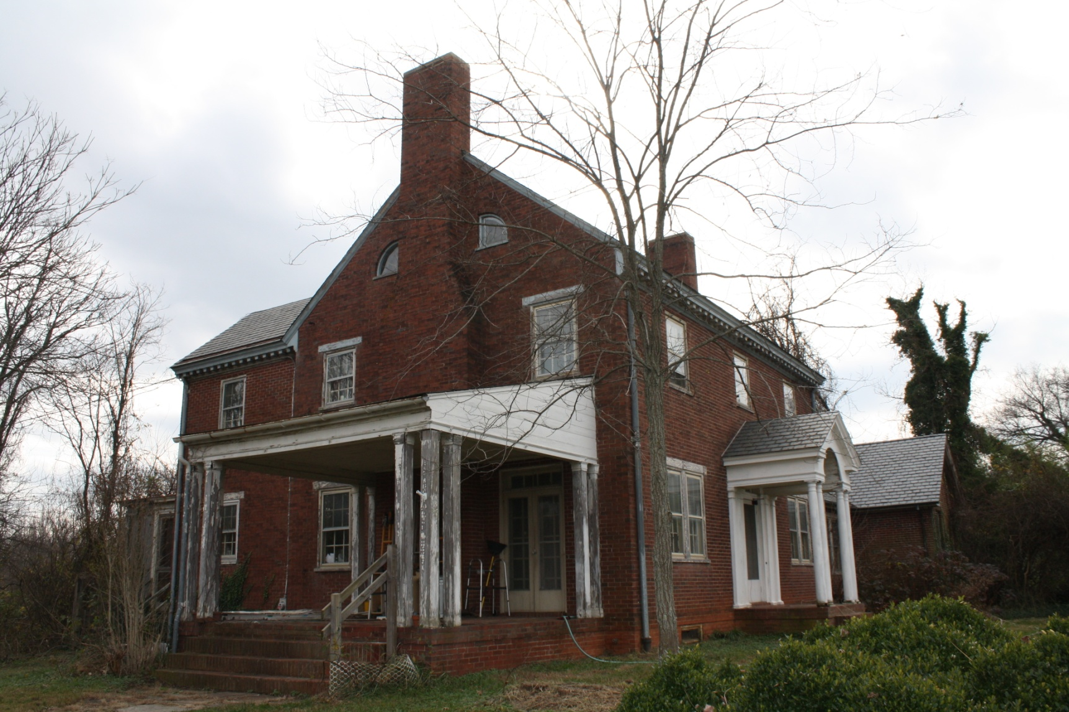
Finds- Houses
005-5109: House, S. Amherst Highway, Madison Heights

Slide 22
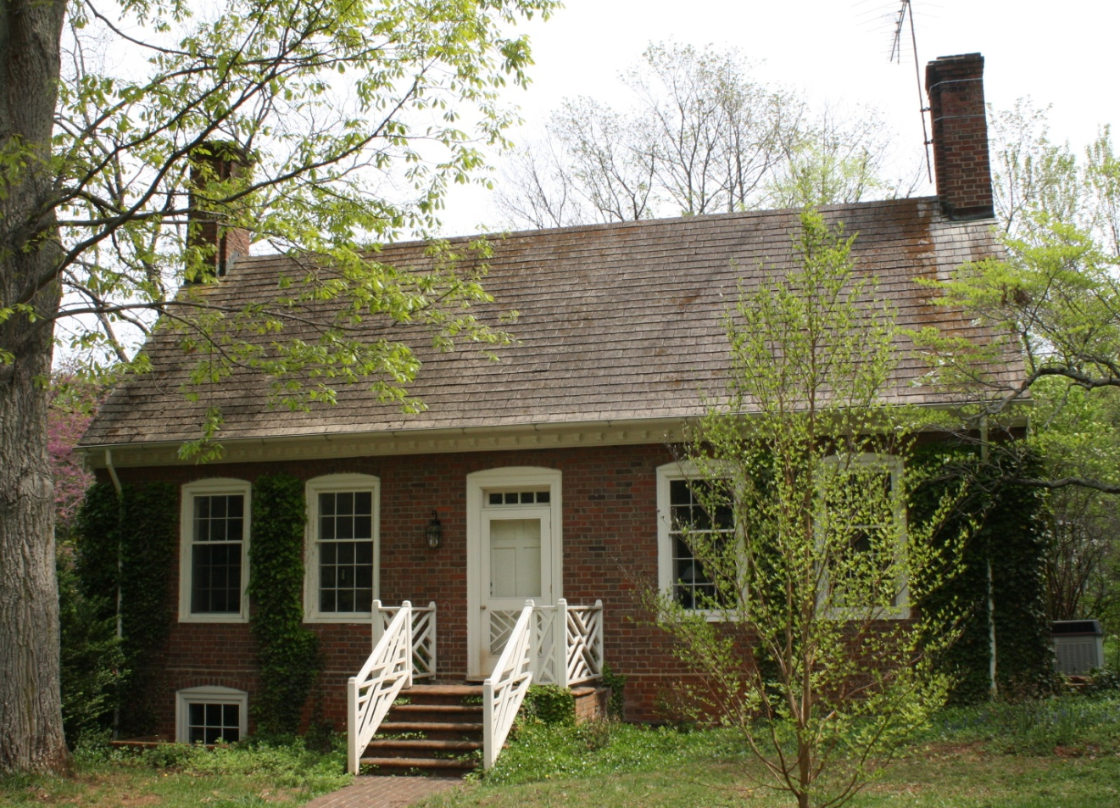
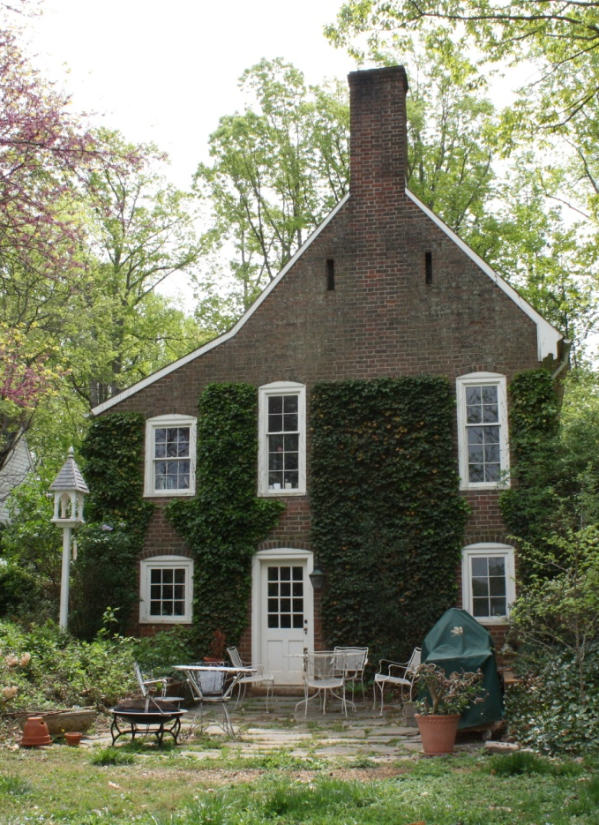
Finds- Houses
005-5315: The Patch, Stage Road

Slide 23
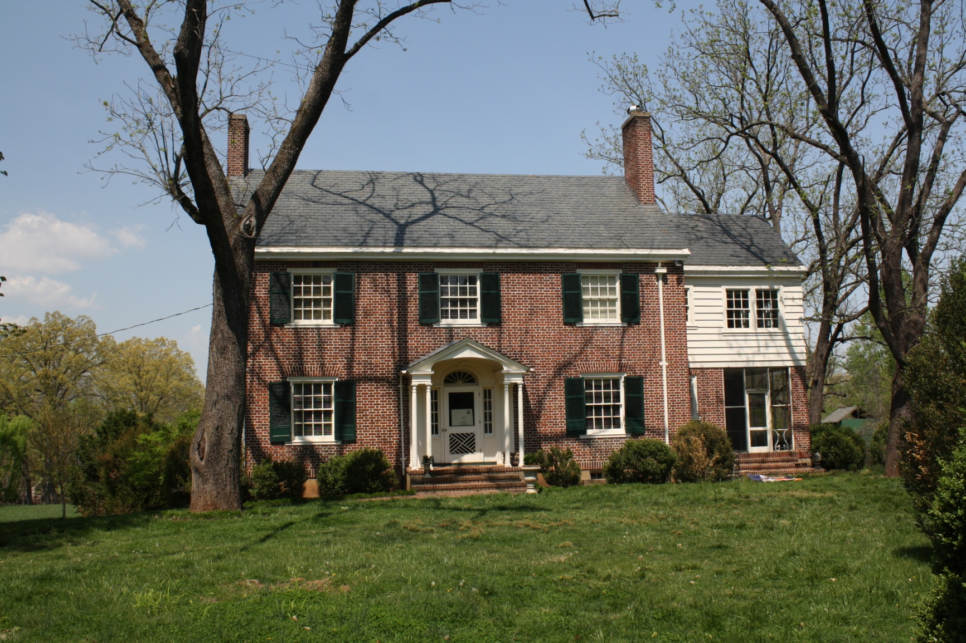
Finds- Houses
005-5332: Longacre, Elon Road

Slide 24
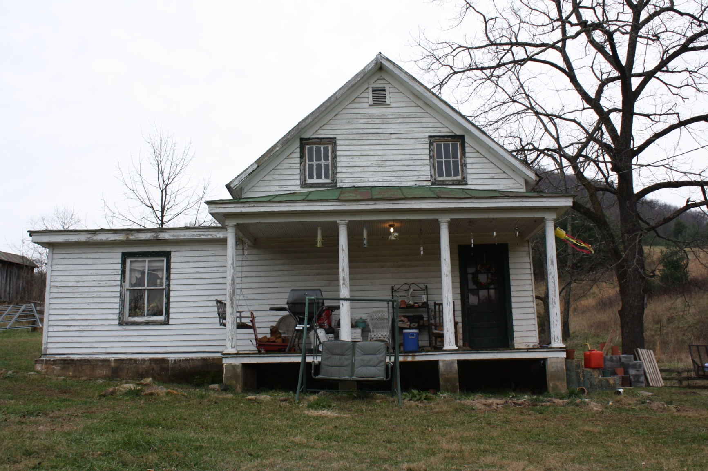
Finds- Houses
005-5196: House, Meadow Hollow Road

Slide 25
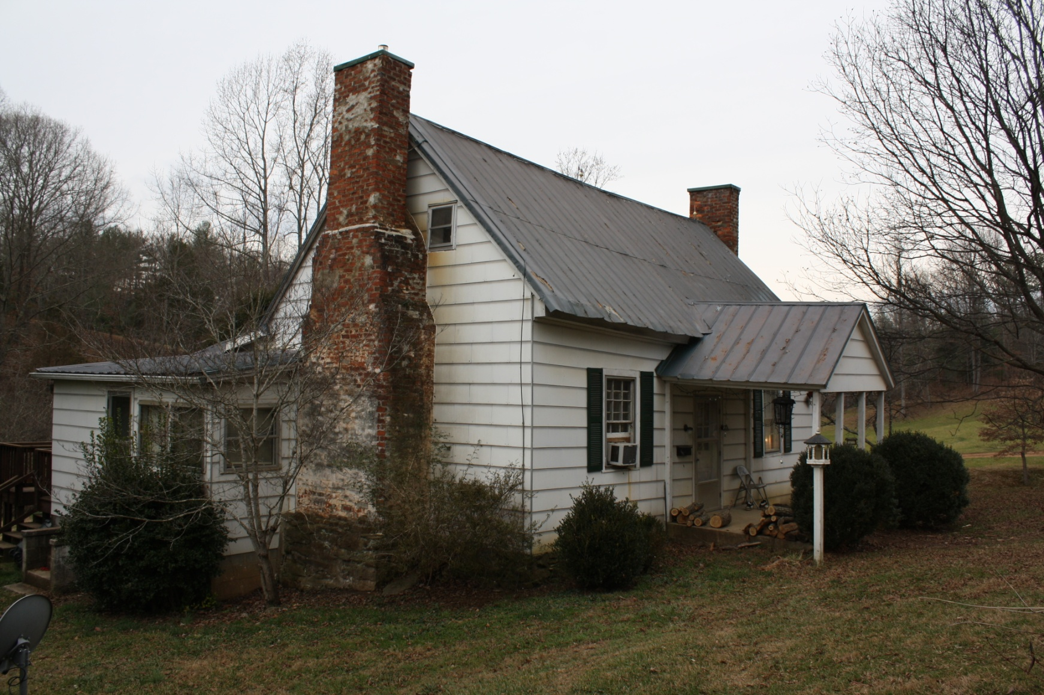
Finds- Houses
005-5198: Kersey Farm

Slide 26
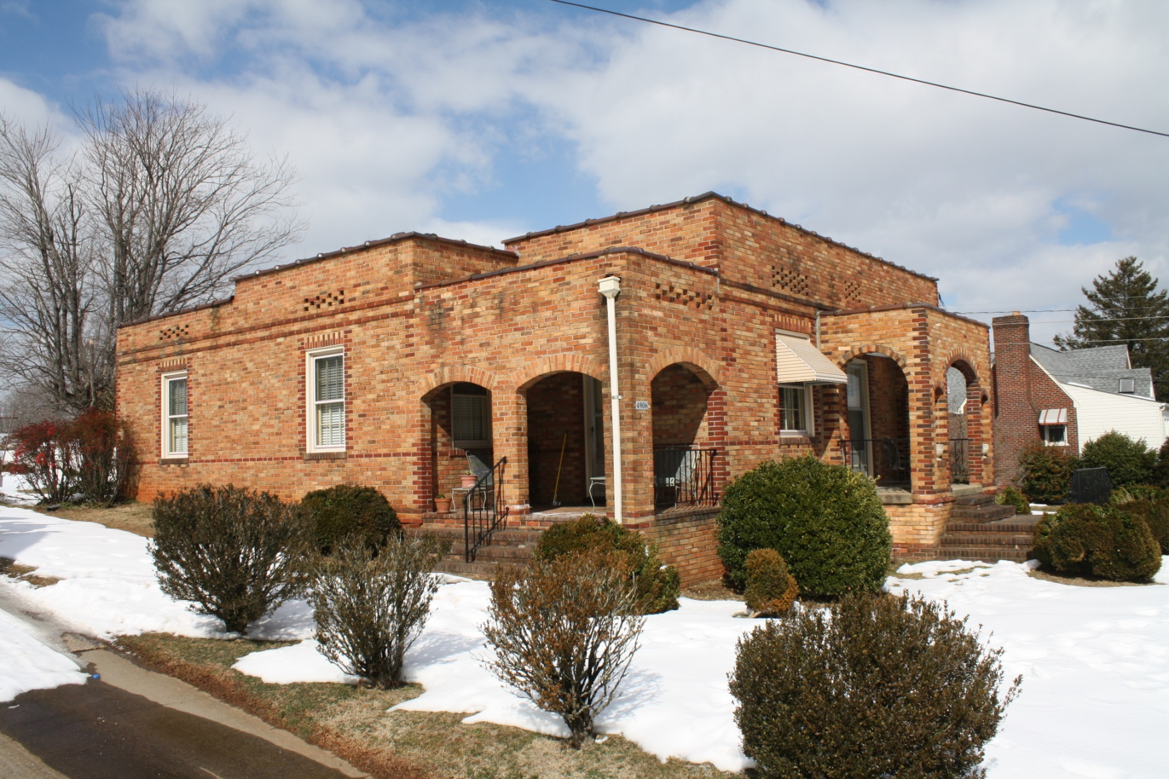
Finds- Houses
005-5150: House, South Amherst Highway

Slide 27
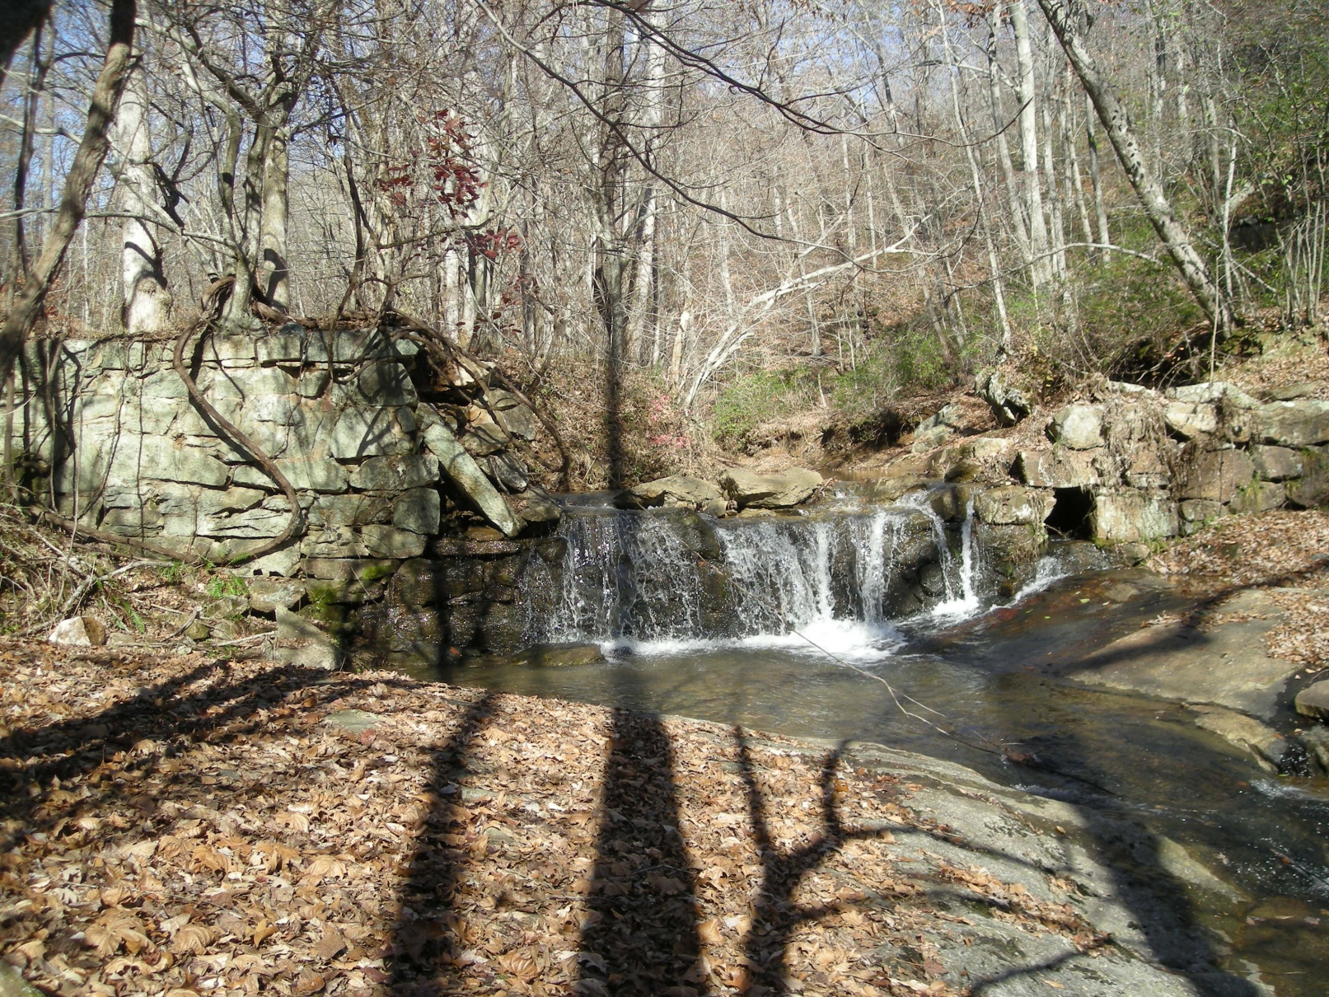
Finds- Commerce/Industry
005-5181: Davies Mill Dam, Crab Creek Road , Bethel

Slide 28
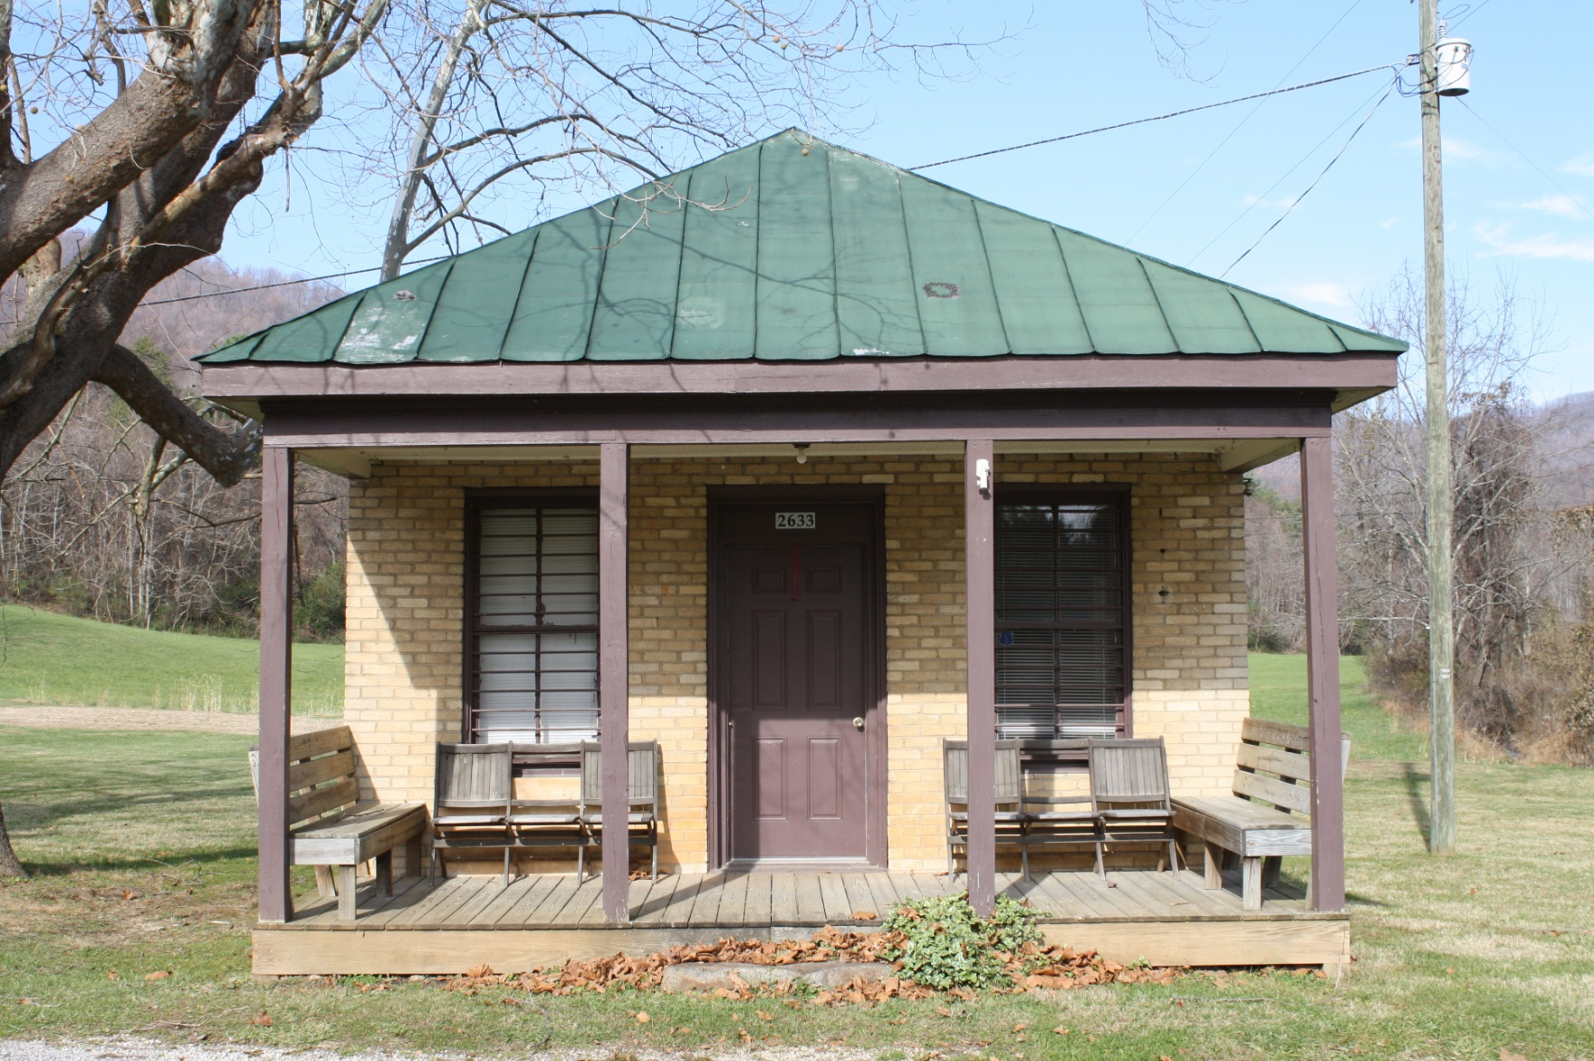
Finds- Commerce/Industry
005-5084: Hicks Store, Wagon Trail Road, Hicks Store

Slide 29
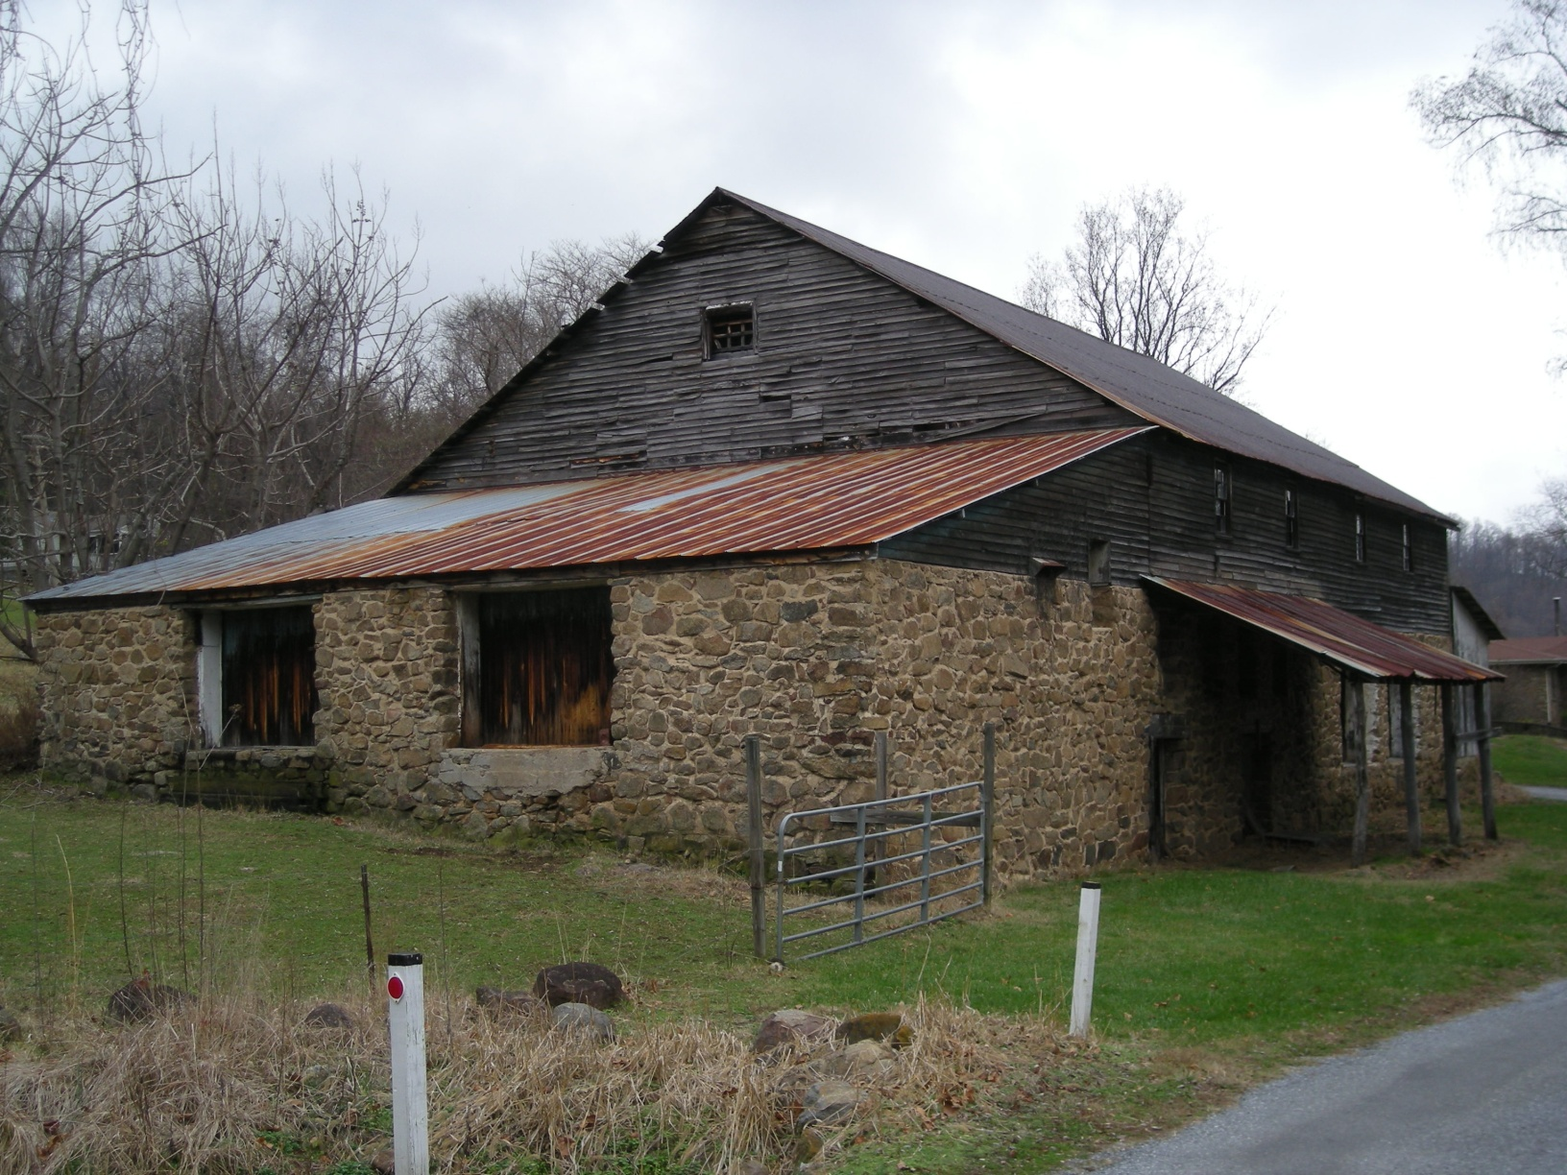
Finds- Commerce/Industry
005-5094: Montrose Orchards Packing Shed, Montrose Road

Slide 30
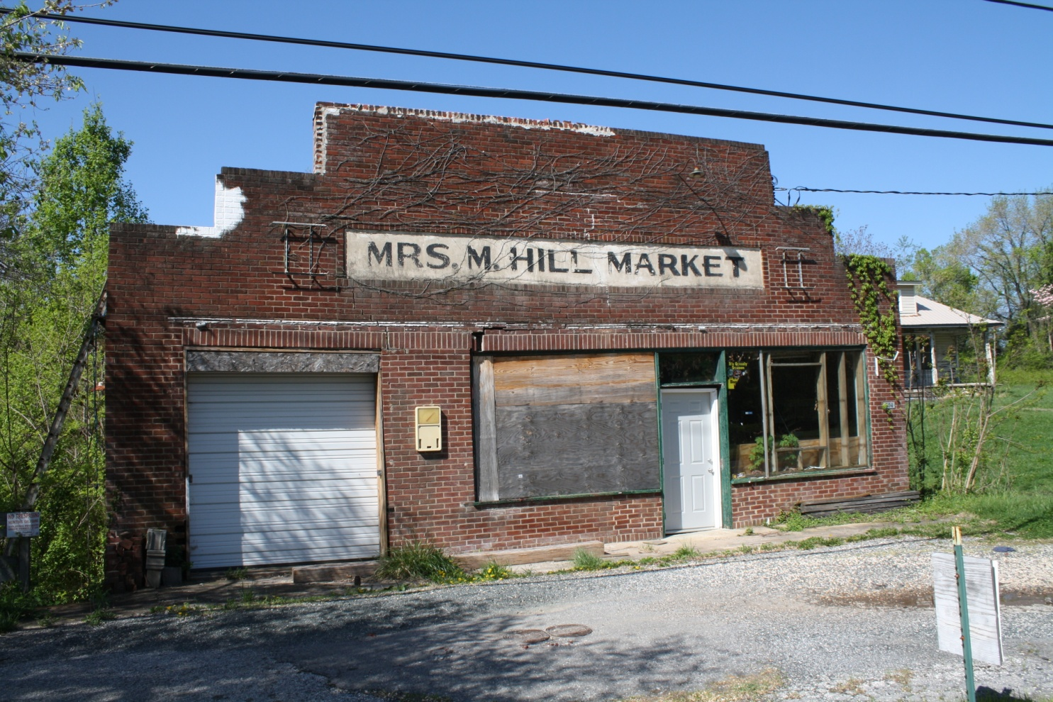
Finds- Commerce/Industry
005-5207, Mrs. M. Hill Market, Colony Road

Slide 31
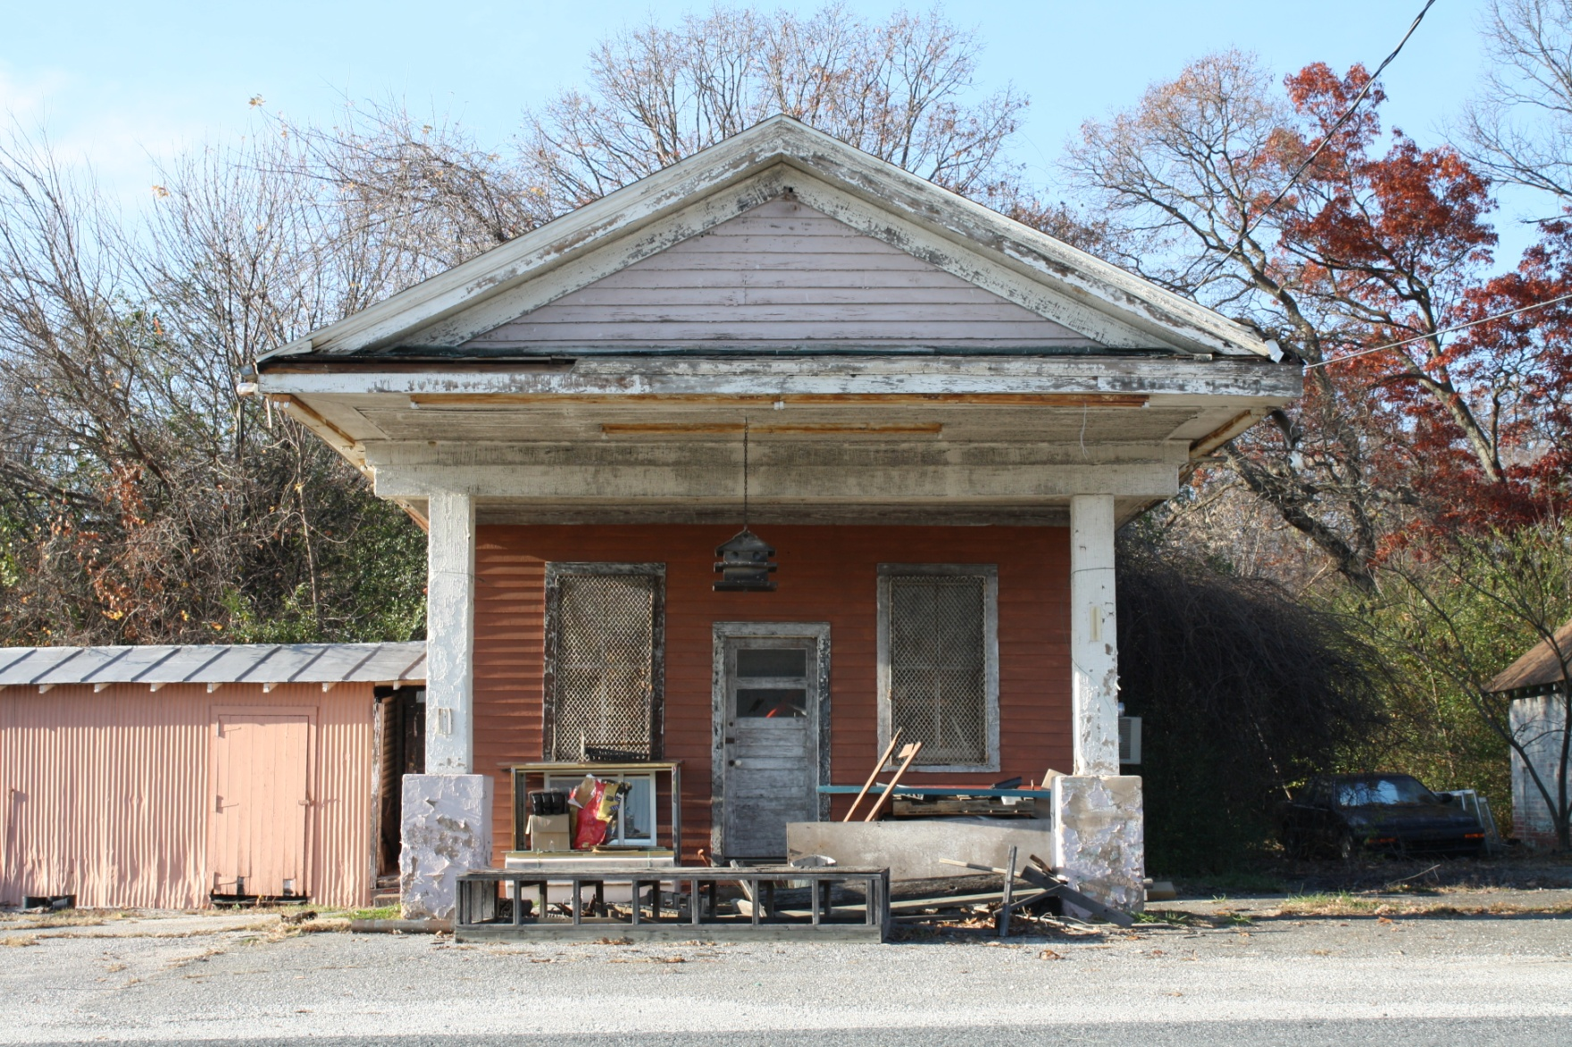
Finds- Commerce/Industry
005-5091: Faulconer’s Store, Faulconerville Drive, Faulconerville

Slide 32
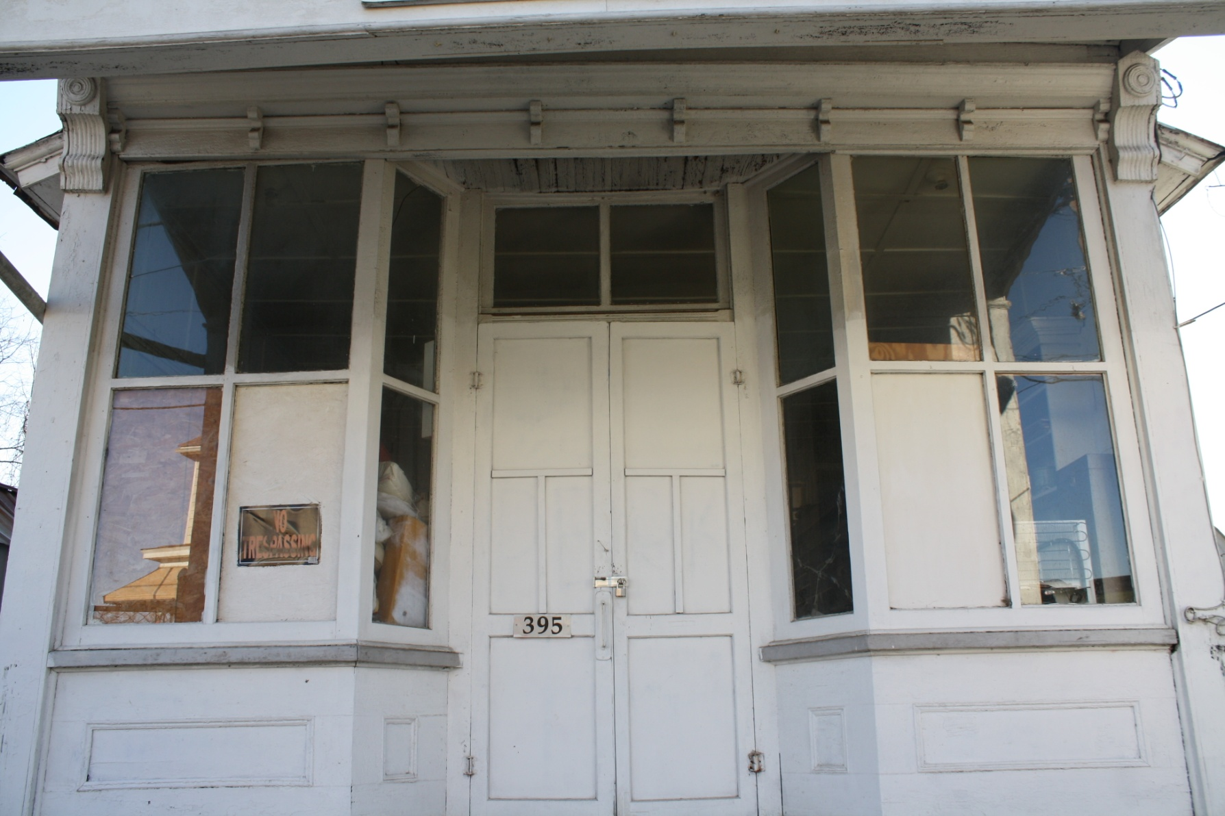
Finds- Commerce/Industry
005-5128: Store, Main Street, Madison Heights

Slide 33
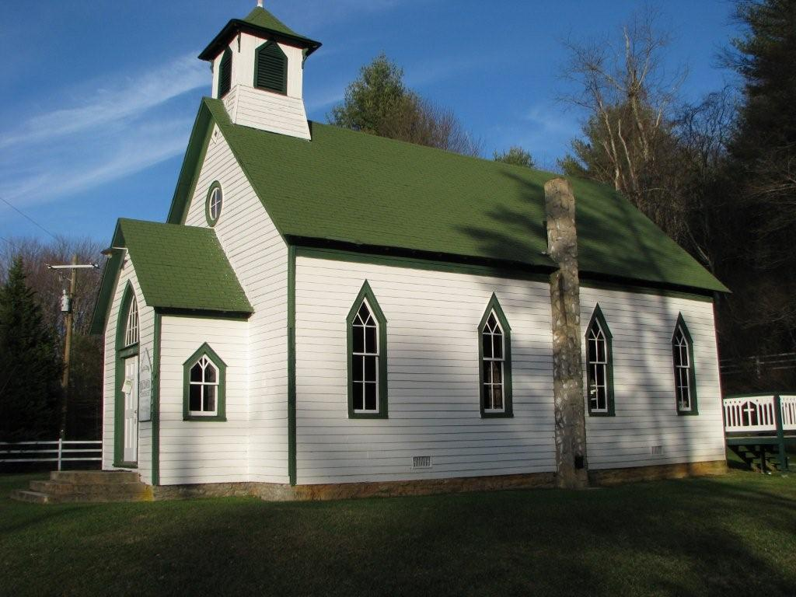
Finds- Churches
005-5159: New Macedonia Church, Coffeytown Road, Coffeytown

Slide 34
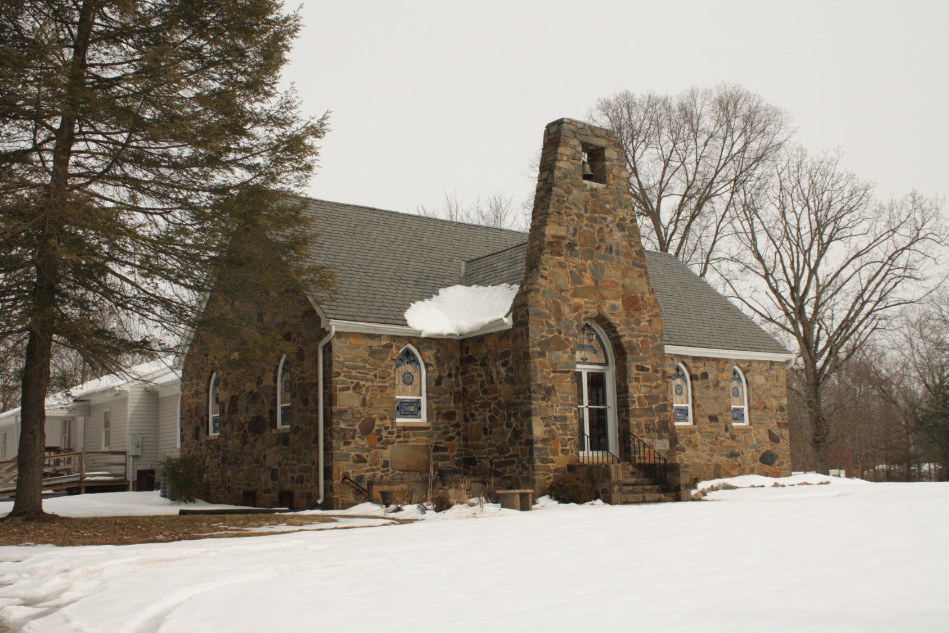
Finds- Churches
005-5140: Poplar United Methodist Church

Slide 35
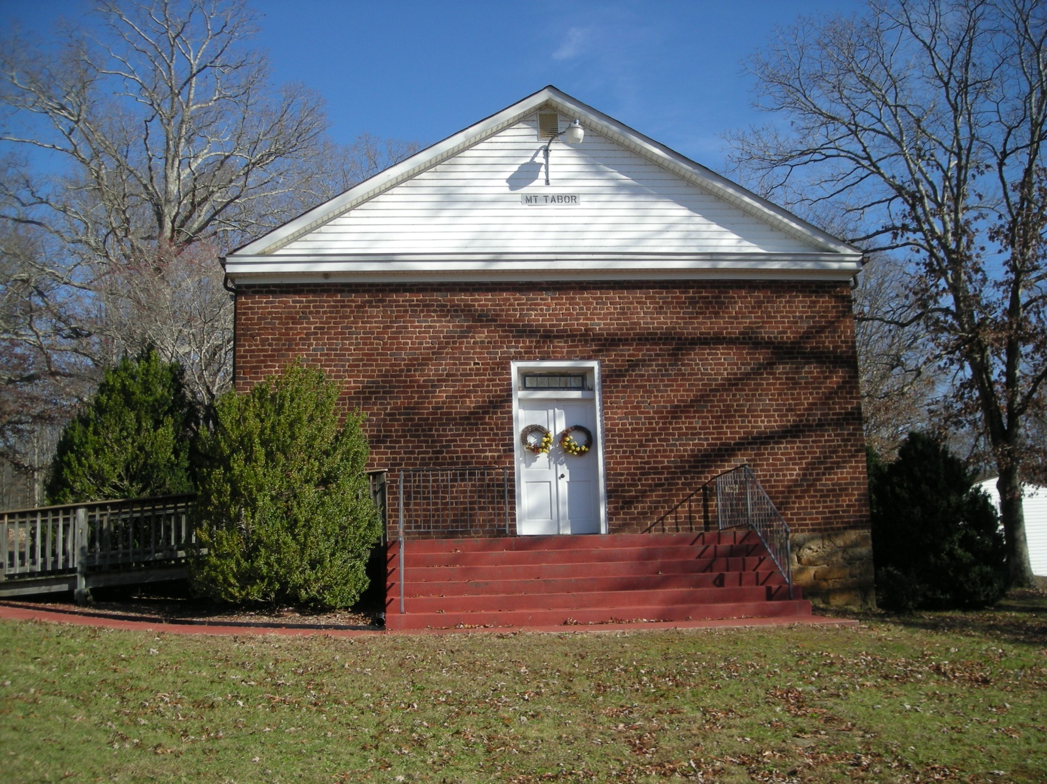
Finds- Churches
005-5080: Mt. Tabor Church, Cloudcroft Drive, Agricola

Slide 36
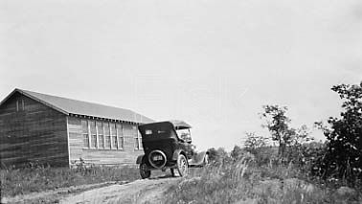
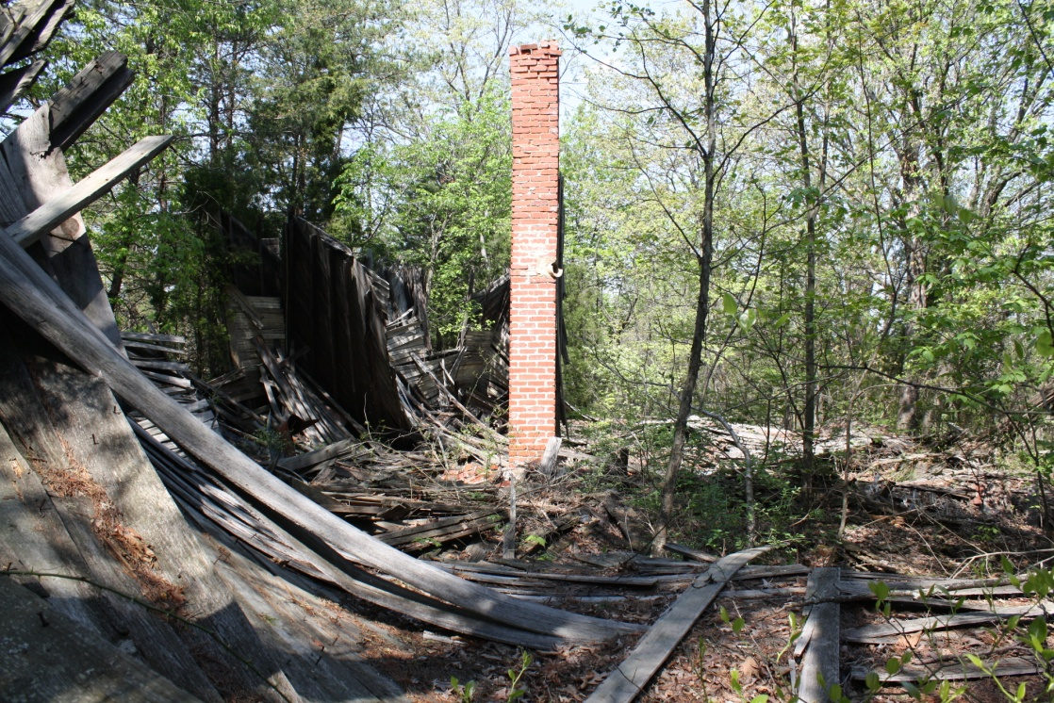
Finds- Schools
005-5155: Lovingston School (Rosenwald), Kings Road

Slide 37
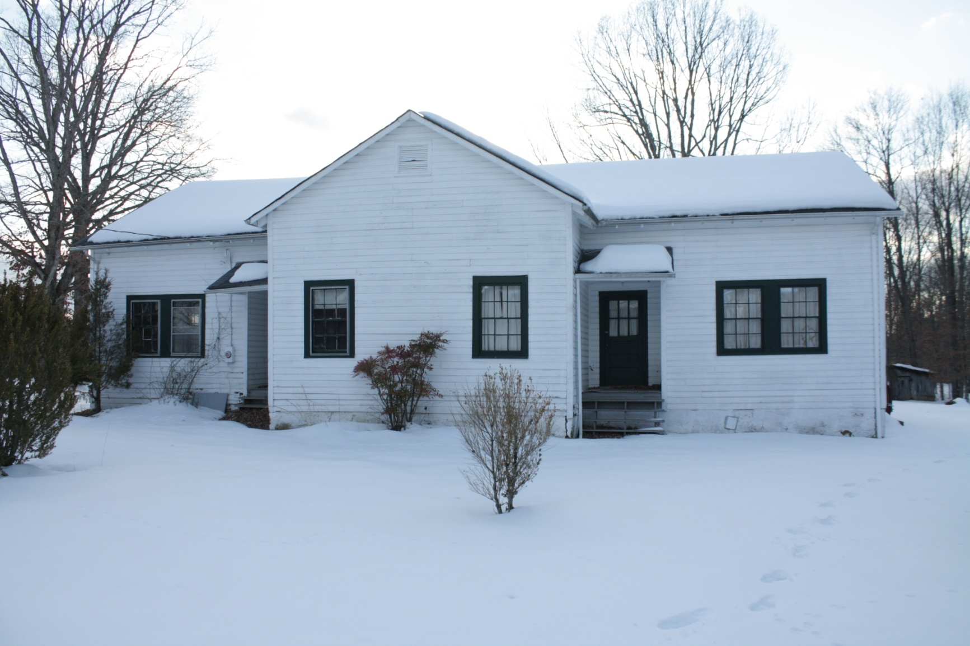
Finds- Schools
005-5130: School, Boxwood Farm Road

Slide 38
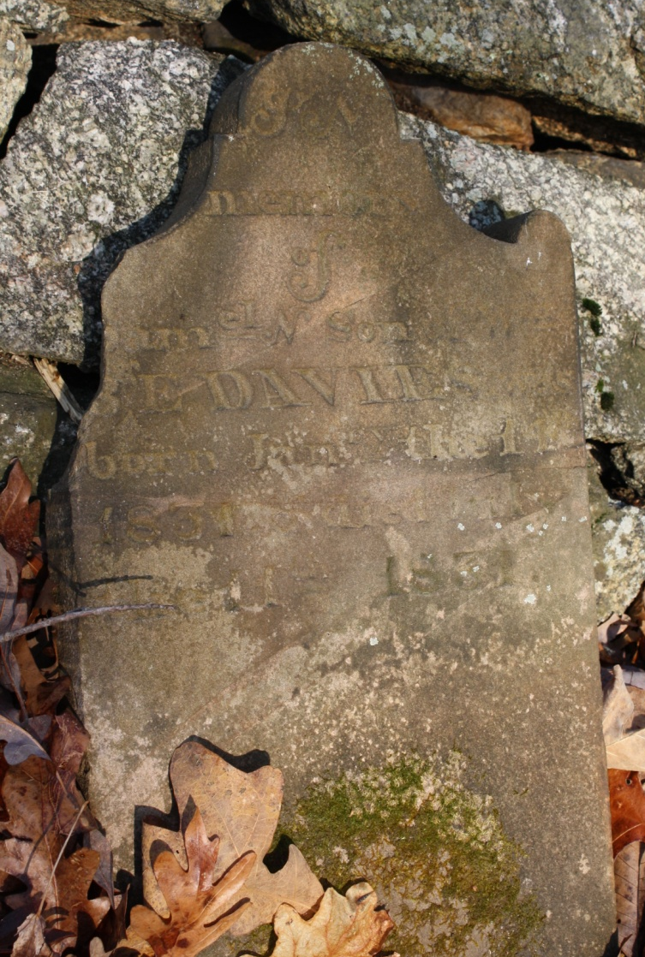
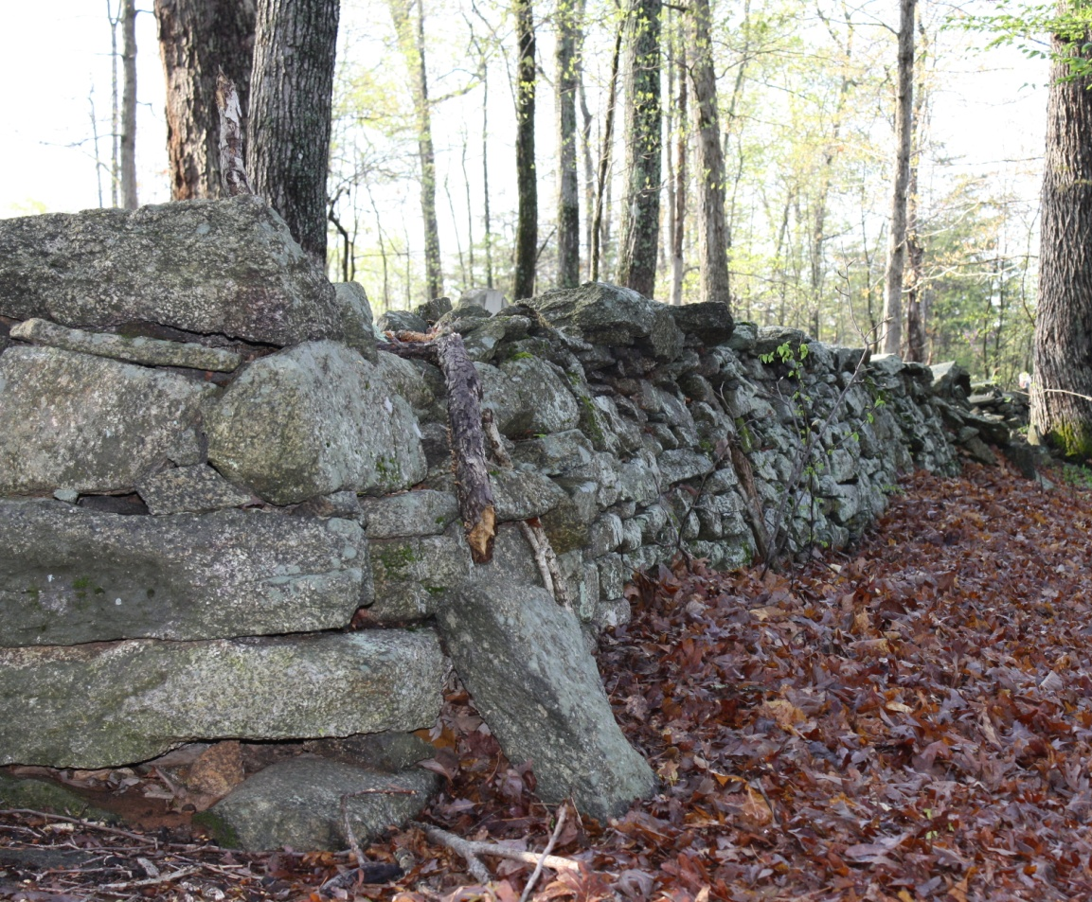
Finds- Cemeteries
005-5276 Vault Hill Cemetery, off of Monacan Park Road

Slide 39
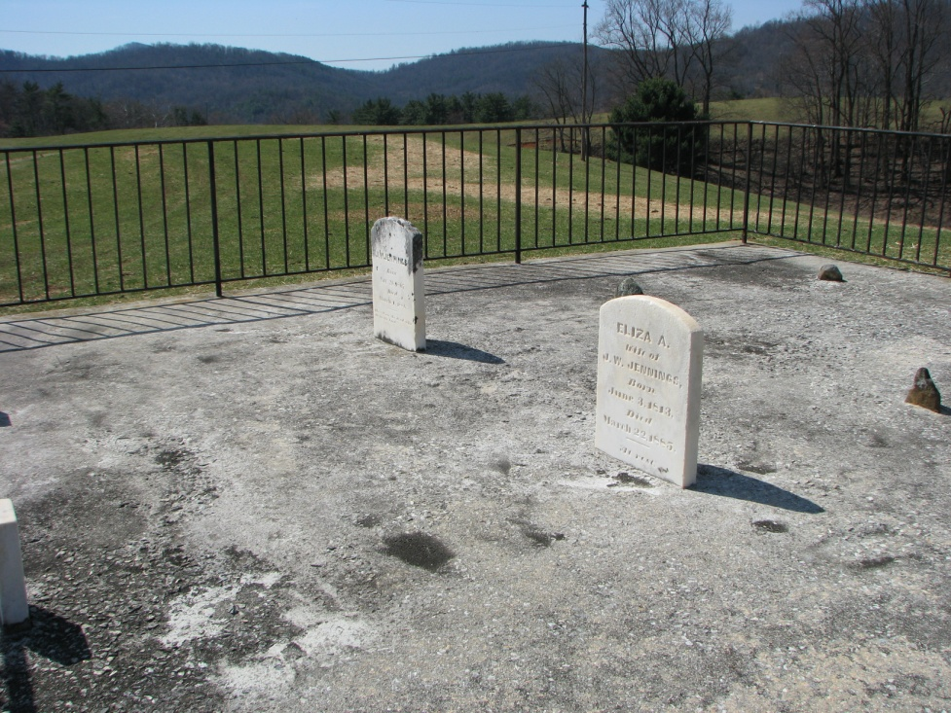
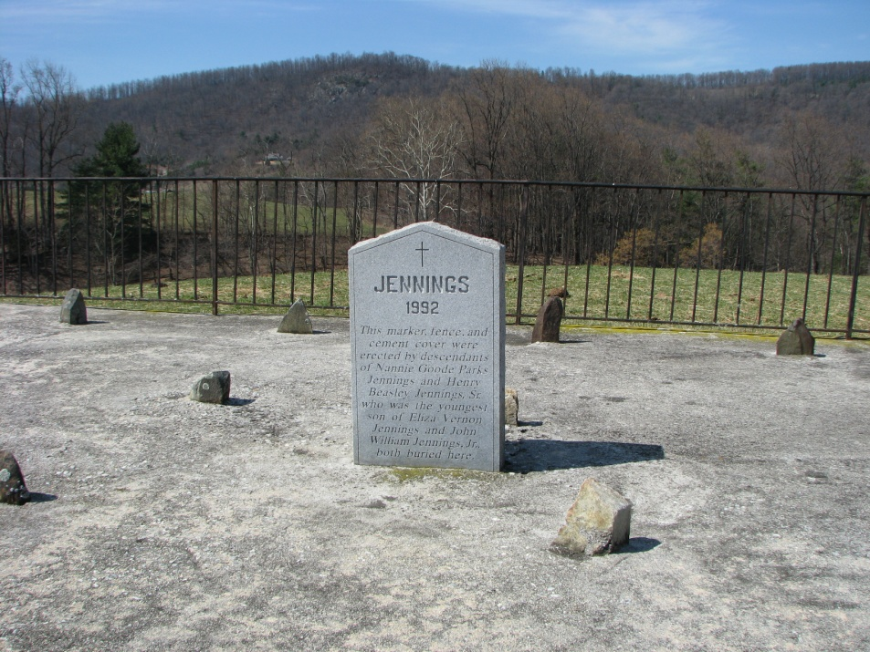
Finds- Cemeteries
005-5253: Jennings Cemetery, Hideaway Farm Road

Slide 40
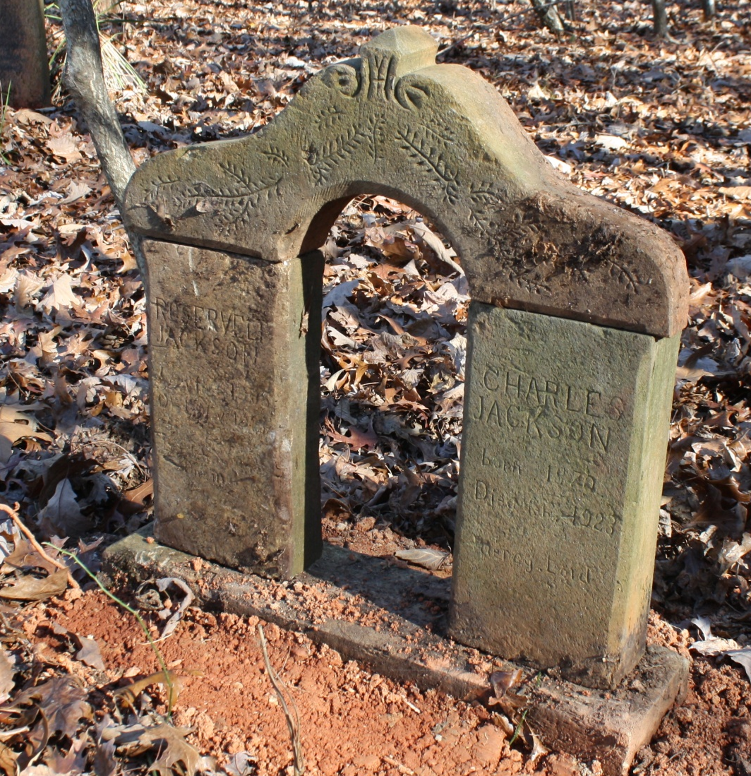
Finds- Cemeteries
005-5129: Cemetery, Early Farm Road

Slide 41
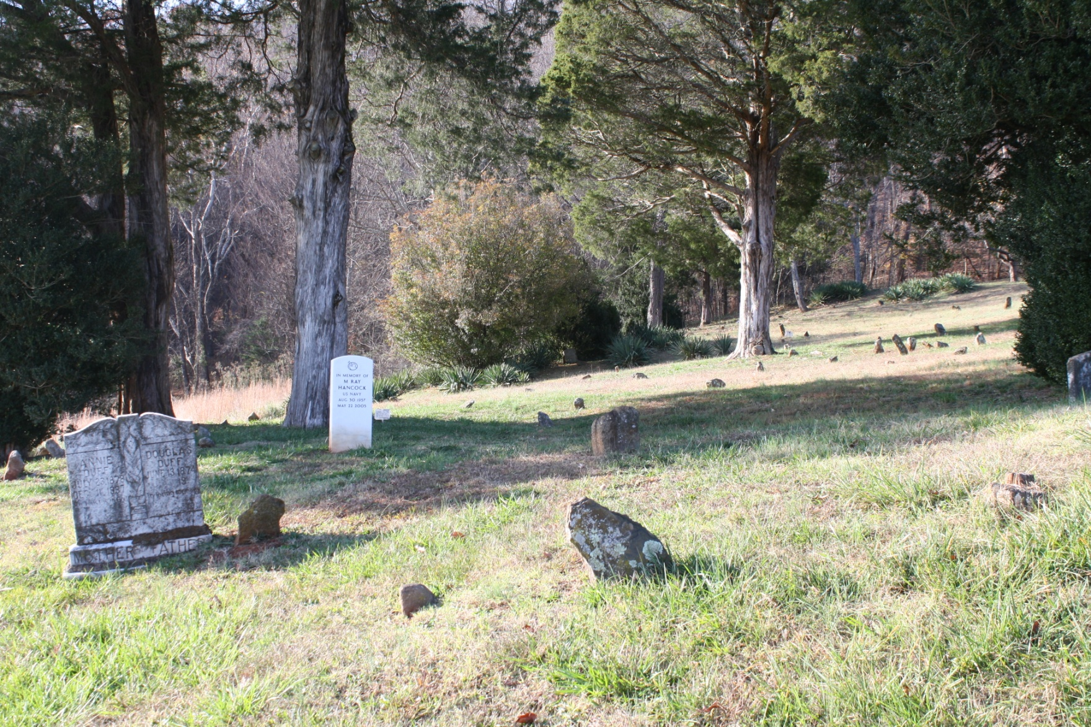
Finds- Cemeteries
005-5089: Monacan Burial Ground, Matohe Road

Slide 42
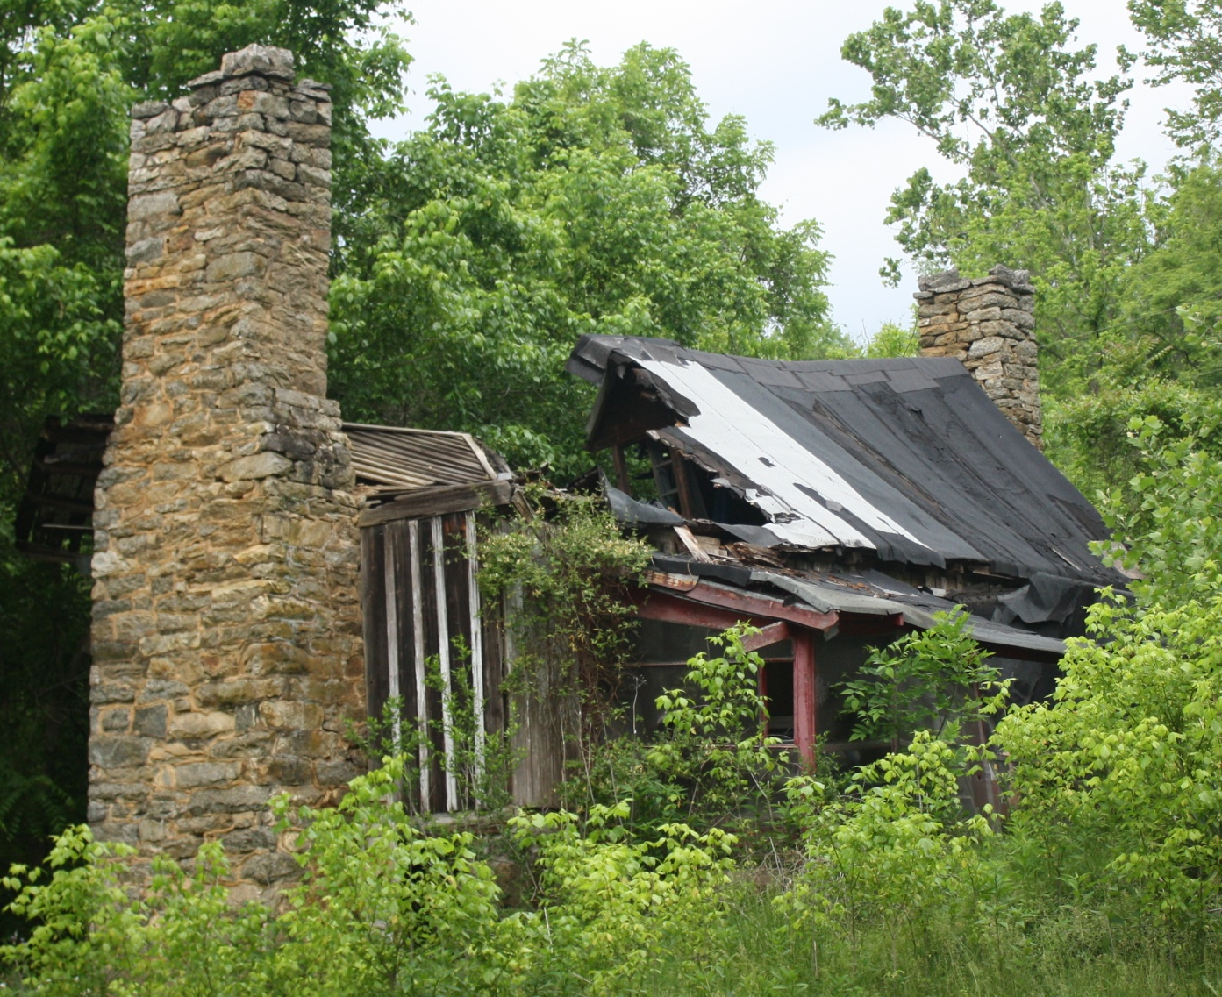
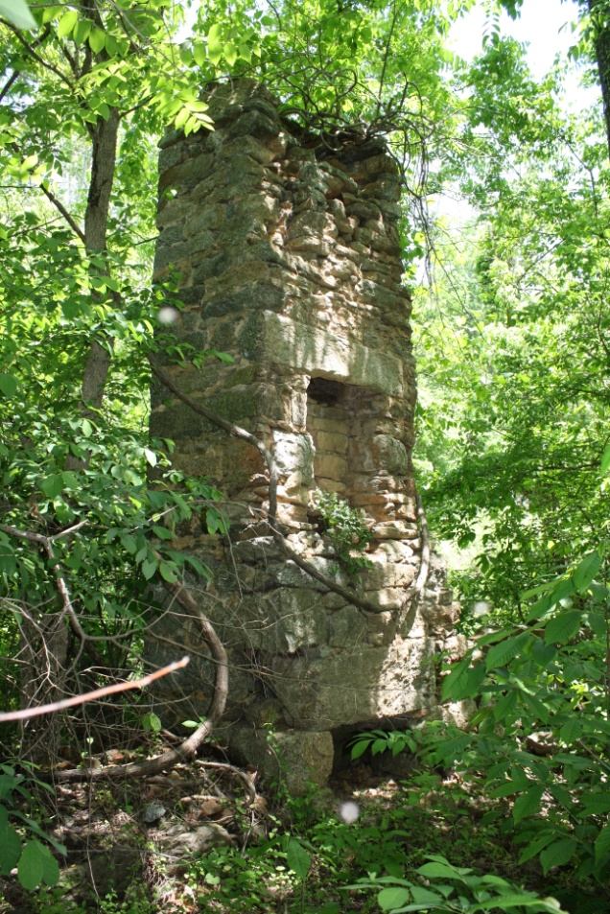
Finds- Communities
005-5336: Bethel

Slide 43
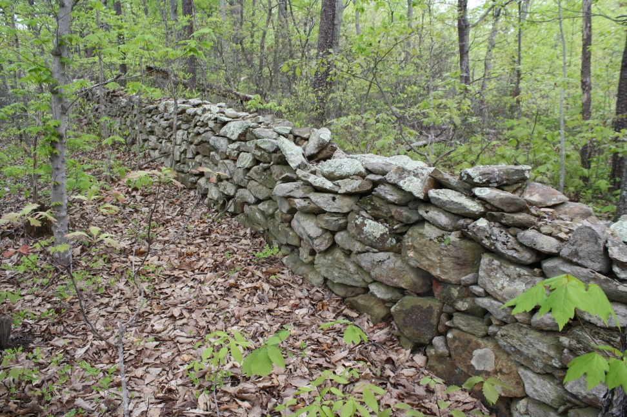
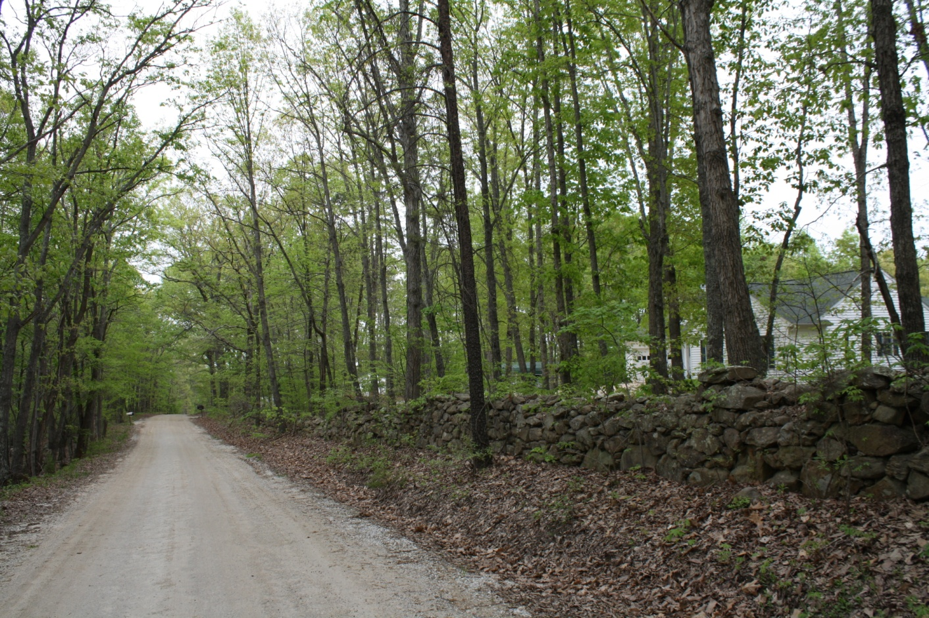
Finds- Other
005-5223: Stone Fence, Braxton Ridge Road

Slide 44
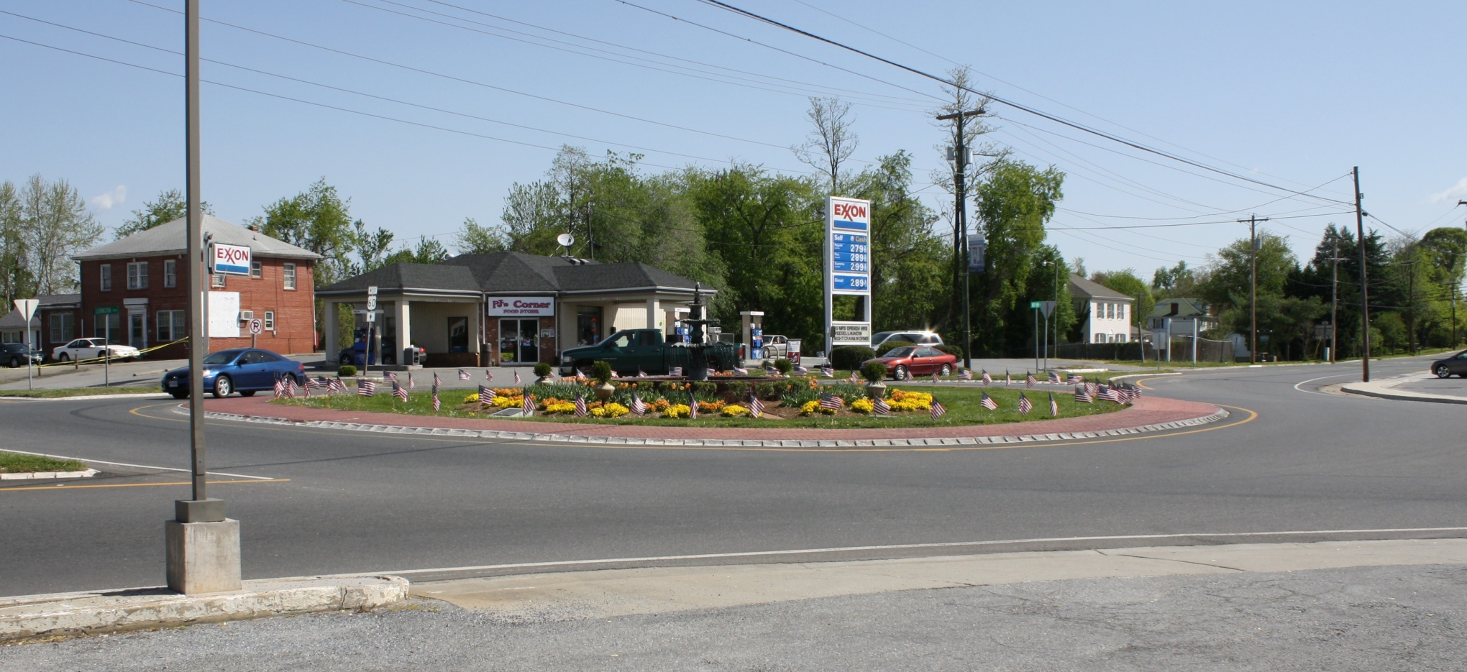
Finds- Other
163-5006: Amherst Traffic Circle

Slide 45
Recommendations
Cultural landscape surveys:
  Charlottesville & Lynchburg Stage Road Route
  Tobacco Row foothills apple industry area
Resurvey significant previously surveyed properties to access condition and conduct intensive survey (ex: Kentmoor, Duckbill)

Slide 46
Recommendations
Rural Historic Districts- encourage citizens to nominate Sandidges and Pedlar Mills to the National Register
Other possible districts include:
  Monroe, Coffeytown, Pleasant View. Old Madison Heights, Five Forks, Elon

Slide 47
Recommendations
Conduct an intensive survey of Amherst Baptist Church if it is to be demolished
Conduct a follow-up survey
  Survey 500 remaining “medium value targets”
  Conduct intensive surveys on 15-30 properties of particular interest identified in the 2009-2010 survey

Slide 48
Contact Information
www.AmherstHistoricSurvey.org

